Slide 1


The Evolving Scope and Content of Central Bank Speeches
Pierre Siklos, Samantha St. Amand, Joanna Wajda
      1 October 2018
      University of Stellenbosch

Slide 2
Agenda
      Motivation
      Literature
      Communication Strategies of the Bank of Canada and US Federal Reserve
      Speech Sample Properties
      Topic Modelling
      Evolving Content & Scope of Central Bankers’ Speeches
      Future Work
2

Slide 3
Evolution of Central Bank Communication
Motivation
      Three major shifts in central bank communication over the past few decades:
      From secrecy to transparency
      From surprising markets to explaining actions and use of communication as a policy tool
      Emphasis on public trust and engagement
3

Slide 4
Role of Central Bankers’ Speeches
Motivation
      Engage stakeholders on central bank activities and research
      Clarify view of the monetary policy committee before or after policy deliberation
      Elaborate on policy shifts or revisions
      Express diversity of perspectives of individual central bankers
      Versatile communication tool, but role and impact of speeches remains an understudied aspect of communications strategies.
4

Slide 5
Key Questions
Motivation
      Examine speeches delivered by members of the Bank of Canada Governing Council and US Federal Reserve Board of Governors from 1997 to 2017.
      How has the delivery of speeches by central banks changed over time?
      How has the content of central bankers’ speeches evolved?
      What factors correlate with speech topics (i.e. speaker, economic events, venue)?
5

Slide 6
Key Questions
Motivation
      Examine speeches delivered by members of the Bank of Canada Governing Council and US Federal Reserve Board of Governors from 1997 to 2017.
      How has the delivery of speeches by central banks changed over time?
      How has the content of central bankers’ speeches evolved?
      What factors correlate with speech topics (i.e. speaker, economic events, venue)?
      How can central bankers’ speeches be used to engage with different stakeholders (e.g. financial markets, media, general public)? (preliminary work)
6

Slide 7
Evaluating Central Bankers’ Speeches
Literature
      Early literature found little-to-no-impact of speeches on financial market volatility (e.g. Kohn and Sack 2004; Reeves and Sawicki 2007).
      Studies that differentiate based on content of speeches more likely to conclude that speeches can have a significant impact on financial market volatility (e.g. Ehrmann and Fratzscher 2007a, 2007b).
      Impact of speeches on financial markets appears to have intensified over the last 10 years, and speeches have been used as policy devices (e.g. Fratzscher et al. 2016; Krishnamurthy and Vissing-Jorgensen 2011).
      Evidence that the speaker, content and timing of speeches matter (e.g. Gertler and Horvath 2017; Rosa 2016; Ehrmann and Fratzscher 2009; Ehrmann and Sondermann 2012).
7

Slide 8
Text Mining & Central Bank Communication
Literature
      Manual coding dovish/neutral/hawkish (e.g. Jansen and De Haan 2005; Rosa and Verga 2007; Berger, De Haan and Sturm 2011)
      Bag of Words/Dictionary (e.g. Apel and Blix Grimaldi 2012; Meade et al. 2015; Siklos 2013; Lombardi et al. 2017; Schmeling and Wagner 2017)
      Word Associations/n-grams (e.g. Amaya and Filbien 2015; Picault and Renault 2017)
      Latent Semantic Analysis (e.g. Acosta 2015; Hendry and Madeley 2010; Hendry 2012)
      Latent Dirichlet Allocation (e.g. Hansen et al. 2018; Jegadeesh and Wu 2017; Oshima and Matsubayashi 2018)
8

Slide 9
Sample Selection/Communications Strategy
Communications Strategies
 | Bank of Canada | US Federal Reserve
Organization of Communications | Centralized | Decentralized
Dissemination of Information | Consensus-oriented | Individualistic
Monetary Policy Decision Making | Consensus | Majority vote (Collegial)
Monetary Policy Operational Guide | Inflation Targeting | Full Employment and Inflation Target
Other Responsibilities | Financial market infrastructures oversight Lender of last resort Assessing financial stability Participates in national & international bodies on matters related to financial system stability Currency design, issuance and distribution Funds Management | Financial market infrastructures oversight Lender of last resort Assessing financial stability Participates in national & international bodies on matters related to financial system stability Currency design, issuance and distribution Funds Management Macroprudential supervision and regulation Microprudential supervision and regulation Consumer protection
9

Slide 10
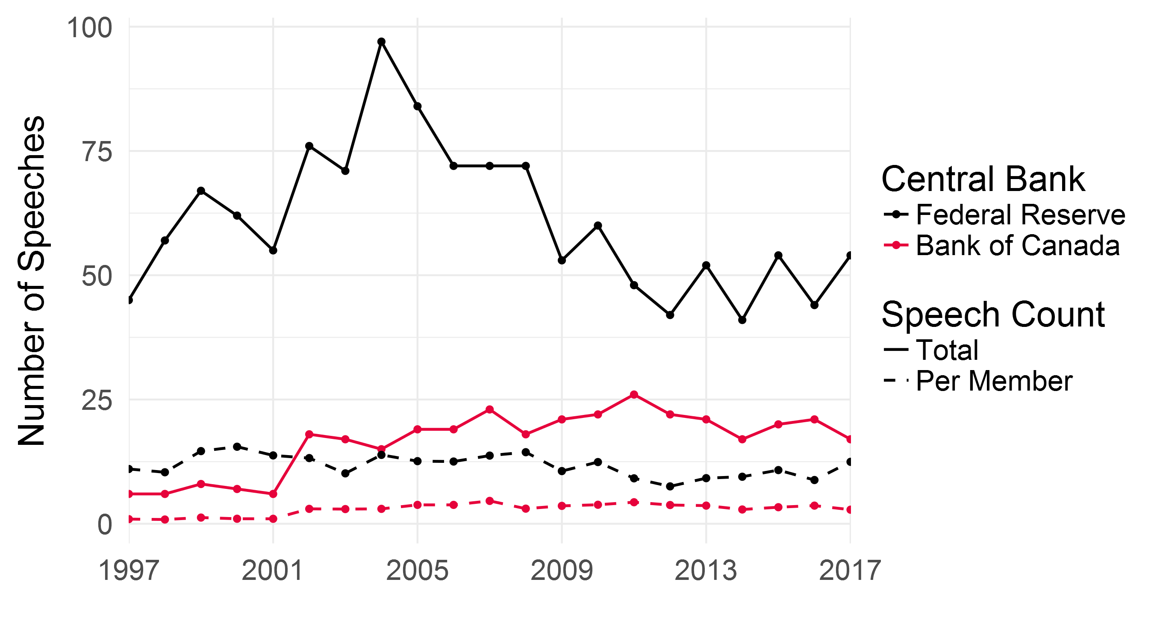
Number of Speeches Delivered per Year
Sample Properties
Data source: Central banks’ online speech archives.
10
Notes:
Bank of Canada: Speeches per member goes from 1 during Gordon Thiessen’s tenure, to 3 to 4 for the rest of the sample. Average 2.9 over full sample. Fairly consistent starting in 2001.
US Federal Reserve: Speeches per member peaks at 15.5 in 2000, a trough of 7.5 in 2012 (general drop in 2011 to 2016) and back to 12.5 at the end of the sample. Average 11.7 over full sample. General drop in 2011 to 2016. Uptick in 2017 could have to do with leadership transition – 15 delivered by Powell, 13 by Yellen, 14 by Brainard.

Slide 11
Share of Speeches Delivered by Leader
Sample Properties
Bank of Canada
 | Gordon Thiessen | David Dodge | Mark Carney | Stephen Poloz | Full Sample
Applicable Tenure | 1997 – 2001 | 2001 – 2008 | 2008 – 2013 | 2013 – 2017 | 1997 – 2017
Governor’s share of speeches in total | 96% | 80% | 47% | 34% | 59%
US Federal Reserve
 | Alan Greenspan | Ben Bernanke | Janet Yellen | Full Sample
Applicable Tenure | 1997 – 2006 | 2006 – 2014 | 2014 – 2017 | 1997 – 2017
Chair’s share of speeches in total | 29% | 36% | 23% | 30%
11

Slide 12
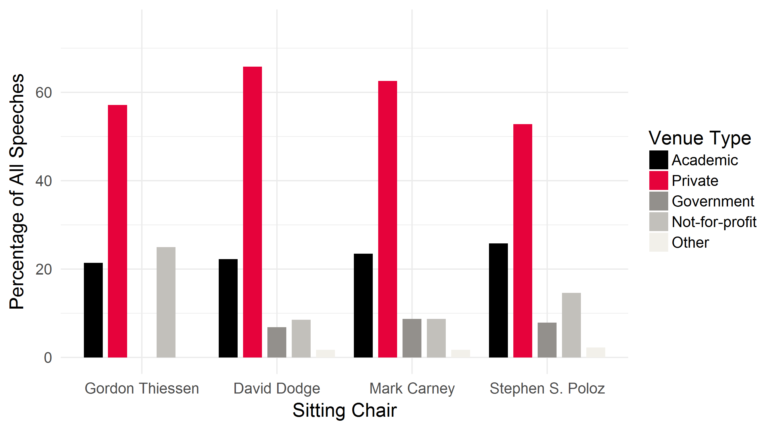
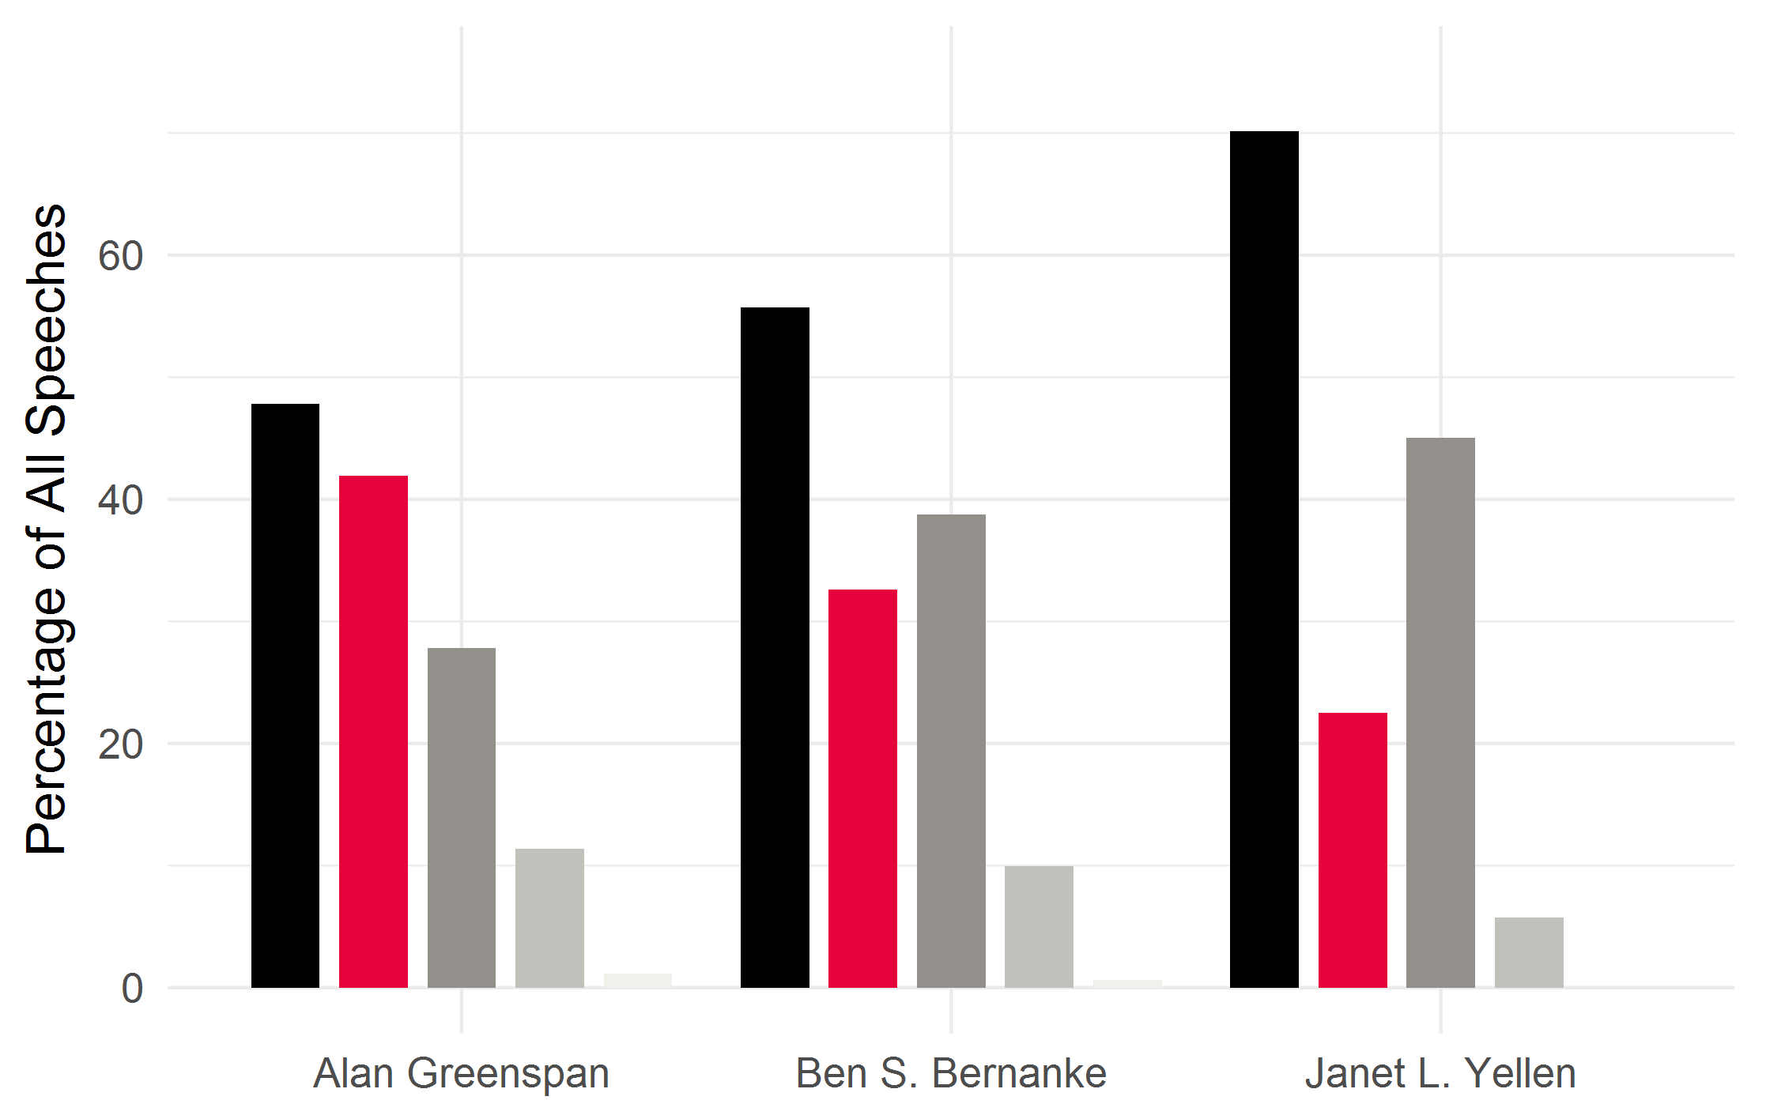
Share of Speeches by Venue
Sample Properties
Bank of Canada
US Federal Reserve
Data source: Authors’ elaboration on central banks’ online speech archives.
12

Slide 13
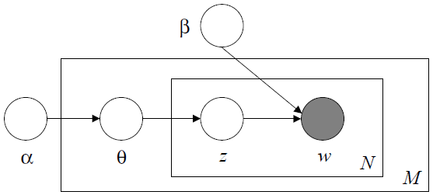
Topic Modelling: Latent Dirichlet Allocation
Topic Modelling
      Latent Dirichlet Allocation (LDA) is an unsupervised machine learning algorithm that estimates a probabilistic distribution of words over topics and topics over documents
      Latent variables include the distribution of topics over documents (θ), topic assignment of words (z) and distribution of words over topics (β)
      Fixed parameters include:
        the Dirichlet prior from which the distribution of topics over documents are sampled (α)
        the Dirichlet prior from which the distribution of words over topics are sampled (δ)
        the number of topics (k)
δ
Source: Blei et al. 2003
13

Slide 14
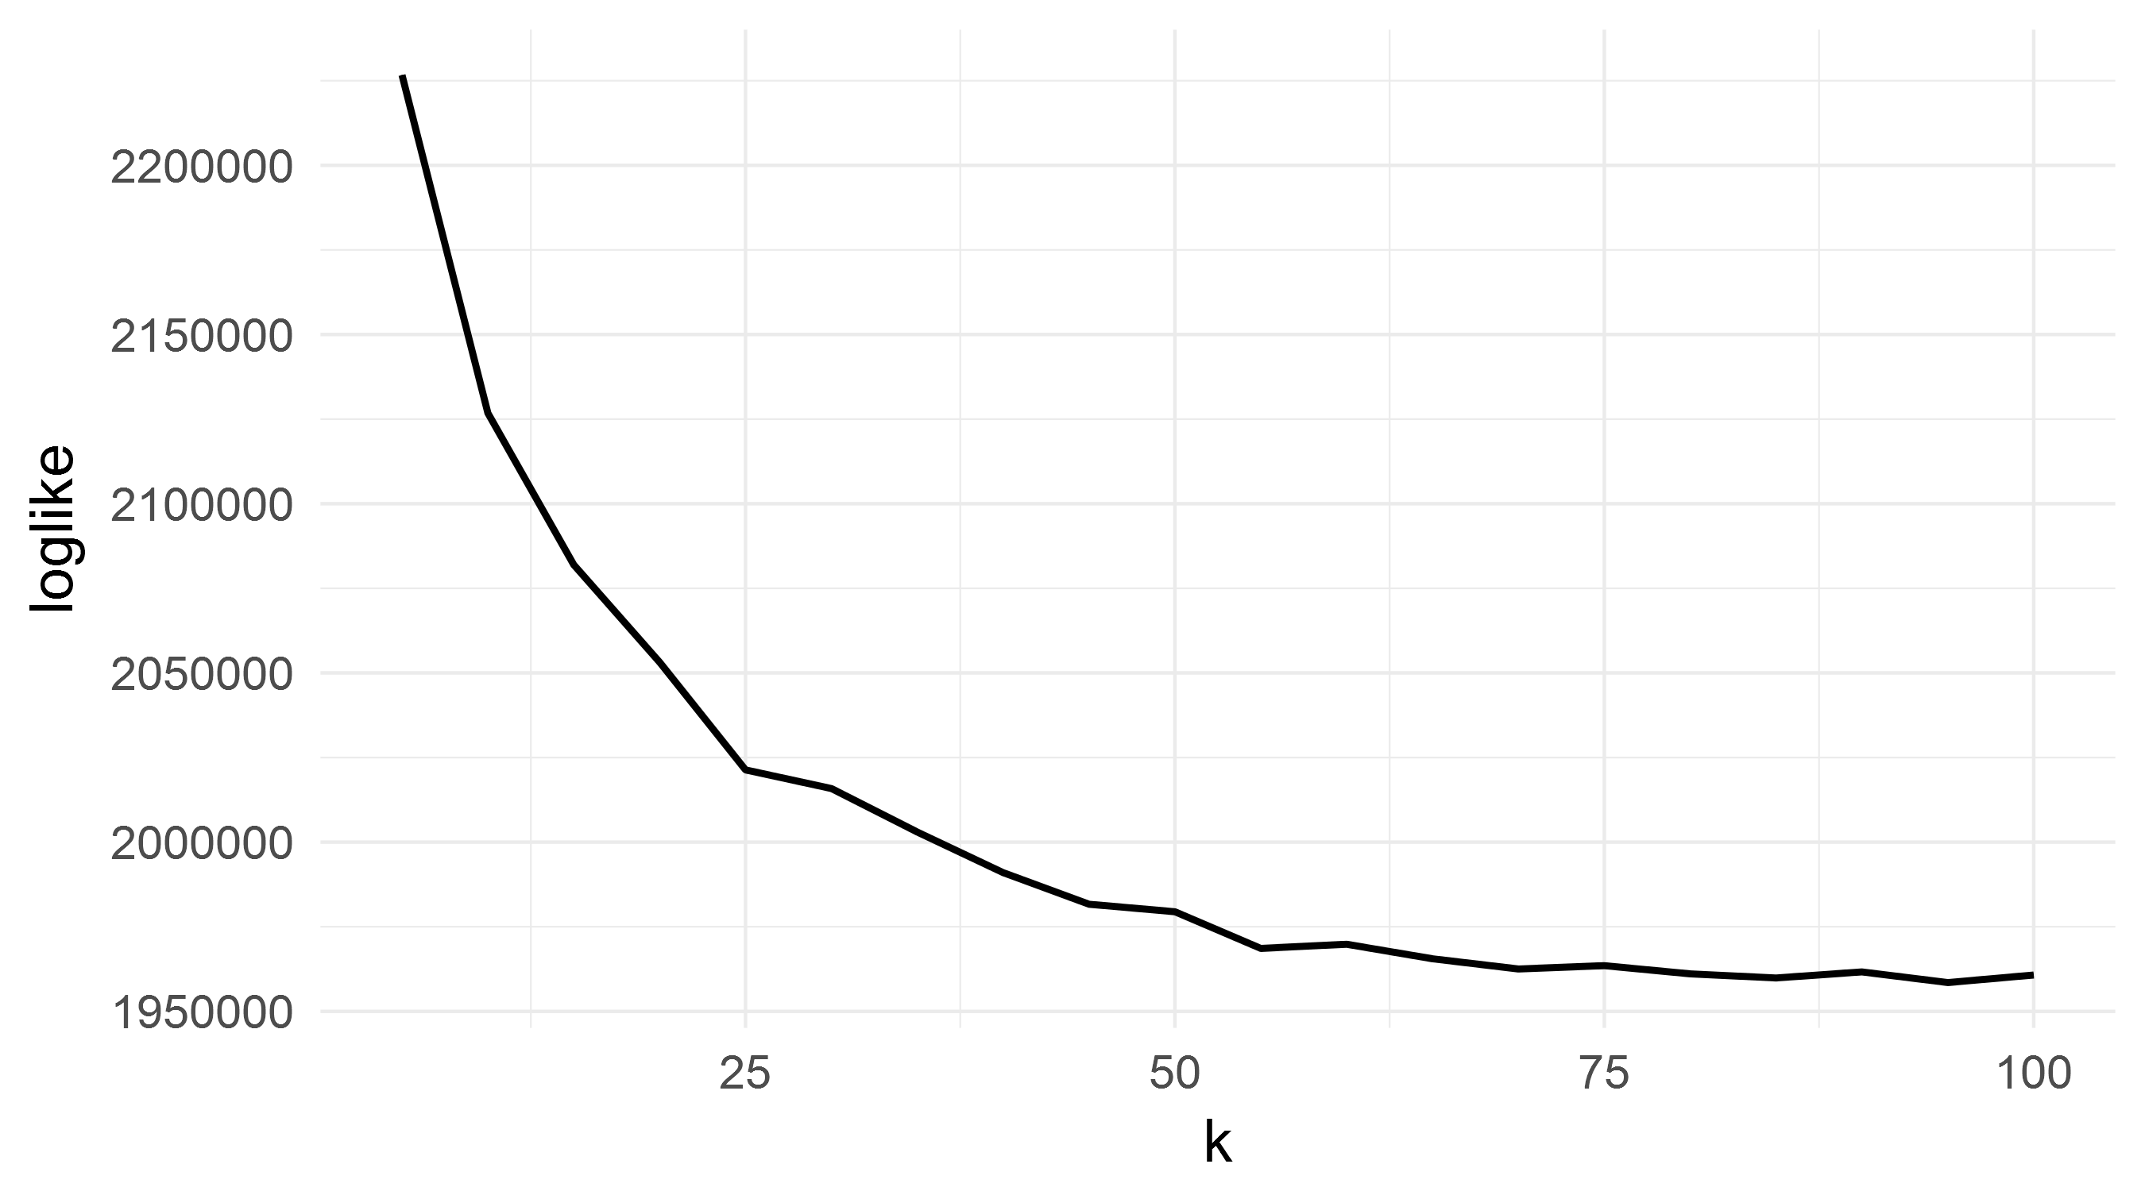
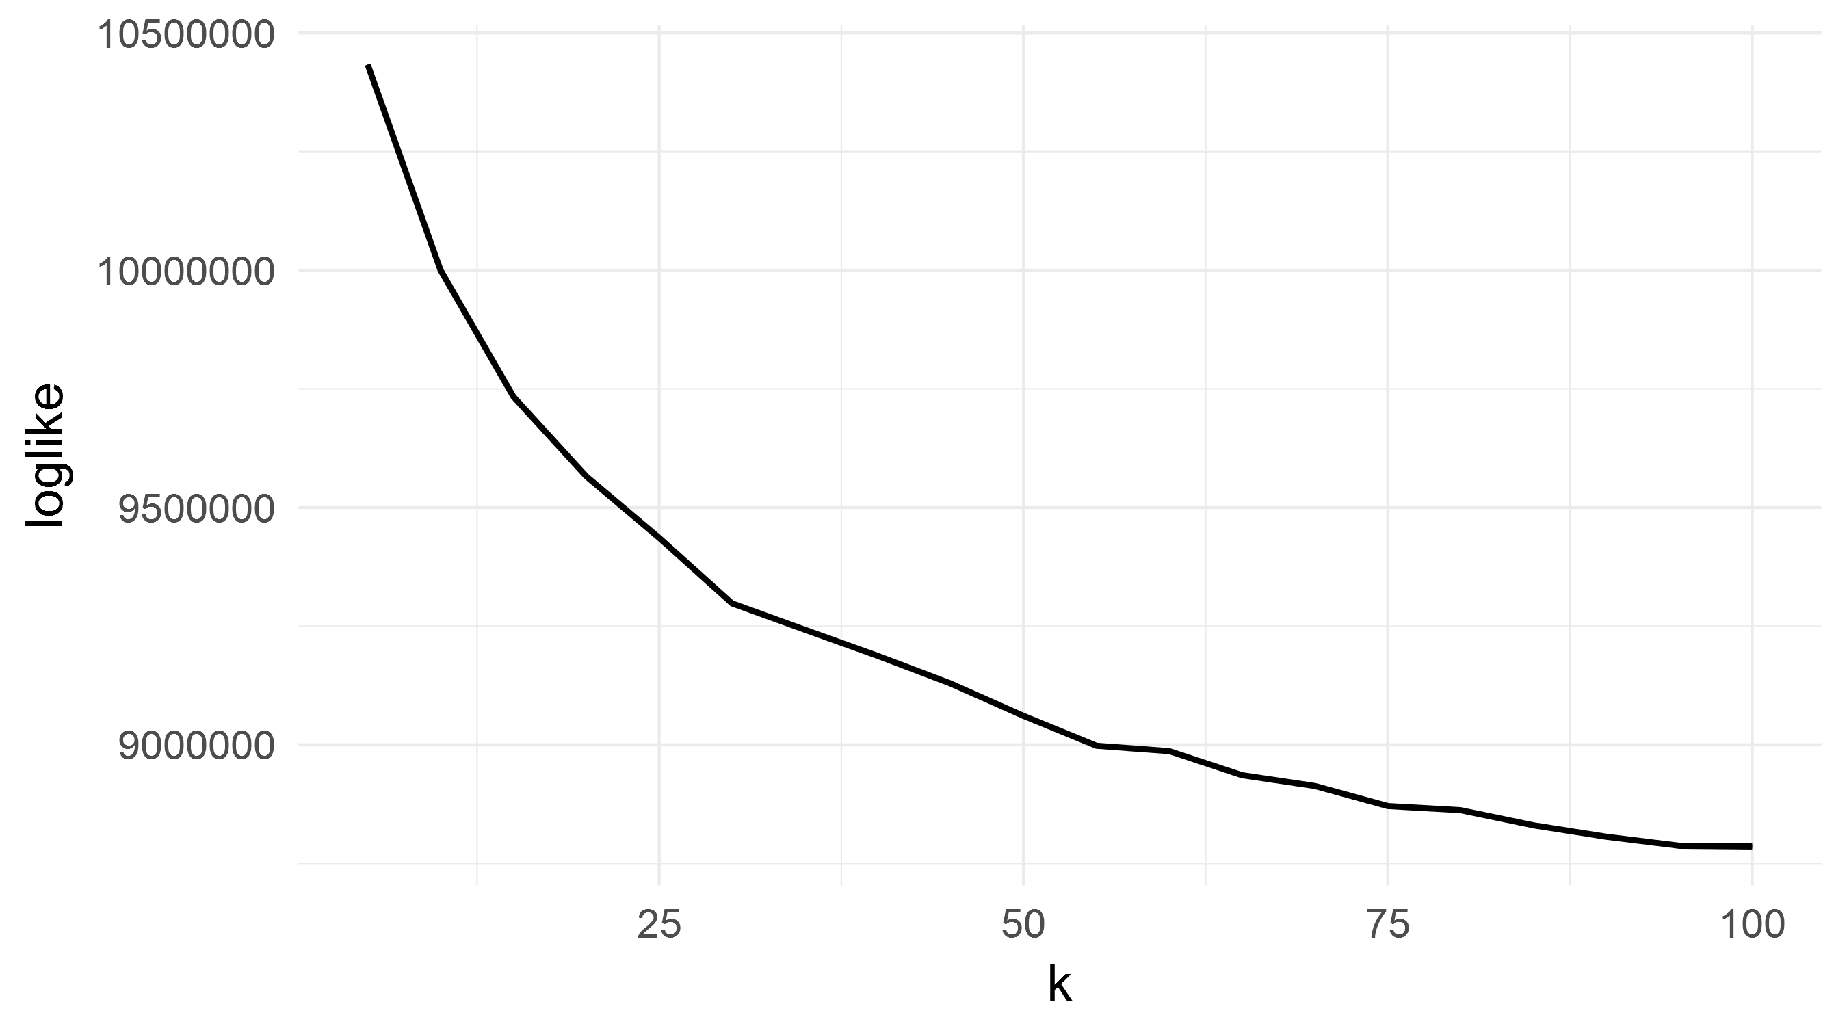
Choice of K (# of Topics)
Bank of Canada
US Federal Reserve
k = 45
k = 65
Plot of the log likelihood functions over range of values of k (5 to 100 at intervals of 5)
Using Gibbs sampling method, log-likelihood function is $log p(w|z)$
14

Slide 15
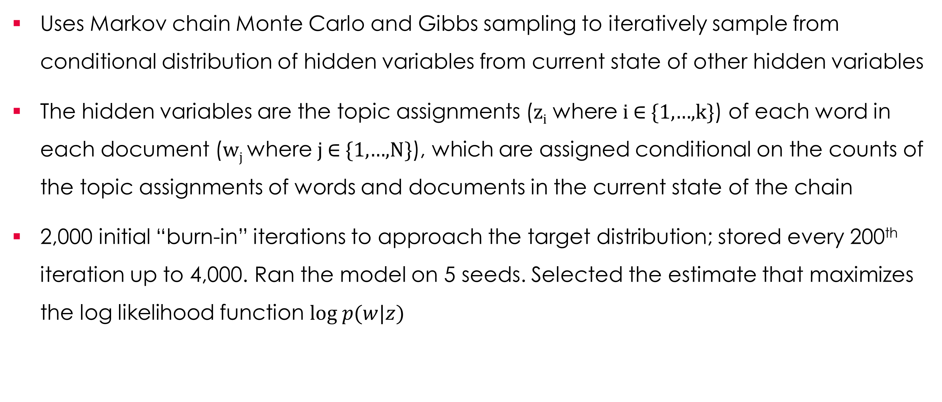
Collapsed Gibbs Sampling
      Uses Markov chain Monte Carlo and Gibbs sampling to iteratively sample from conditional distribution of hidden variables from current state of other hidden variables
      The hidden variables are the topic assignments (z_{i} where i ∈ {1,…,k}) of each word in each document (w_{j} where j ∈ {1,…,N}), which are assigned conditional on the counts of the topic assignments of words and documents in the current state of the chain
      2,000 initial “burn-in” iterations to approach the target distribution; stored every 200th iteration up to 4,000. Ran the model on 5 seeds. Selected the estimate that maximizes the log likelihood function $log p(w|z)$
15

Slide 16
Text Pre-Processing
Topic Modelling
      Converted commonly used acronyms (e.g. MPR, FOMC, CPI, MBS)
      Joined grouped terms (e.g. stress test, real estate)
      Removed punctuation, numbers and stop-words (e.g. it, the, a, and)
      Removed terms that occur in less than 2.5 percent of speeches or more than 90 percent (e.g. Canada, United States, market)
Corpus Properties
 | Bank of Canada | US Federal Reserve
Number of Documents | 349 | 1,278
Raw Text Unique Words | 33,370 | 77,962
Processed Text Unique Words | 2,480 | 2,748
      Stemmed words (i.e. removing suffixes like –ing, -y, –ies)
      Converted text to lower case
      Removed ambiguous words, including indefinite pronouns, proper names, indicators of measurement, time and location, pleasantries, comparators and connectors
16
Notes:
Words that occur in more than 90 percent of speeches:
US Fee - "can" "develop" "effect" "financi" "import" "increas" "mani" "market" "need" "unitedst" "well" "will"
BoC - "boc" "can" "canada" "canadian" "continu" "econom" "economi" "effect" "financi" "growth" "import" "increas" "market" "monetari" "need" "polici" "term" "unitedst" "well" "will"

Slide 17
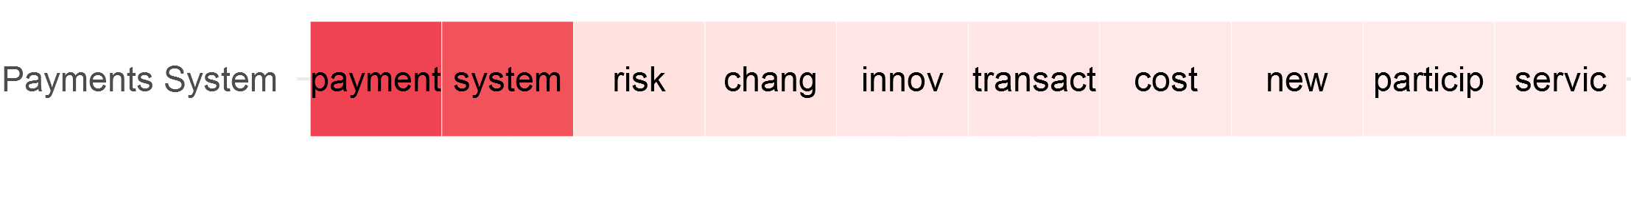
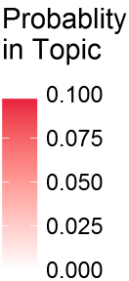
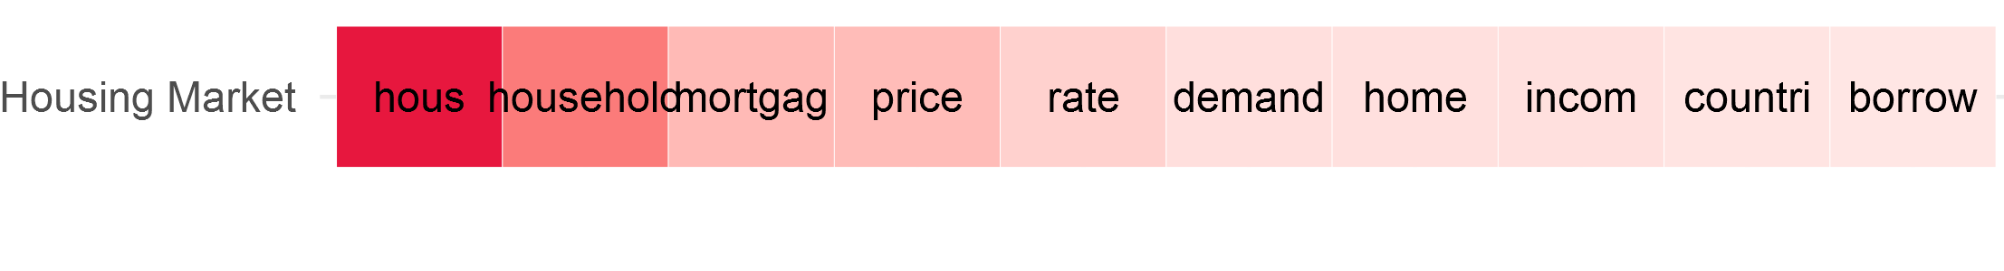
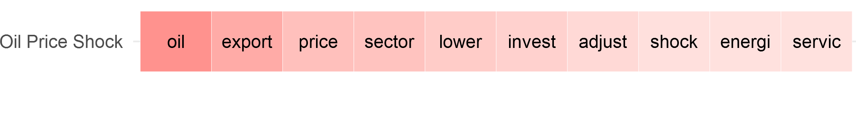
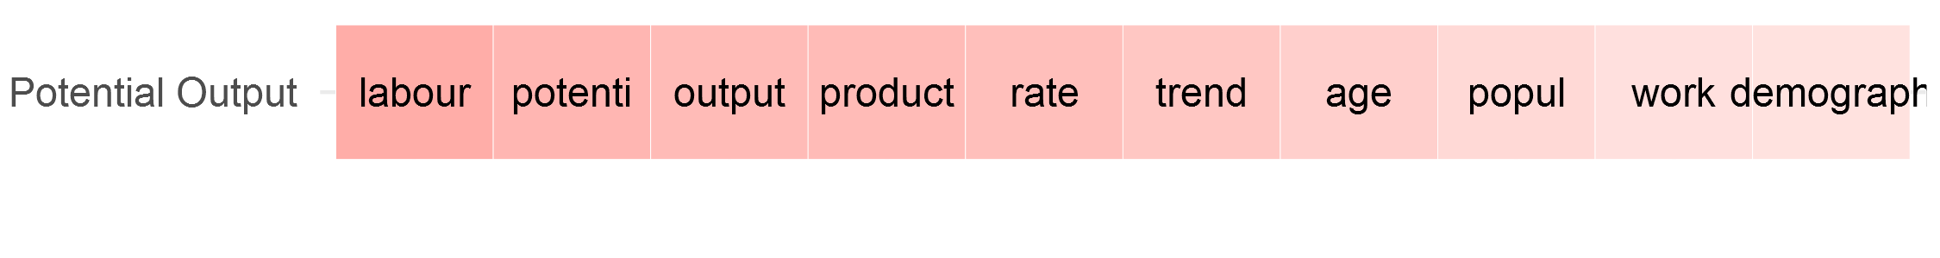
Identifying Topics: Bank of Canada
Topic Modelling
Assigned Topic Label
Top 10 Terms in Topic
Top Speeches in Topic
A Dual Vision for the Canadian Payments System, 62%, 2014
Upgrading the Payments Grid: The Payoffs Are Greater Than You Think, 56%, 2017
The Long-Term Evolution of House Prices: An International Perspective, 54%, 2015
Housing in Canada, 43%, 2011
Real Estate, Mortgage Markets, and Monetary Policy, 41%, 2008
Adjusting to the Fall in Commodity Prices: One Step at a Time, 40%, 2016
Canadian Economic Update: Strength in Diversity, 34%, 2017
The Canadian Economy: A Progress Report, 33%, 2016
Demographics, Labour Input, and Economic Potential: Implications for Monetary Policy, 49%, 2007
Aging Gracefully: Canada’s Inevitable Demographic Shift, 49%, 2012
The Promise of Potential, 40%, 2013
17

Slide 18
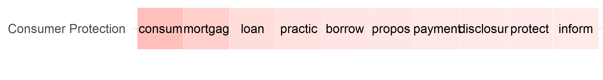
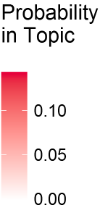
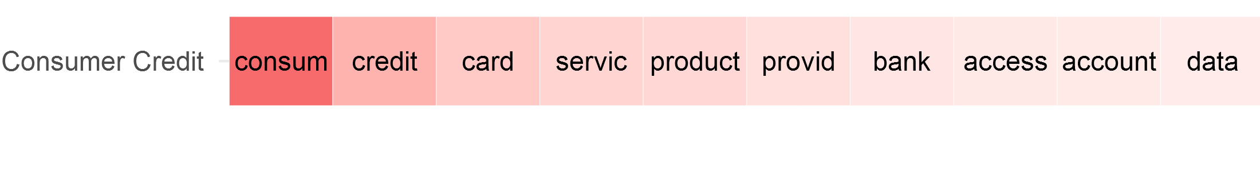
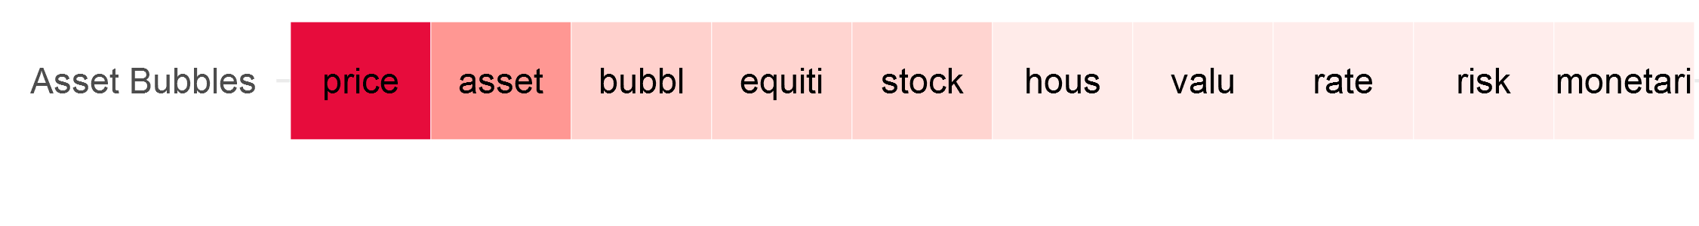
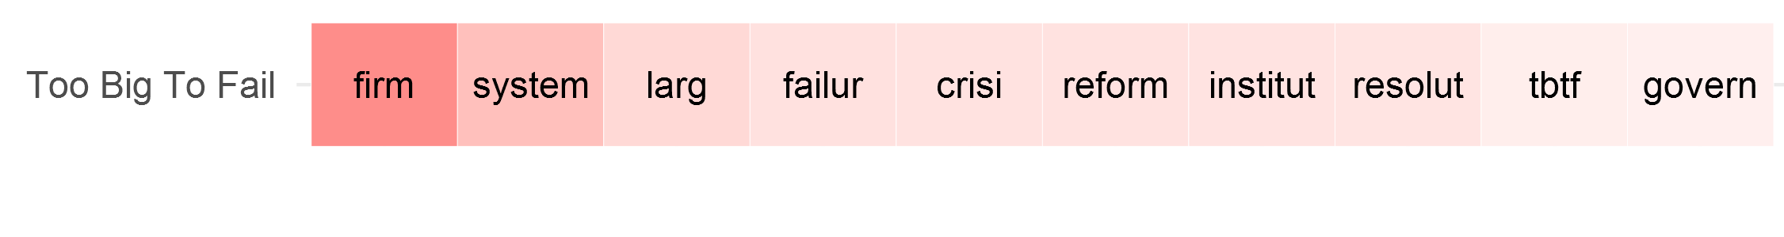
Identifying Topics: US Federal Reserve
Topic Modelling
Assigned Topic Label
Top 10 Terms in Topic
Top Speeches in Topic
Protecting Homeowners and Sustaining Home Ownership, 73%, 2008
Encouraging Responsible Mortgage Lending: Prospective Rulemaking Initiatives, 71%, 2007
Creating More Effective Consumer Disclosures, 68%, 2007
Where Do Consumers Fit in the Fintech Stack?, 56%, 2017
Developments in the Landscape for Consumer Credit and Payments, 38%, 2010
Financial Access for Immigrants: The Case of Remittances, 29%, 2004
Recessions and Recoveries Associated with Asset-Price Movements: What Do We Know?, 42%, 2005
How Should We Respond to Asset Price Bubbles?, 38%, 2008
Comments on the Resolution Framework for Bank Holding Companies in the United States, 65%, 2016
Toward Building a More Effective Resolution Regime: Progress and Challenges, 57%, 2013
Ending “Too Big to Fail”, 54%, 2013
18

Slide 19
Top 10 Topics in Corpus
Scope and Content
Bank of Canada (k = 45)
US Federal Reserve (k = 65)
 | Topic Label | Probability of Topic in Corpus
1 | Economic Outlook | 6.4%
2 | Inflation Targeting Framework | 5.6%
3 | Adjusting to Globalization | 3.8%
4 | Productivity & Innovation | 3.6%
5 | Global Economic Recovery | 3.6%
6 | Inflation Outlook | 3.5%
7 | Role of the Bank of Canada | 3.5%
8 | Financial System Regulation & Reform | 2.9%
9 | Principles for Good Economic Policy | 2.9%
10 | Understanding Low Economic Growth | 2.8%
 | Topic Label | Probability of Topic in Corpus
1 | GDP Growth | 2.9%
2 | Financial Regulatory & Supervisory Framework | 2.9%
3 | Challenges for Monetary Policy | 2.8%
4 | Challenges of Macroeconomic Policy | 2.7%
5 | Community Economic Development | 2.5%
6 | Economic Flexibility & Adaptation | 2.5%
7 | Technology & Innovation | 2.4%
8 | Liquidity Facilities | 2.2%
9 | Monetary Policy Outlook | 2.1%
10 | Balance Sheet Policies | 2.1%
19

Slide 20
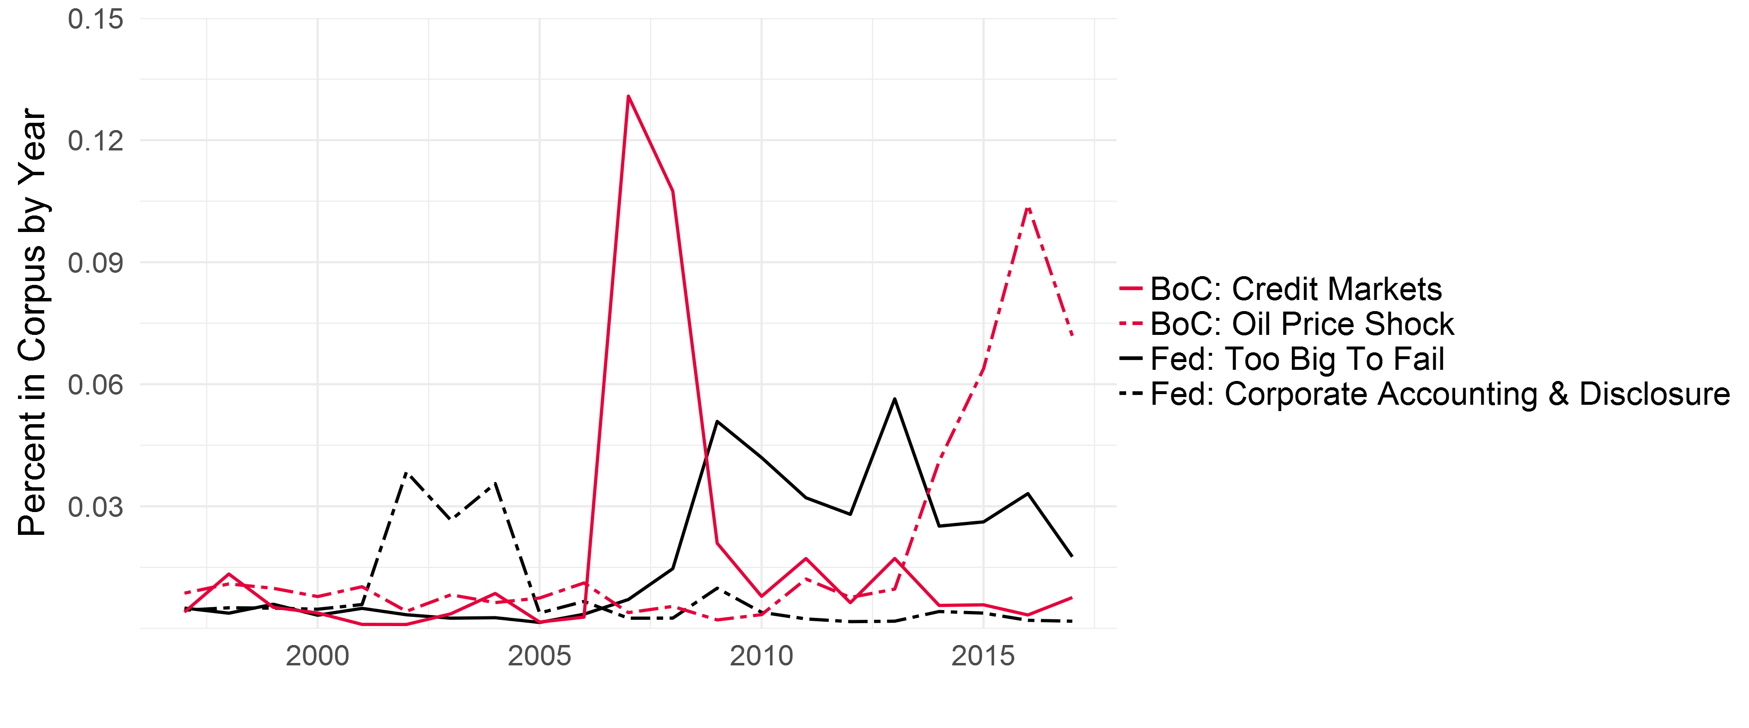
Content Relates to Key Economic Events
Scope and Content
20

Slide 21
Content Relates to Key Speakers
Scope and Content
Bank of Canada
US Federal Reserve
Speaker | Topic | Share
David Dodge | Top Share for 23/45 Topics
Gordon Thiessen | Inflation Outlook | 61%
Mark Carney | Global Economic Recovery | 61%
Mark Carney | Financial System Regulation & Reform | 55%
Stephen Poloz | Understanding Low Economic Growth | 53%
Mark Carney | Re-Evaluating the Monetary Policy Framework | 50%
Stephen Poloz | Global Trade Integration | 35%
John Murray | Global Economic Governance | 31%
David Longworth | Liquidity Facilities | 28%
Tiff Macklem | Export Competitiveness | 25%
Speaker | Topic | Share
Susan Bies | Corporate Governance | 67%
Alan Greenspan | Rule of Law & Market Capitalism | 59%
Alan Greenspan | Energy Markets | 54%
Daniel Tarullo | Prudential Regulation | 53%
Susan Bies | Corporate Accounting & Disclosure | 50%
Ben Bernanke | Monetary System | 49%
Susan Bies | Corporate Risk Management | 46%
Alan Greenspan | Technology & Innovation | 47%
Roger Ferguson Jr. | Preparing for Financial Service Disruptions | 42%
Edward Gramlich | Subprime Mortgage Lending | 42%
Edward Gramlich | Social Security | 40%
21
Notes:
The Governors presented the largest share of 39/45 (87%) topics. At the Fed, this is 36/65 (55%).

Slide 22
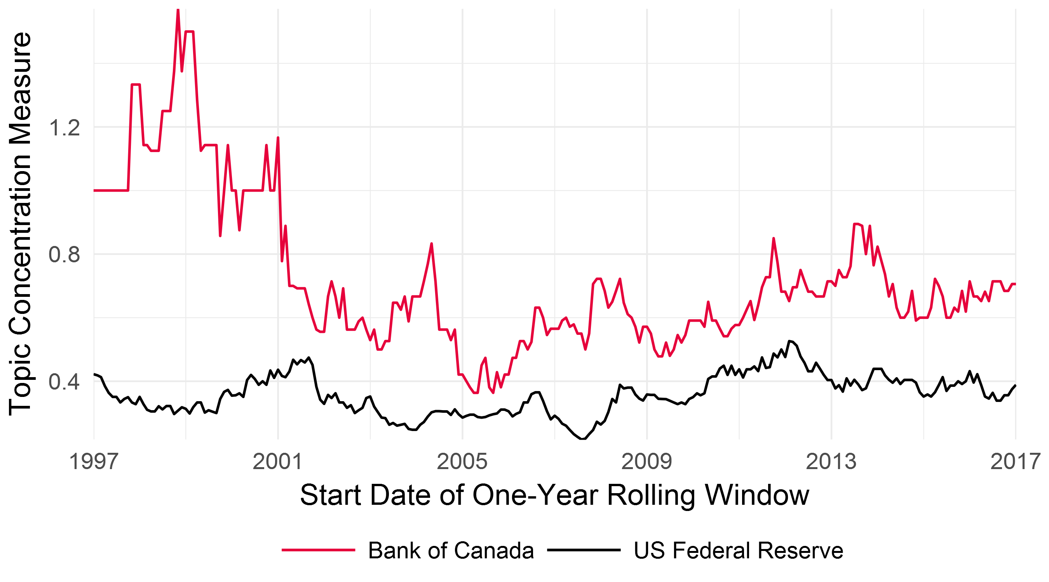
Concentration of Speech Topics over Time
Scope and Content
Measure of topic concentration: Number of topics required to explain 2/3 of speech corpus within a 1-year period, divided by the number of speeches in that year
A lower value means speech topics are more concentrated
22

Slide 23
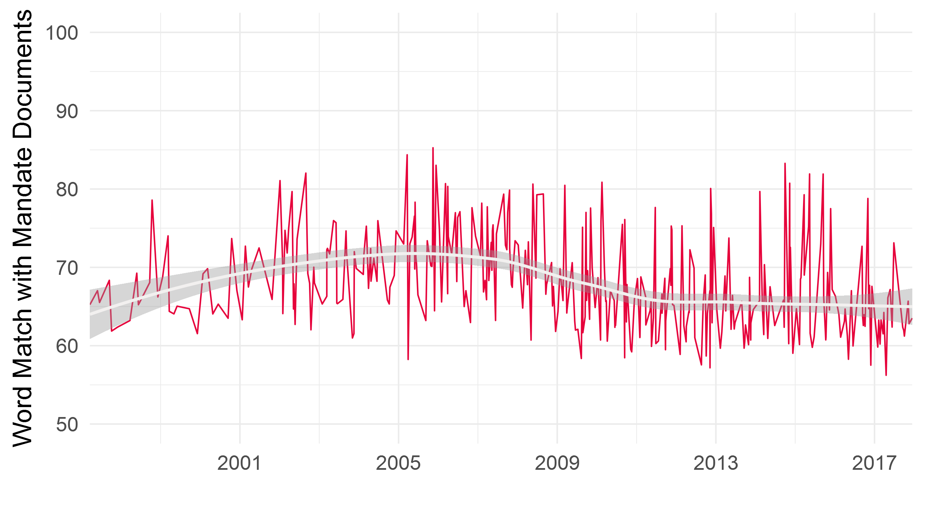
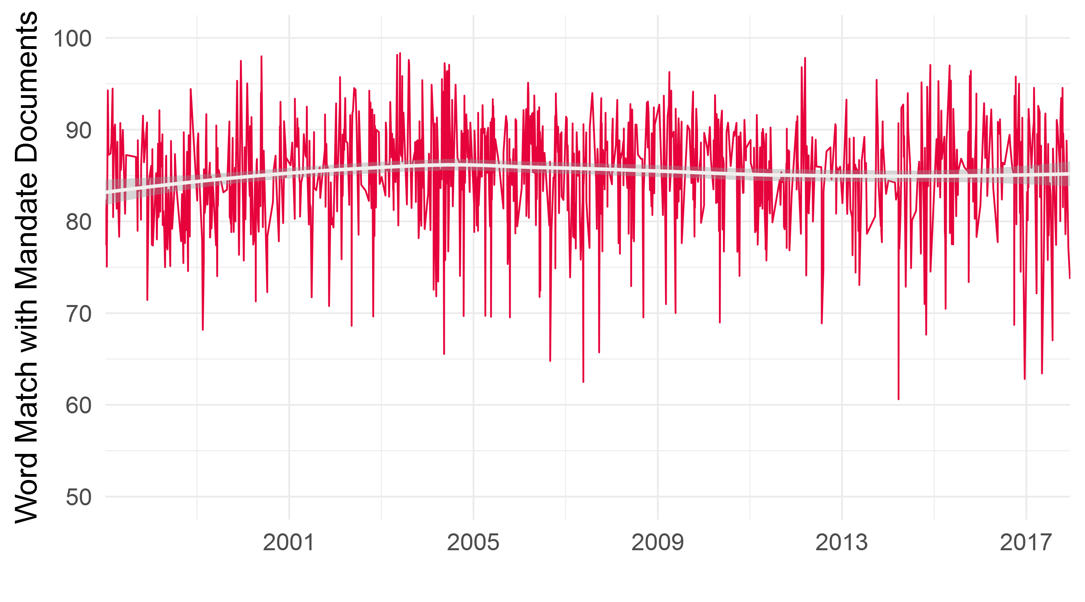
Relation of Topics to Mandate Documents
Scope and Content
Bank of Canada
US Federal Reserve
Bank of Canada Act
Joint Statement of the Government of Canada and Bank of Canada on the Renewal of the Inflation-Control Target
Federal Reserve Act
FOMC Statement on Longer-Run Goals and Monetary Policy Strategy
23

Slide 24
Future Work
Future Work
      Identify how speeches can be used to engage with different stakeholders:
        relation between speech topics and financial markets, the general public and media (preliminary results available)
      Assess interrelation of speech topics across central banks to identify strength of the transnational epistemic community vs. influence of domestic economic issues
      Analyze whether central banks’ discussion of economic and financial risk precedes or follows crises
24

Slide 25
Outliers of Speech Topics by Venue Type
Bank of Canada
US Federal Reserve
Venue | Speech Topics Overrepresented in Venue | Share of Speeches in Topic Presented at Venue
Academic | Macroeconomic Stabilization Policy | 60%
 | Wage Setting | 51%
Private | - | -
Gov’t | Re-Evaluating the Monetary Policy Framework | 25%
 | Corporate Accounting & Disclosure | 22%
 | Global Economic Governance | 20%
Non-Profit | Payments System | 48%
Other | Currency Issuance | 27%
Venue | Speech Topics Overrepresented in Venue | Share of Speeches in Topic Presented at Venue
Academic | Monetary Policy Rules | 79%
Private | Basel II | 62%
 | Corporate Governance | 60%
 | Corporate Risk Management | 58%
Gov’t | Community Banks Regulation & Supervision | 58%
Non-Profit | Financial Literacy | 35%
 | Community Economic Development | 26%
 | Fiscal Budgets | 25%
Other | - | -
25

Slide 26
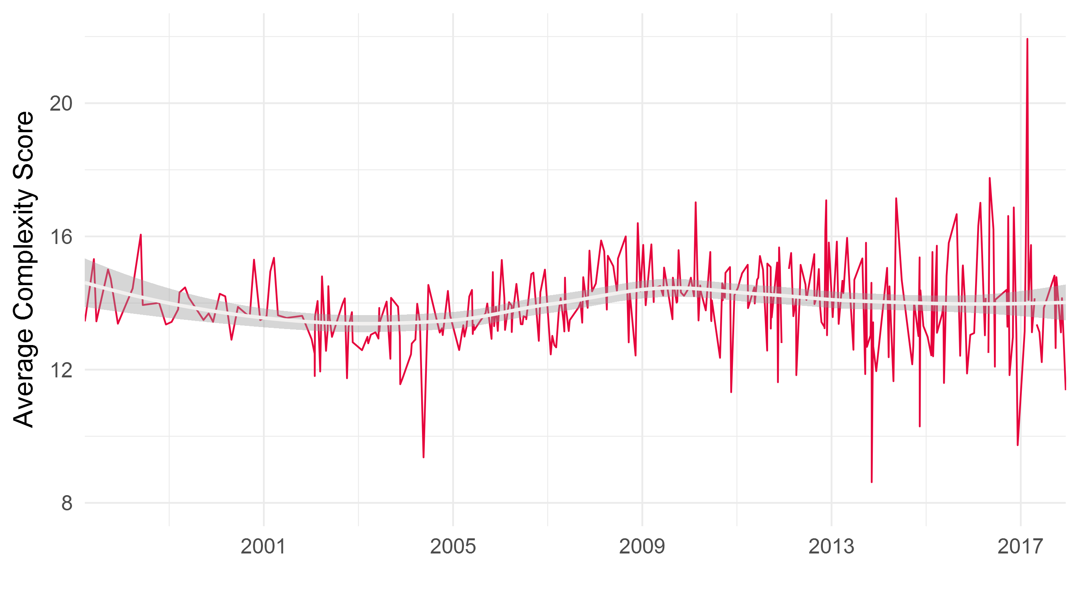
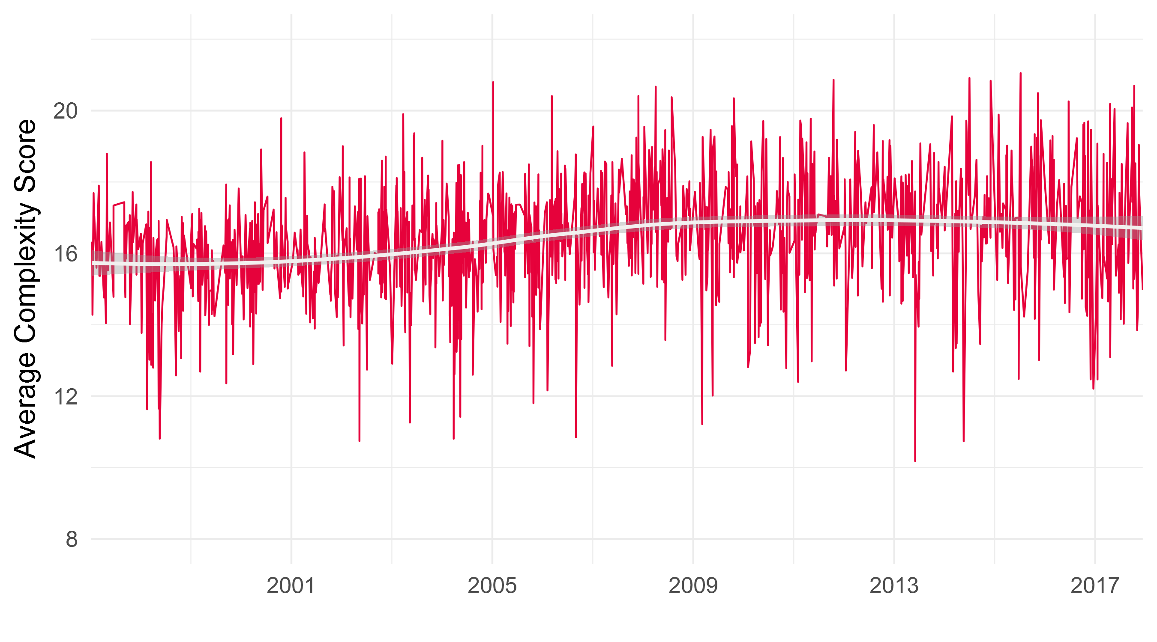
Text Complexity
Average of Flesch-Kincaid, Gunning Fog, Coleman-Liau, SMOG, and Automated Readability indies. Smoothing function is local quadratic regression with smoothing parameter equal to 0.75 and 95 percent confidence interval.
26

Slide 27
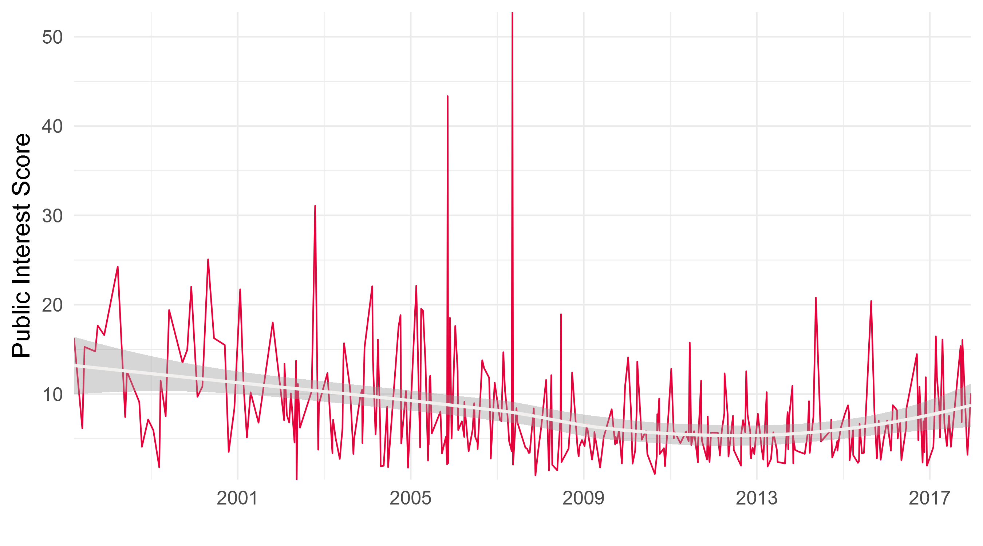
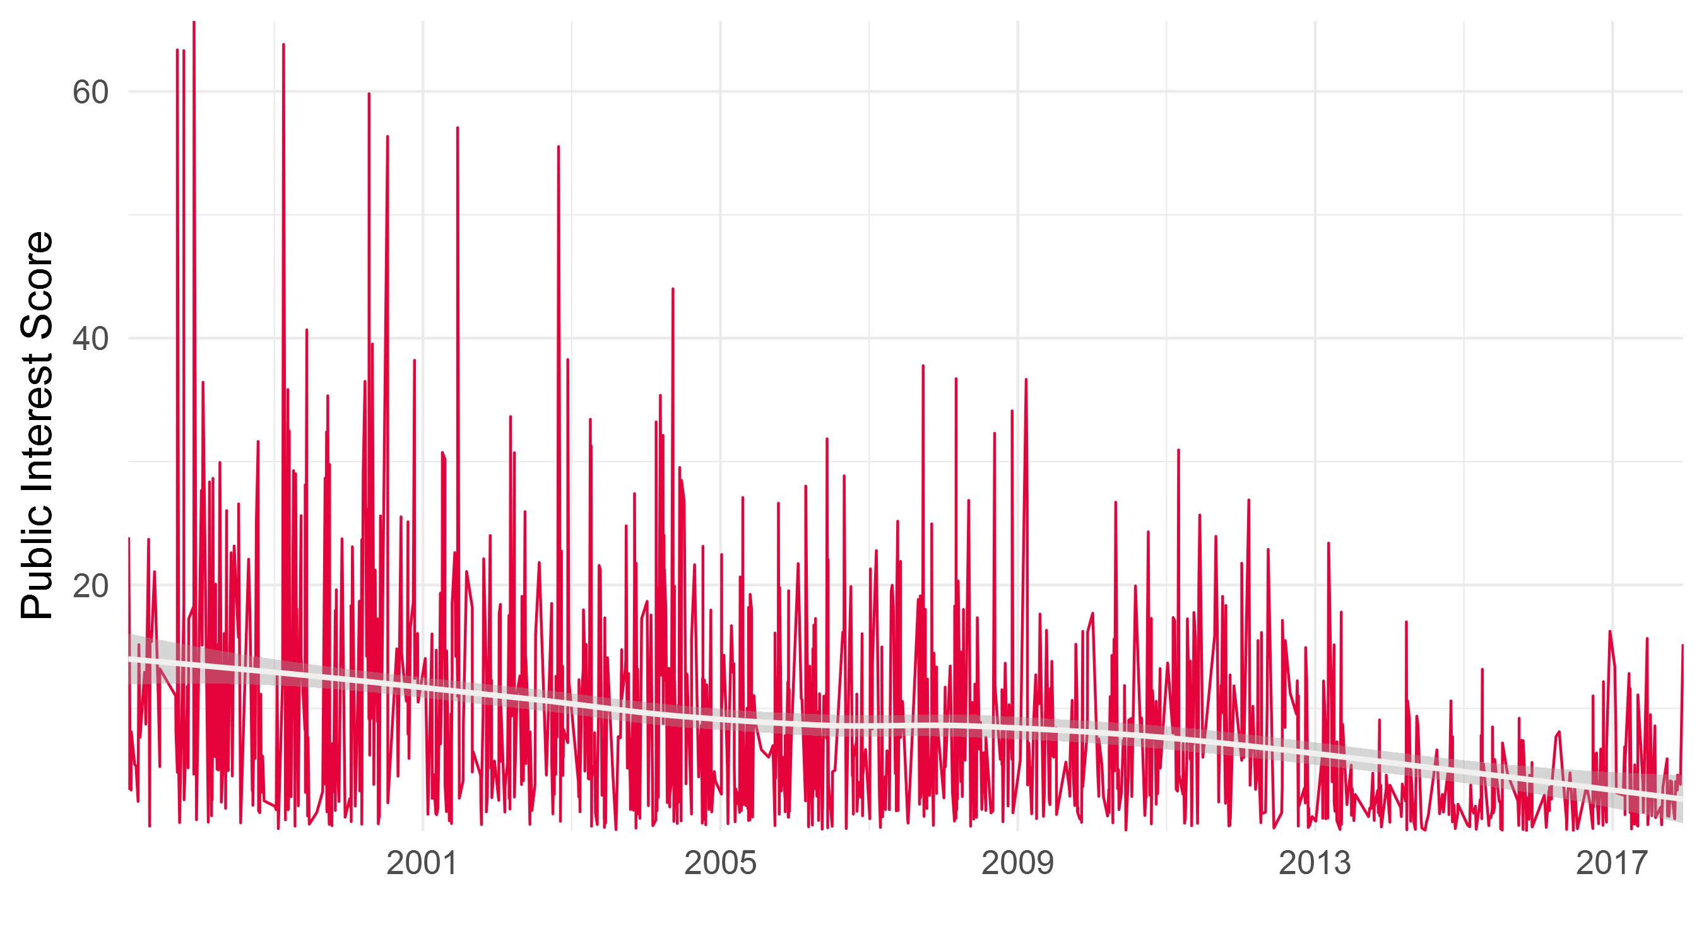
Public Interest
Public interest score is based on Google Trends search history data in the respective country of the central bank for the speech topics.
27

Slide 28
Additional Slides – if time permits
Financial market reactions to speeches

Slide 29
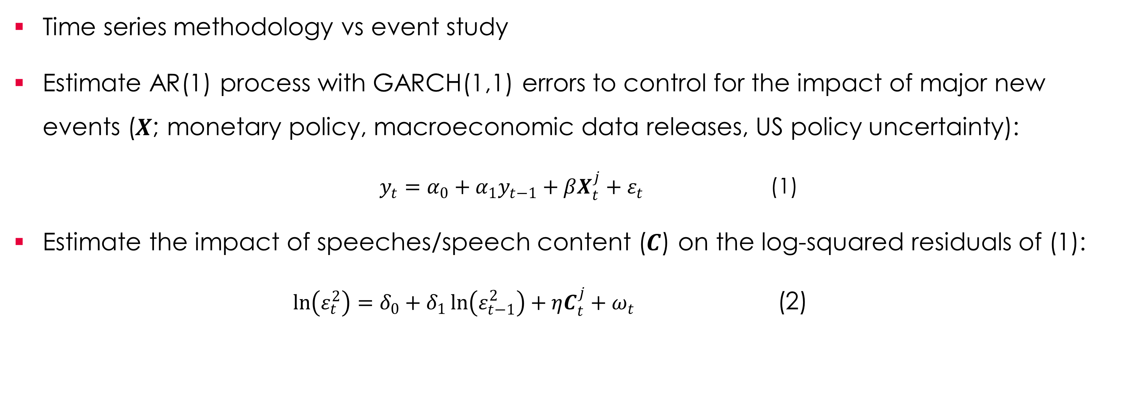
Financial Market Analysis
      Time series methodology vs event study
      Estimate AR(1) process with GARCH(1,1) errors to control for the impact of major new events ($X$; monetary policy, macroeconomic data releases, US policy uncertainty):
      $y_{t}=α_{0}+α_{1}y_{t−1}+βX_{t}^{j}+ε_{t}$ (1)
      Estimate the impact of speeches/speech content ($C$) on the log-squared residuals of (1):
      $\ln\left(ε_{t}^{2}\right)=δ_{0}+δ_{1}\ln\left(ε_{t−1}^{2}\right)+ηC_{t}^{j}+ω_{t}$ (2)
29

Slide 30
Speech Dummies on Canadian Financial Markets
 | 3m Bond | 3m Bond | 1y Bond | 1y Bond | 10y Bond | 10y Bond | Equities | Equities | USD forex | USD forex
BoC Speech | 0.37 (0.24) | 0.33 (0.33) | -0.27 (0.18) | 0.33 (0.33) | 0.18 (0.16) | 0.11 (0.22) | 0.20 (0.16) | 0.11 (0.23) | 0.11 (0.19) | 0.26 (0.26)
Speech by Gov |  | 0.07 (0.46) |  | 0.07 (0.46) |  | 0.15 (0.32) |  | 0.17 (0.31) |  | -0.31 (0.36)
Fed Speech | -0.02 (0.15) | -0.18 (0.17) | -0.22* (0.11) | -0.18 (0.17) | -0.20** (0.10) | -0.20* (0.12) | -0.03 (0.10) | -0.06 (0.12) | -1.17*** (0.12) | -1.11*** (0.14)
Speech by Chair |  | 0.52* (0.28) |  | 0.53* (0.28) |  | -0.02 (0.20) |  | 0.10 (0.20) |  | -0.19 (0.22)
Adj-R² | 0.13 | 0.14 | 0.11 | 0.14 | 0.02 | 0.02 | 0.03 | 0.03 | 0.03 | 0.03
N | 3,282 | 3,282 | 3,307 | 3,307 | 3,302 | 3,302 | 3,313 | 3,313 | 3,429 | 3,429
30

Slide 31
Speech Dummies on Canadian Financial Markets
 | 3m Bond | 3m Bond | 1y Bond | 1y Bond | 10y Bond | 10y Bond | Equities | Equities | USD forex | USD forex
BoC Speech | 0.37 (0.24) | 0.33 (0.33) | -0.27 (0.18) | 0.33 (0.33) | 0.18 (0.16) | 0.11 (0.22) | 0.20 (0.16) | 0.11 (0.23) | 0.11 (0.19) | 0.26 (0.26)
Speech by Gov |  | 0.07 (0.46) |  | 0.07 (0.46) |  | 0.15 (0.32) |  | 0.17 (0.31) |  | -0.31 (0.36)
Fed Speech | -0.02 (0.15) | -0.18 (0.17) | -0.22* (0.11) | -0.18 (0.17) | -0.20** (0.10) | -0.20* (0.12) | -0.03 (0.10) | -0.06 (0.12) | -1.17*** (0.12) | -1.11*** (0.14)
Speech by Chair |  | 0.52* (0.28) |  | 0.53* (0.28) |  | -0.02 (0.20) |  | 0.10 (0.20) |  | -0.19 (0.22)
Adj-R² | 0.13 | 0.14 | 0.11 | 0.14 | 0.02 | 0.02 | 0.03 | 0.03 | 0.03 | 0.03
N | 3,282 | 3,282 | 3,307 | 3,307 | 3,302 | 3,302 | 3,313 | 3,313 | 3,429 | 3,429
31

Slide 32
Speech Dummies on US Financial Markets
 | 3m Bond | 3m Bond | 1y Bond | 1y Bond | 10y Bond | 10y Bond | Equities | Equities | REER | REER
Fed Speech | -0.37*** (0.13) | -0.50*** (0.14) | -0.16 (0.11) | -0.16 (0.13) | -0.14 (0.10) | -0.20* (0.10) | -0.08 (0.10) | -0.11 (0.11) | -0.18** (0.09) | -0.22** (0.10)
Speech by Chair |  | 0.40*** (0.24) |  | -0.01 (0.21) |  | 0.21 (0.17) |  | 0.09 (0.19) |  | 0.12 (0.17)
Adj-R² | 0.29 | 0.29 | 0.10 | 0.10 | 0.02 | 0.02 | 0.03 | 0.03 | 0.01 | 0.01
N | 3,861 | 3,861 | 3,891 | 3,891 | 3,861 | 3,861 | 3,860 | 3,860 | 4,007 | 4,007
32

Slide 33
Topic Distributions on Canadian Financial Markets
 | 3m Bond | 1y Bond | 10y Bond | Equities | USD forex
BoC Economic Outlook | 2.04 (1.27) | 1.82* (0.98) | 0.61 (0.87) | -0.05 (0.87) | 1.77* (0.99)
BoC International Economics & Governance | -0.56 (0.98) | -0.92 (0.75) | 0.36 (0.67) | -0.06 (0.68) | -1.44* (0.77)
BoC Other | 0.44 (1.04) | -1.34* (0.80) | 0.05 (0.72) | 0.09 (0.70) | -0.19 (0.80)
US Economic Outlook | 1.28* (0.66) | 0.37 (0.51) | 0.81* (0.45) | 0.16 (0.46) | -1.11** (0.51)
US Monetary Policy Making | -0.72 (0.56) | -0.35 (0.44) | -0.58 (0.39) | -0.46 (0.39) | -1.54*** (0.44)
US LOLR | 4.53*** (1.23) | 1.40 (0.95) | 2.28*** (0.85) | 2.02*** (0.86) | 0.12 (0.98)
US International Economics & Governance | -1.16 (1.14) | -0.26 (0.88) | -1.82** (0.78) | -0.51 (0.79) | -1.86** (0.91)
US Microprudential Policy | -0.24 (0.46) | -0.91*** (0.35) | -0.57* (0.31) | 0.27 (0.31) | -1.65*** (0.36)
US Community Development & Consumer Protection | 0.41 (0.70) | -0.49 (0.54) | -0.57 (0.48) | -0.15 (0.49) | -1.83*** (0.56)
US Other | -0.58 (0.54) | -0.57 (0.42) | -0.60 (0.38) | -0.16 (0.38) | -0.84* (0.43)
Adj. R² | 0.14 | 0.11 | 0.03 | 0.03 | 0.04
N | 3,282 | 3,307 | 3,302 | 3,313 | 3,429
33

Slide 34
Topic Distributions on US Financial Markets
 | 3m Bond | 1y Bond | 10y Bond | Equities | REER
Financial Market Infrastructure | 0.26 (1.28) | -1.22 (1.13) | -0.25 (0.91) | -1.91* (1.02) | 0.30 (0.92)
LOLR | 2.65** (1.11) | 2.68*** (0.97) | 2.63*** (0.78) | 3.26*** (0.87) | 2.59*** (0.79)
Financial System Stability & Macroprudential Policy | 0.92 (0.96) | 0.37 (0.83) | 0.62 (0.66) | -0.20 (0.74) | -1.80*** (0.67)
Microprudential Policy | -1.39*** (0.37) | -0.39 (0.32) | -1.00*** (0.26) | -0.29 (0.29) | -0.04 (0.26)
Community Development & Consumer Protection | -1.06* (0.56) | -0.32 (0.49) | 0.32 (0.40) | 0.87* (0.44) | -0.01 (0.40)
Other | -0.84* (0.44) | -0.73* (0.40) | -0.28 (0.31) | 0.04 (0.35) | -0.44 (0.32)
Adj. R² | 0.30 | 0.10 | 0.03 | 0.04 | 0.02
N | 3,861 | 3,891 | 3,861 | 3,860 | 4,007
34

