Slide 1
Spillover of Domestic Shocks: Will they counteract the “great moderation”
Alina Carare and Ashoka Mody
June 3 2010

Slide 2
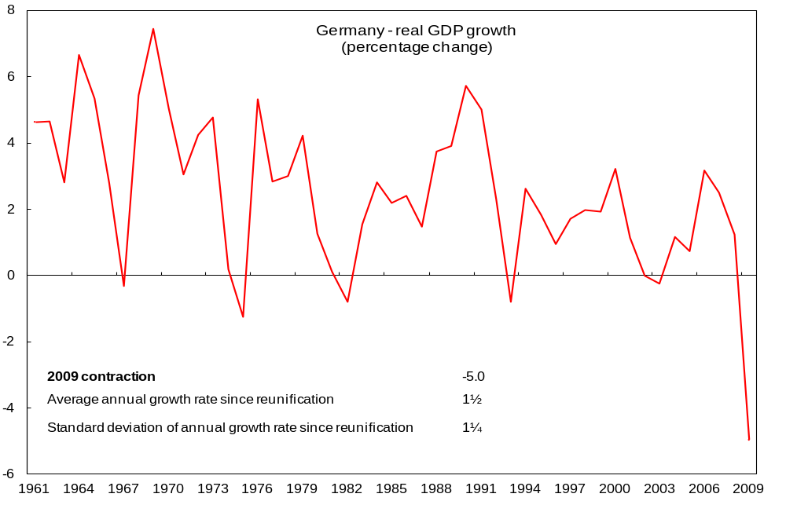
Motivation

Slide 3
Summary
Results:
  Even prior to the extreme volatility recently experienced , output growth volatility was flattening or mildly rising in some countries
  More widespread was increased tendency from mid-1990s for shocks to transmit to other countries
  Higher sensitivity to foreign shocks appears related to vertical specialization

Slide 4
Introduction
Extreme volatility should not have come as a complete surprise
“Great Moderation” – was robustly established trend in industrial countries
Domestic volatility declining due to improved policy management and innovations in private sector
But these analyses did not factor in ongoing integration of global economy

Slide 5
Introduction
Even when considering multiple countries, these analyses dealt with individual country experiences
Stock and Watson (2005) was the exception
  Traced the source of “Great Moderation” to a fall in common international shocks

Slide 6
Introduction
Expand Stock and Watson (2005) analysis
  From G7 to 22 OECD countries
  Using data until 2007Q4
To capture the effects of an increasingly integrated global economy to a perspective on economic volatility
The method decomposes GDP growth volatility into domestic, common international, and spillovers shocks

Slide 7
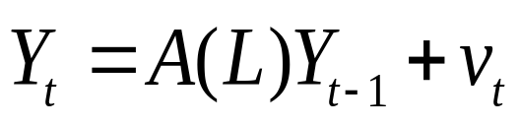
Stock and Watson (2005) method
Y_{t} = vector of stacked detrended growth rates
A(L) = matrix lag polynomial
  First restriction: VAR (p1, p2)
    Each country growth depends on its own growth (4 lags) and other countries growth (1 lag)
Detrending method - Baxter-King (1999) band pass (BP) filter with 8 leads and lags and a pass-band of 6-32 quarters applied to annualized quarter-on-quarter GDP growth rates
Volatility is measured as the time-varying variance of this model

Slide 8
Stock and Watson (2005) method
For each date t a regression is estimated by weighted least squares using two-sided exponential weighting
  Observation at date s receives a weight of δ |t−s| and δ = 0.97
  Observations further away from the point of interest t receive an exponentially-lower weight
  s takes values between 1960:Q1 and 2007:Q4, while t takes values between 1977:Q1 and 2006:Q4
Results are robust to different discount factors and length of sample

Slide 9






Stock and Watson (2005) method
VAR errors are decomposed into common international shocks and country-specific shocks:
  Where are common international factors or shocks,
  Γ is the 22 x k matrix of factor loadings (22 countries times k factors) , and
  are country-specific or idiosyncratic shocks.
Common international shocks and the domestic shocks are assumed to be uncorrelated
and
Second VAR restriction: common shocks affect all countries at once, while country-specific shocks affect other countries after one quarter, spillovers
Parameters estimated using Gaussian maximum likelihood
Variance for each shock is calculated using spectral decomposition

Slide 10
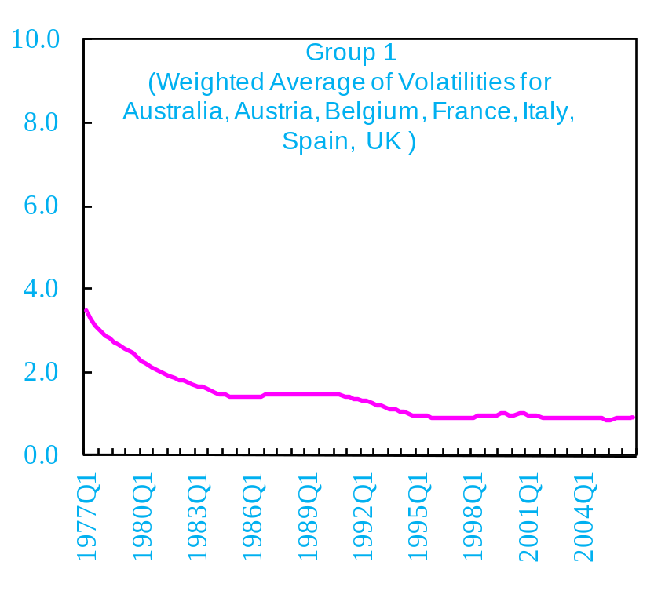
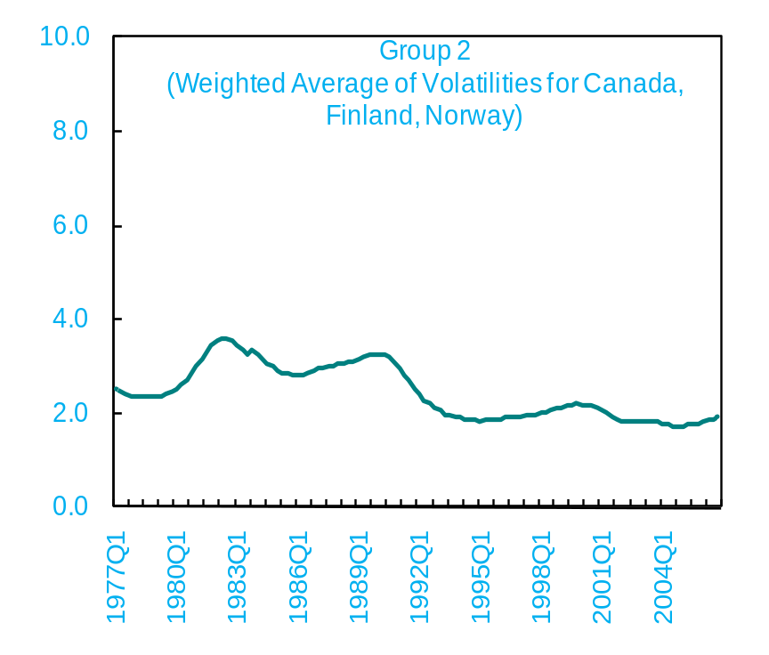
1st result (part I):
Prior to the crisis volatility has declined, and remained low in many industrial countries...

Slide 11
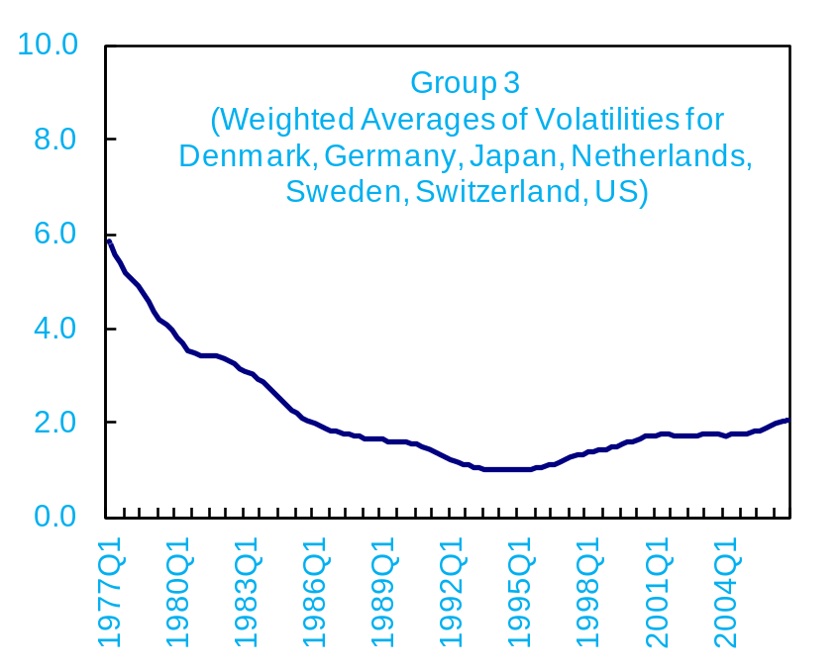
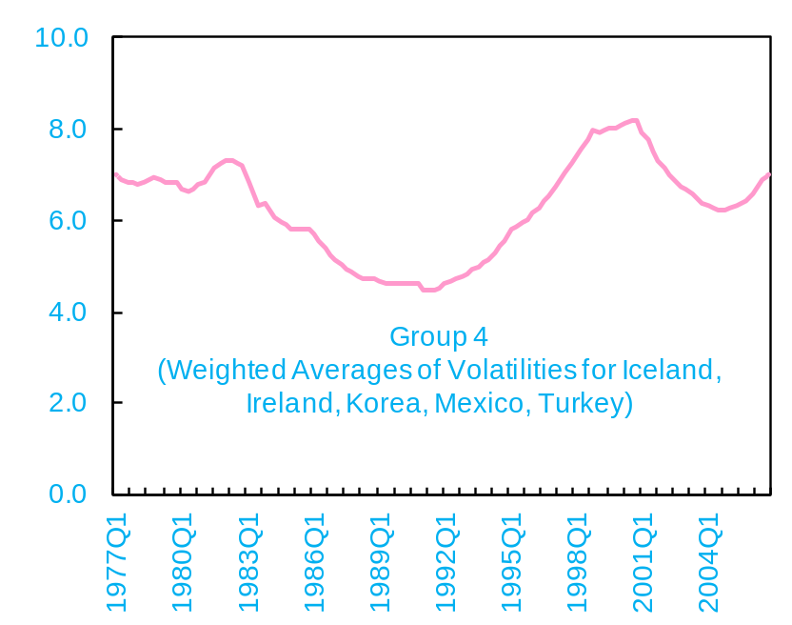
  1st result (part II):
  ...but there was a tendency to rise mildly in others

Slide 12
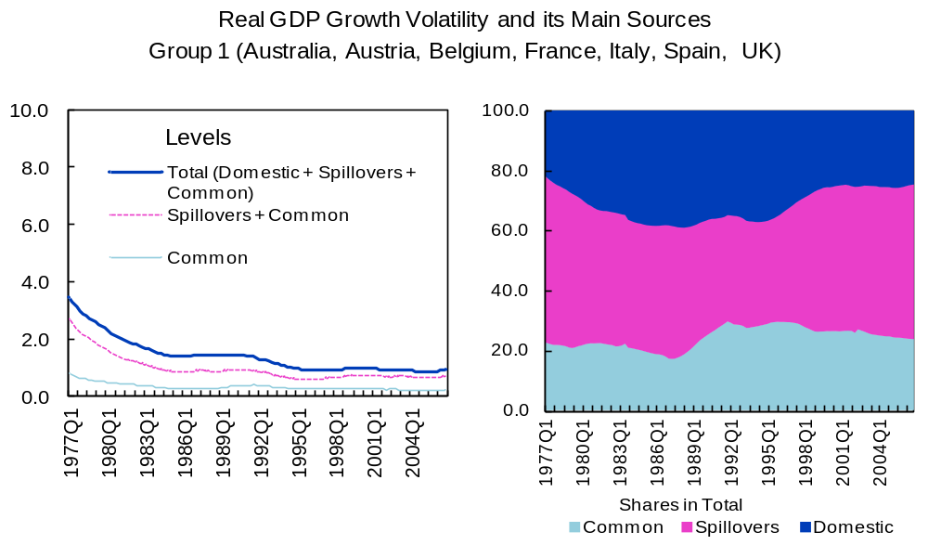
2d result (part I)

Slide 13
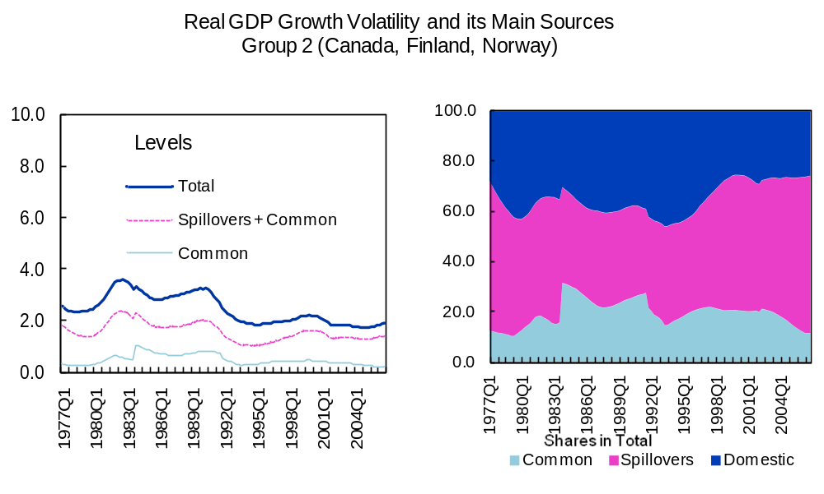
2d result (part II)
Increased tendency from mid-1990s for shocks to transmit to other countries

Slide 14
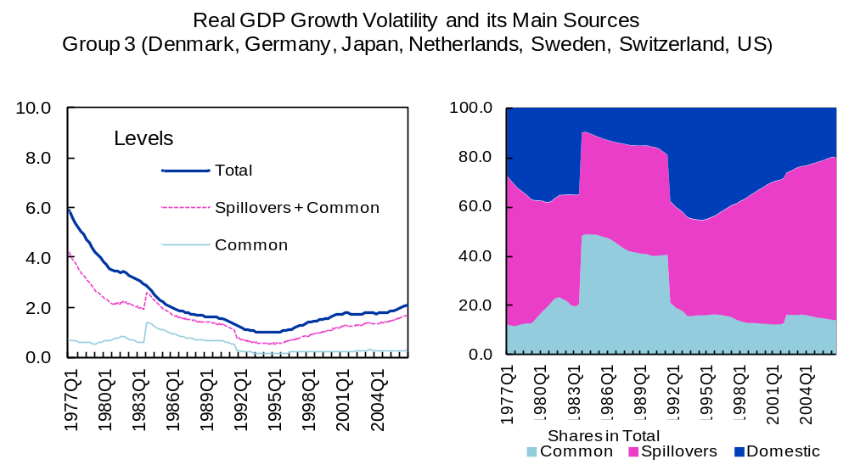
2d result (part III)
Increased tendency from mid-1990s for shocks to transmit rapidly to other countries

Slide 15
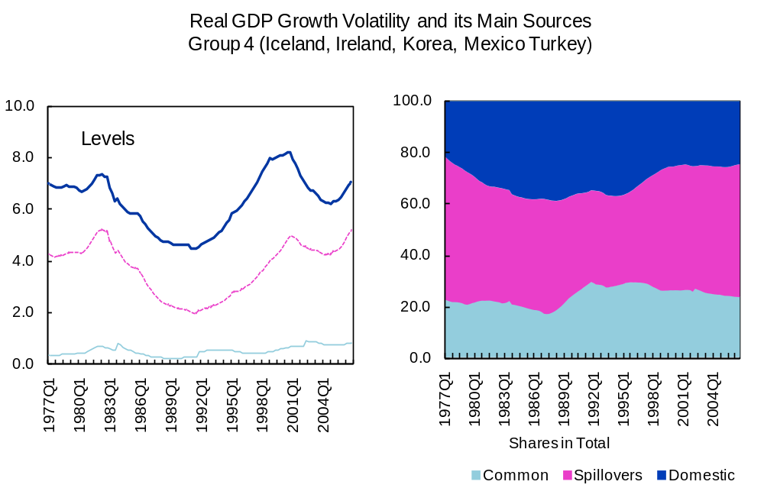
2d result (part IV)
Increased tendency from mid-1990s for shocks to transmit rapidly to other countries

Slide 16






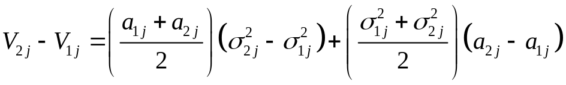
2d result – further explanations (method)
-variance of 4-quarter ahead forecast errors in a given country in period p
  where p=1 or 2 correspond to 1977-1994 or 1995-2007
Variance decomposition attributes a portion of to each of the 24 shocks (international shock, domestic shock, and 22 spillover shocks)
, where , variance in period p attributed to shock j
Change in the variance between two periods is:
  where variance component can be rewritten as , where is a term depending on the cumulative impulse response to shock j in period p and is the variance of shock j in period p
Change in contribution of the jth shocks can be decomposed as:
In other words, change in variance can be decomposed into contribution from change in shock variance plus contribution from change in impulse response

Slide 17
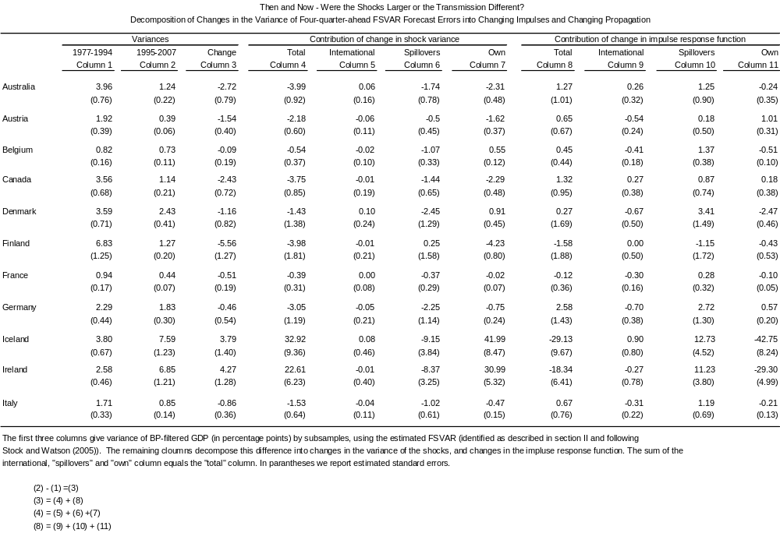
2d result (part Va):
Increased tendency from mid-1990s for shocks to transmit to other countries

Slide 18
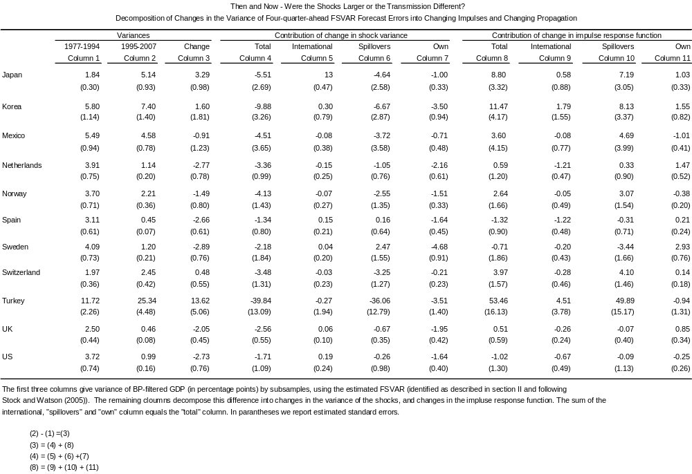
2d result (part Vb):
Increased tendency from mid-1990s for shocks to transmit to other countries

Slide 19
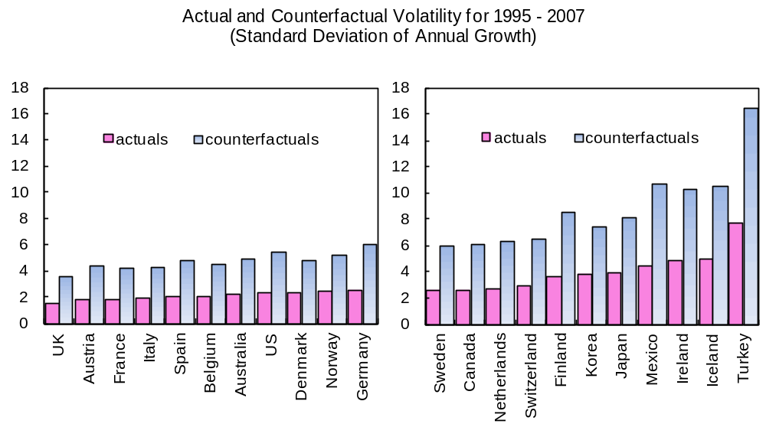
2d result (part VI):
Increased tendency from mid-1990s for shocks to transmit to other countries

Slide 20
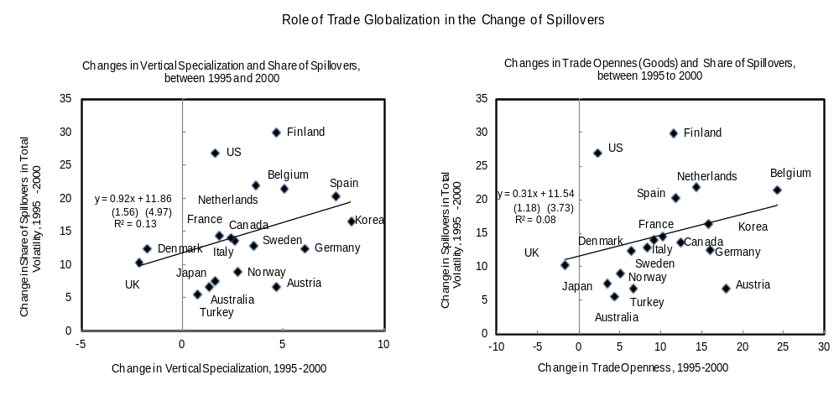
3d result:
Higher sensitivity to foreign shocks appears related to vertical specialization

Slide 21
Conclusions
Results:
  Even prior to the extreme volatility recently experienced, output growth volatility was flattening or mildly rising in some countries
  More widespread was increased tendency from mid-1990s for shocks to transmit to other countries
  Higher sensitivity to foreign shocks appear related to vertical specialization
Policy implications
  Increased spillovers call for stronger ex-post coordination mechanism when shocks are large
  Ex-ante prevention consists of sensible national policies

Slide 22
Extra slides

Slide 23
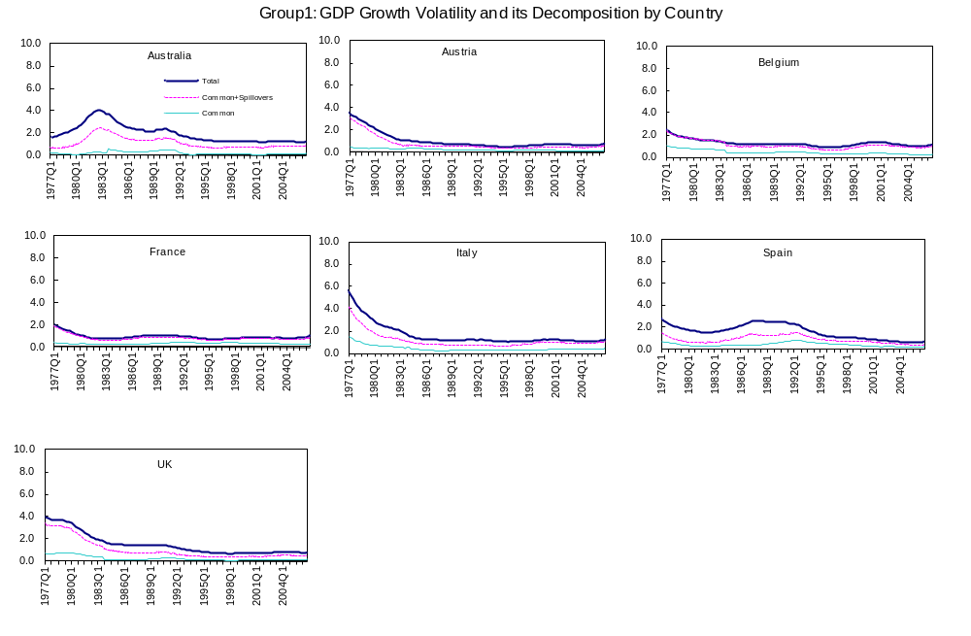

Slide 24
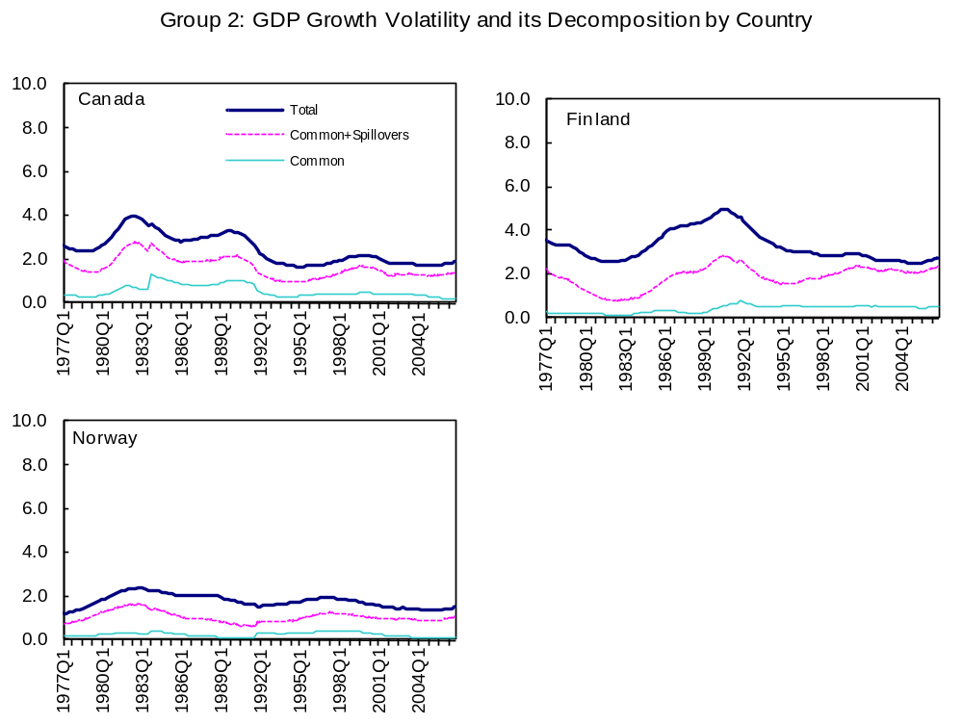

Slide 25
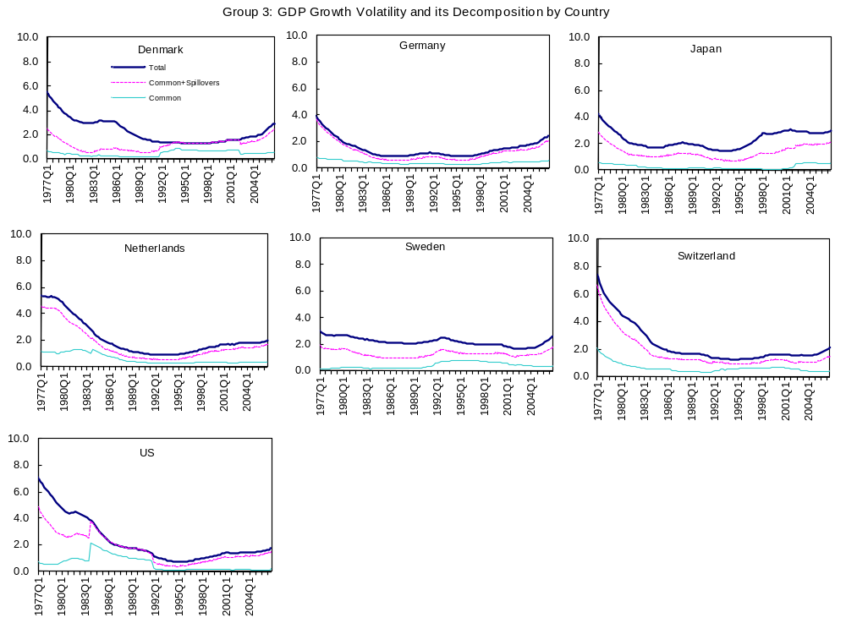

Slide 26
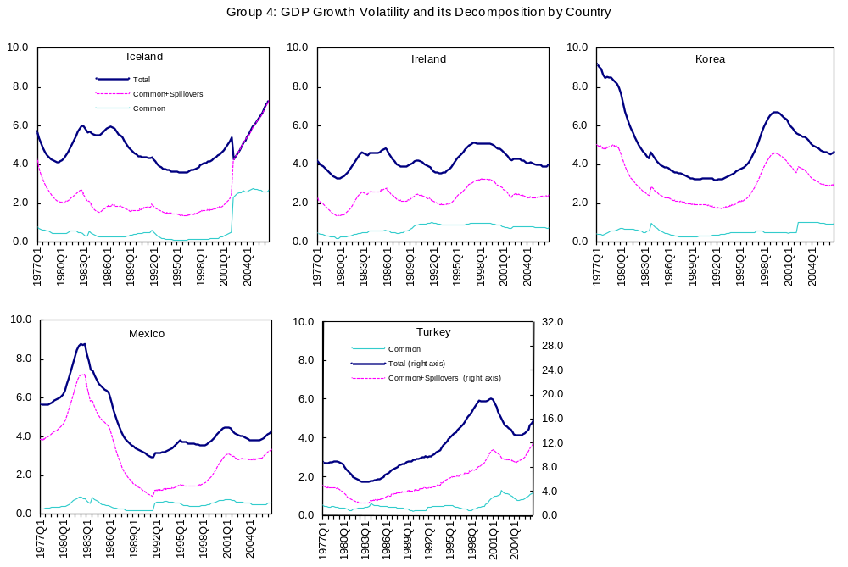

Slide 27
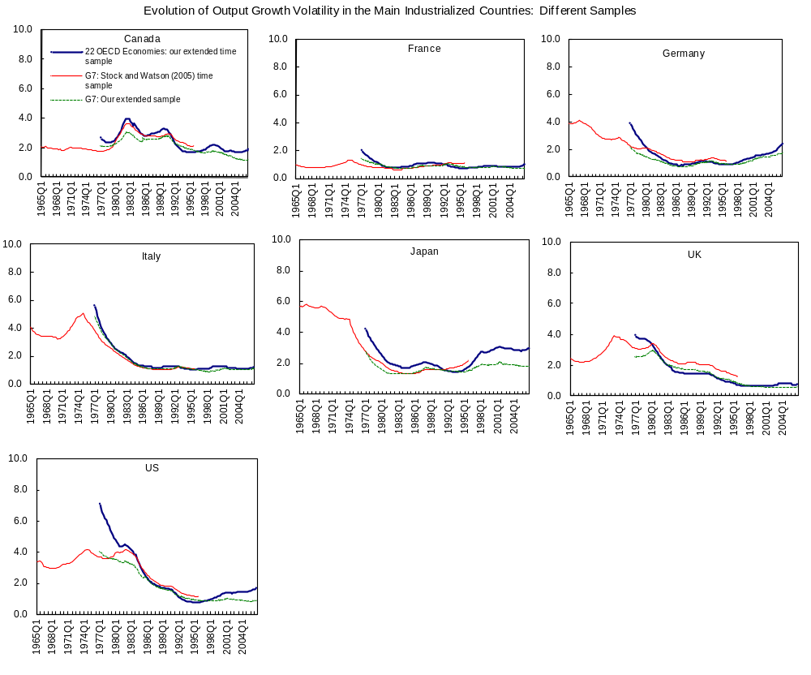

Slide 28
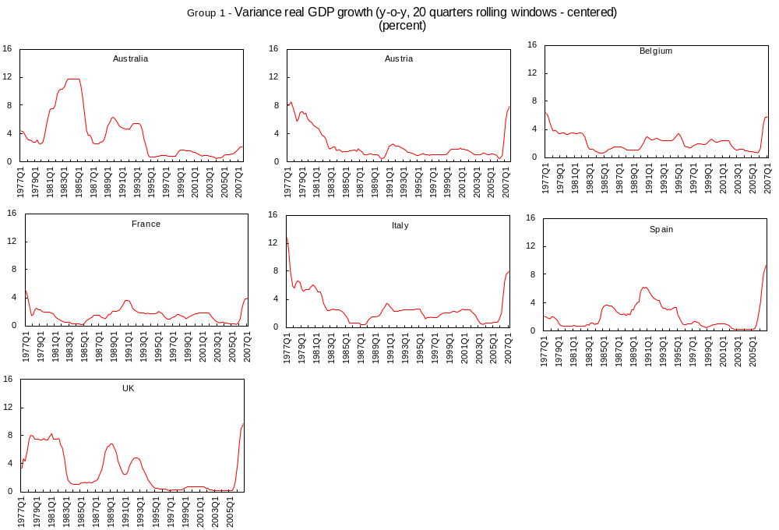

Slide 29
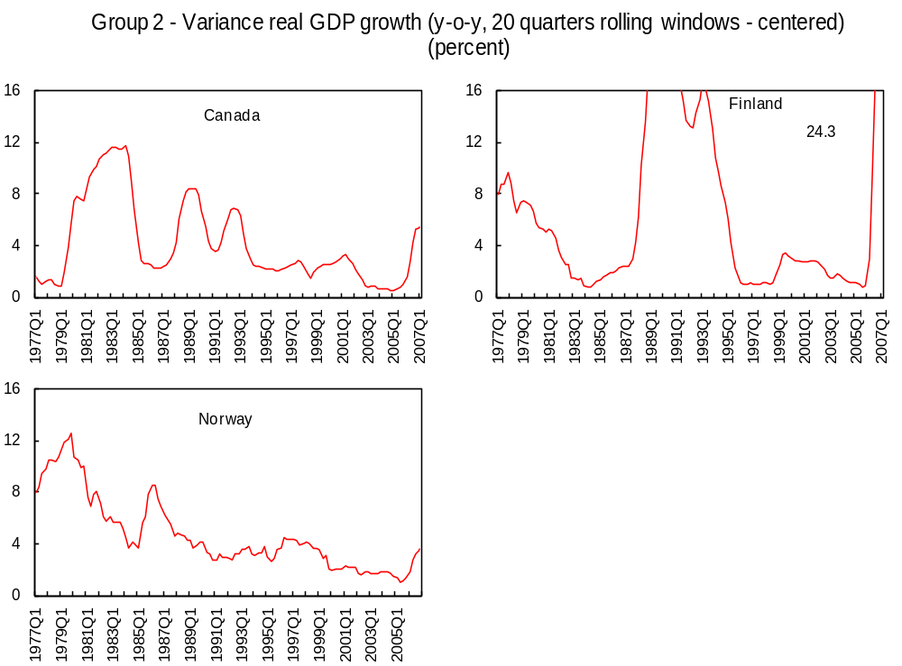

Slide 30
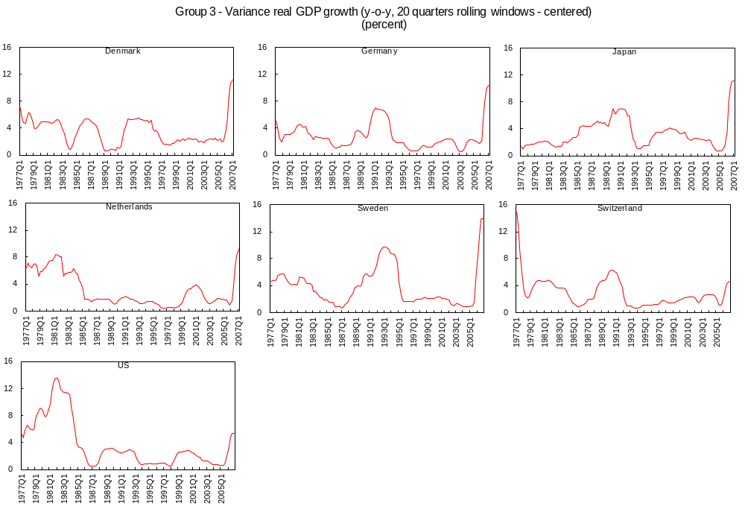

Slide 31
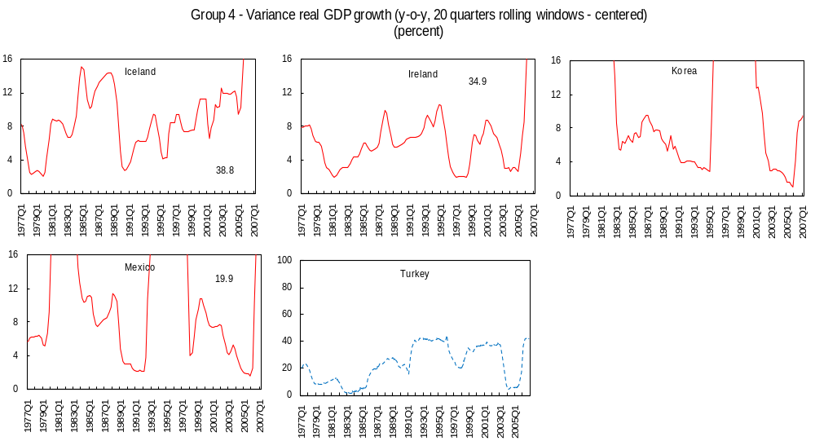

Slide 32
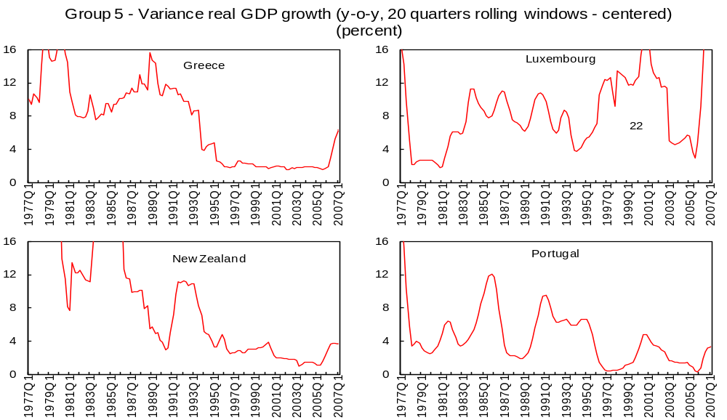

Slide 33
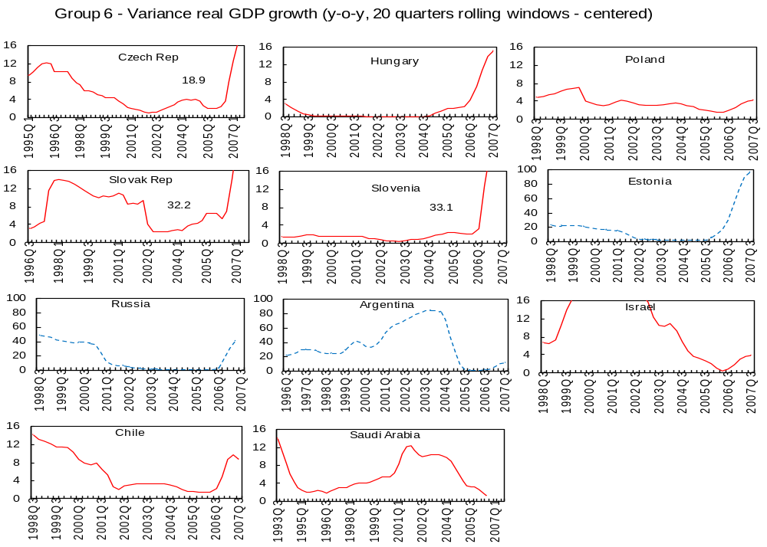

Slide 34
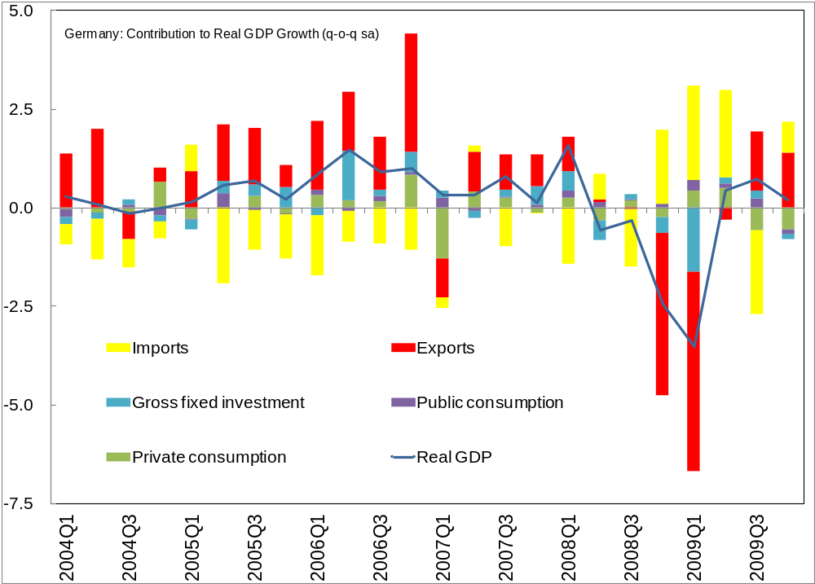
Motivation

