Slide 1
Is inequality good for growth?
Kuben Naidoo
Stellenbosch University
20 September 2012

Slide 2
Hypothesis and conclusion
Hypothesis
  Inequality is bad for growth
  While some degree of inequality is accepted as normal, inequality undermines the growth process in important ways.
Conclusion
  To support growth, South Africa needs more redistribution, but done carefully

Slide 3
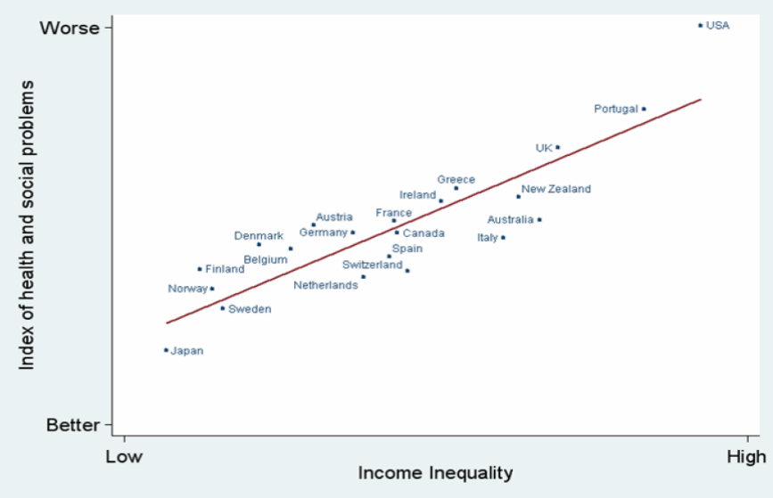
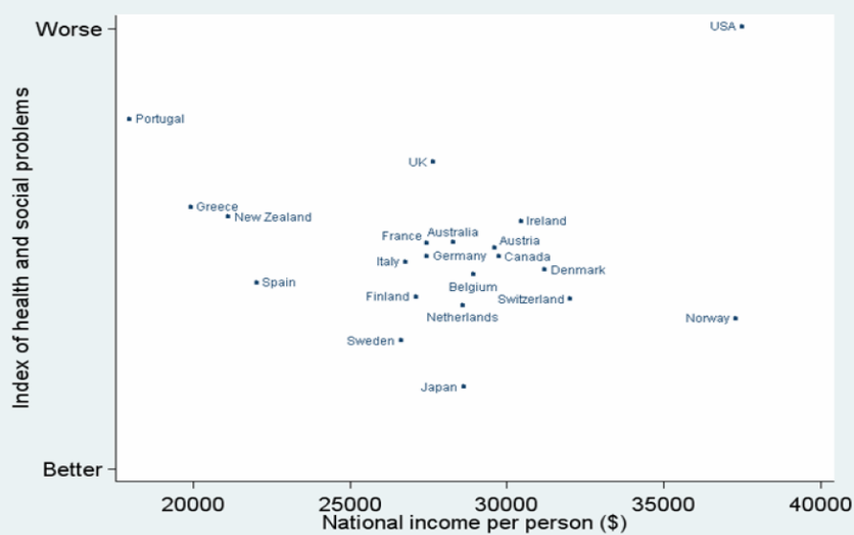
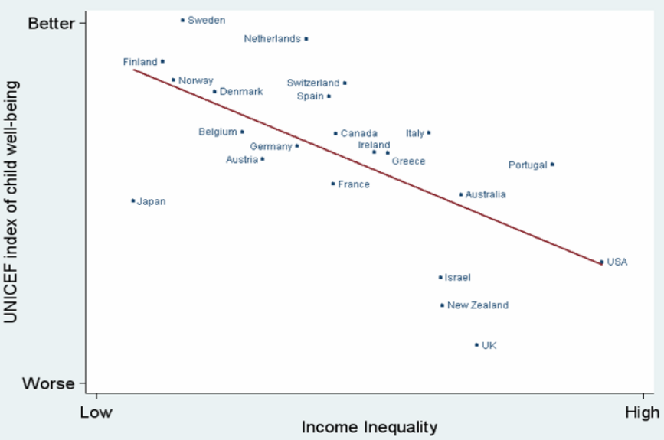
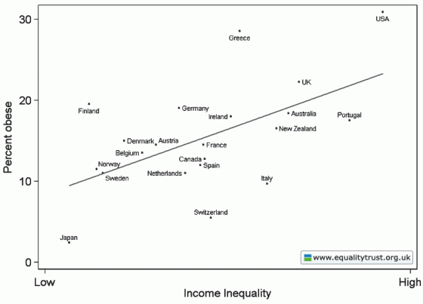
Lots of evidence that inequality is bad, including for the rich

Slide 4
But is inequality good for growth?
What do the models say
Classical model
Keynesian model
Savings is the main determinant for long run growth
Inequality is good for growth because it distributes income to those with a higher marginal propensity to save
Variations of the classical model
  Inequality is good for growth when credit markets function perfectly
Consumption is the main determinant of growth
Inequality is bad for growth because it redistributes money away from those with a higher marginal propensity to consume
Rich have declining marginal productivity of investment

Slide 5
Is inequality good for growth?
What do the models say
Political economy models
Human capital models
Inequality is bad for growth because it result is more redistribution which undermines effort and hence growth
Inequality is bad for growth because it weakens political institutions and this is bad for growth
In conditions of imperfect credit markets, inequality reduces investment in human capital and is therefore bad for growth
In a learning by doing model, the poor cannot accumulate sufficient human capital to get out of poverty

Slide 6
Inequality is good for growth?
Kaldor
  Rich have a higher marginal propensity to save and savings drive long run growth
  Investment indivisibilities
    Initial stage investment requires large amounts of capital and only the rich have this amount of capital
  Incentive considerations, Mirrlees, 1971
Arthur Okun, 1975,
  The Big Tradeoff, argues that equality reduces incentives to work harder; redistribution is like a ‘leaky bucket’

Slide 7
What does the empirical research suggest?
Kuznet’s curve??
Three empirical studies that focus on the short-run relationship (Li and Zou, 1998; Forbes, 2000; Deininger and Olinto, 2000) find a positive partial correlation between inequality and growth, whereas
Studies which use data over a longer time span tend to find a negative partial correlation between inequality and growth.
Alesina and Rodrik (1994), Birdsall, Ross and Sabot (1995), Sylwester (2000) and Easterly (2000) all obtain a negative partial correlation between income inequality and economic growth.
Barro (2000) finds evidence of a negative relationship for poor countries, but a positive relationship for rich countries.
In contrast, Perotti finds evidence of a negative correlation between inequality and growth, with some suggestion that the correlation may be insignificant for poor countries.
Persson and Tabellini (1994) find a negative correlation for democracies only, whereas
Clarke (1995) obtains a negative correlation for both democracies and non-democracies.
Deininger and Squire (1998) and Castelló and Doménech (2001) obtain a negative coefficient, but this becomes insignificant once continental dummies are included in the regression equation.

Slide 8
What does the empirical research suggest?
Keefer and Knack (2000) find evidence of a negative correlation between income inequality and growth, but this correlation becomes insignificant once a measure of property rights is included as a control variable.
Berg, Ostry and Zettelmeyer, 2011 argue that more equal countries have longer growth spells
  Note that Berg and Ostry work for the IMF
Michael Todaro's book Economic Development provides four general arguments why "greater equality in developing countries may in fact be a condition for self-sustaining economic growth,“ namely:
  Dissaving and or unproductive investment by the rich;
  Lower levels of human capital held by the poor;
  Demand pattern of the poor being more biased towards local goods; and
  Political rejection by the masses.
Wilkinson and Pickett in their book, The Spirit Level, 2009 argue that inequality is bad for the rich too

Slide 9
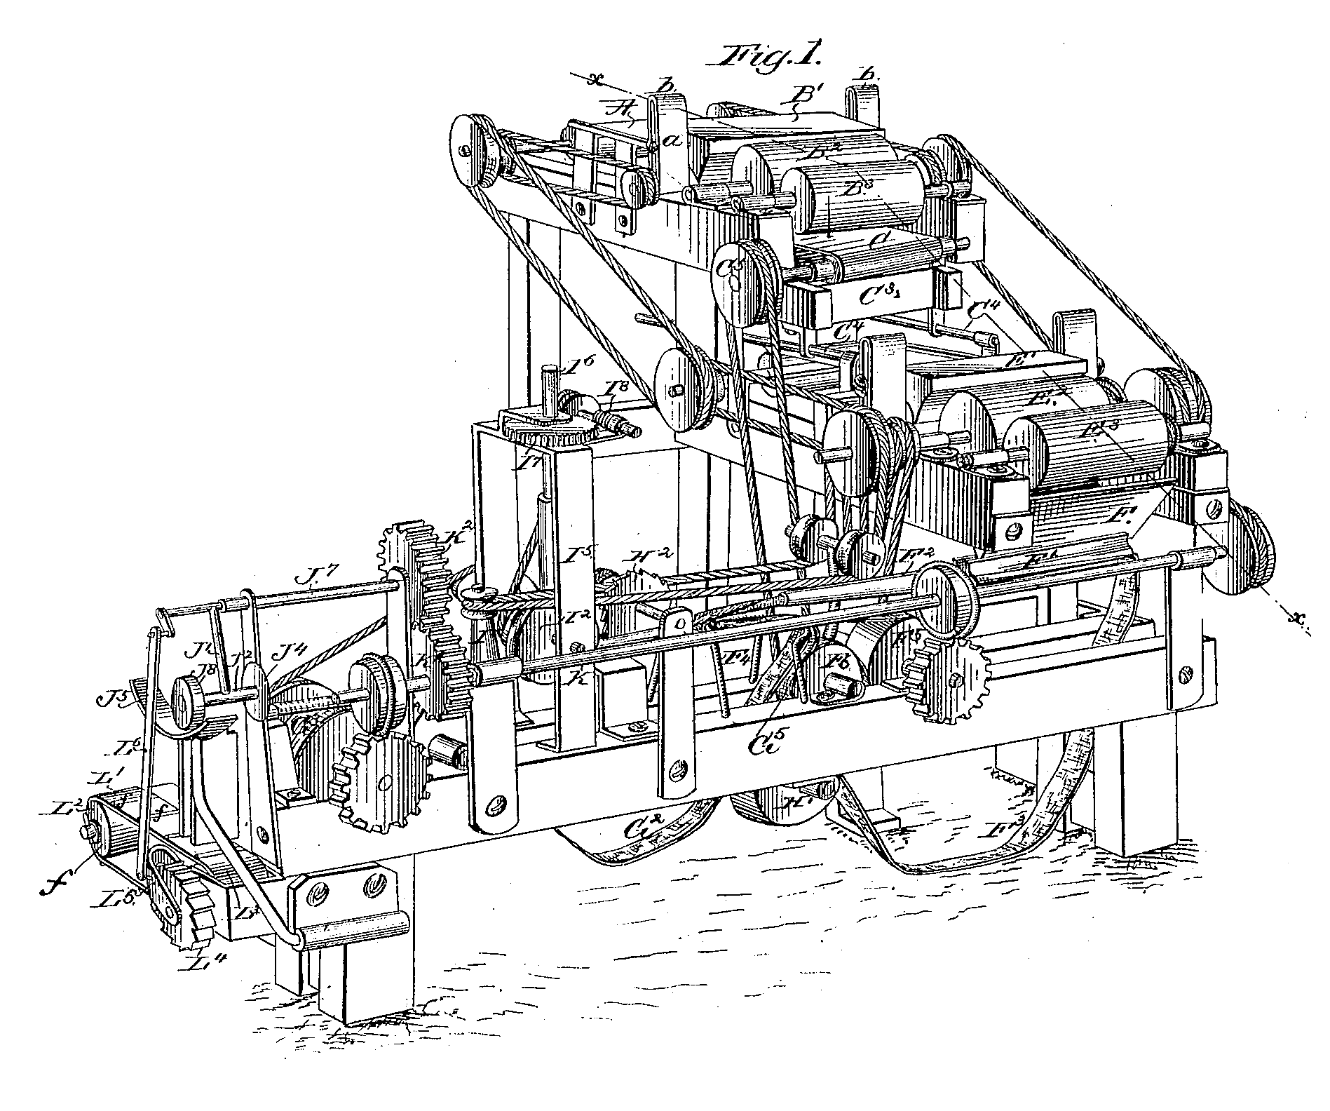
Mechanisms by which inequality affects growth
Macroeconomic factors
  Stability
  Financial market risk
Political factors
  Redistribution
  Institutions, including trust
Credit market failures
  Investment opportunities
  Aspirational consumption
Human capital formation
  Credit markets
  Learning by doing

Slide 10
Macroeconomic stability
In general, volatility is negatively associated with GDP growth
  Haussmann & Gavin and Breen & Garcia-Penalosa show correlation between volatility and lower growth
Berg, Ostry and Zettelmeyer show that unequal countries fail to sustain growth spells
The two periods 1918 to 1929 and 1980 to 2008 saw the fastest rise in inequality in the US (and the UK)
  Both periods were followed by severe economic crises – great depression in 1929 and the great recession in 2009
Effect on consumption
  Cyclical unemployment is the result of lower aggregate demand
    Rising inequality leads to lower aggregate demand
  Lower interest rates often result in credit bubbles, followed by recession

Slide 11
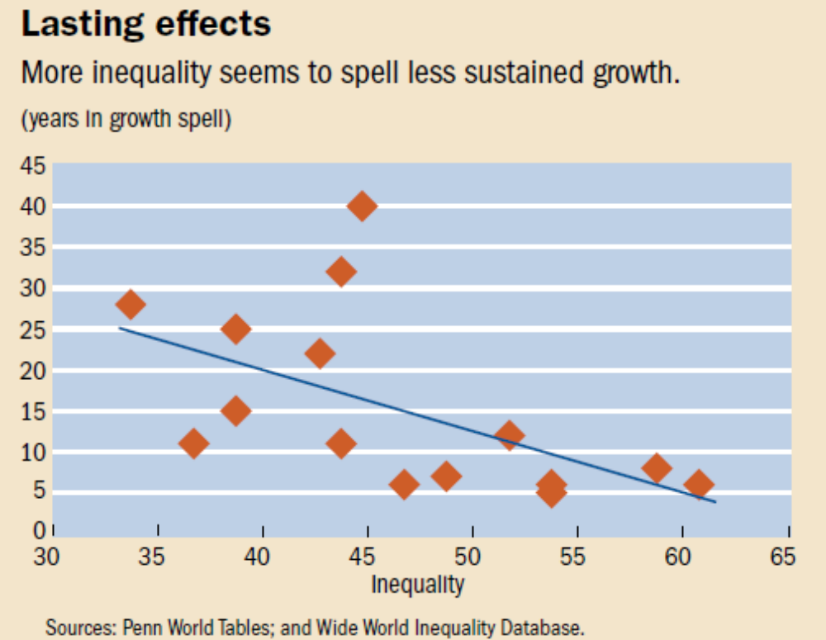
Unequal countries do not have long growth spells (Berg, Ostry et al, 2011)

Slide 12
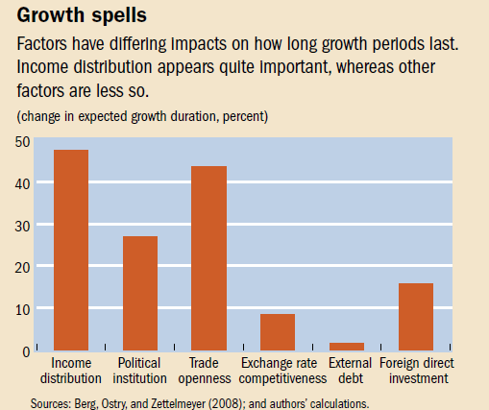
Income distribution is critical in determining length of growth spells

Slide 13
Macroeconomic volatility
Evidence suggests that causality runs from high inequality to political instability to macroeconomic inequality
Work by Aghion, Bacchetta and Banerjee (1998) considers a small open economy and develops a model of financial crises.
  The real interest rate is fixed at the international market-clearing level and the transmission variable becomes the price of non-tradeable goods relative to tradeable goods.
  The accumulation of debt results in an increase in the relative price of non-tradeables relative to tradeables. At some point, the credit market constraint becomes binding and brings about the collapse in the price of non tradeables, that is, a financial crisis.
Rodrik (1998) provides empirical evidence that unequal societies are less likely to carry out the adjustments necessary to respond to negative macroeconomic shocks.
Indeed, Rodrik finds that what is particularly destructive is a combination of high inequality and poor institutions of conflict management (such as social safety nets, democratic institutions, rule of law, and efficient government institutions). He finds that an interaction of these is a strong predictor of growth collapse during the 1980s.
  Think Marikana

Slide 14
Macroeconomic stability
Vandemoortele, 2010 – Inequity undermines macroeconomic resilience in 4 direct ways.
  It leads to aspirational consumption and increasing personal debt.
  Second, inequity leads to risky investment.
  Borrowers have to take on more debt simply to cope.
  Third, inequity increases household exposure to risk.
  Financial liberalisation has shifted the burden of risk to households.
  Fourth, inequity provides incentives for crime and tax evasion.
  Alesina and Perotti (1996) argue that high inequity creates incentives for people to engage in illegal activities, such as drug trafficking and other crimes, which contribute to instability.
  Research also indicates that rising income inequity makes it easier to avoid taxes and fines, reducing fiscal space. Bloomquist’s (2003) analysis of US data between 1947 and 2000 finds a link between the wage share of those in the top 10% of income, and the underreporting of their wages and salaries.

Slide 15
Political economy
Inequality weakens political institutions
In unequal societies, the poor perceive the ‘system’ to be unjust
  This results in breakdown of the rule of law and corruption is harder to fight
  Marikana
Trust is required to support long term investments
  In societies with low trust index, both business and labour take a shorter term perspective
In unequal societies, willingness to finance public goods is lower

Slide 16
Is redistribution good for growth?
Political economy model – when the median voter’s income is far below the average, they choose redistribution since the gains are higher than the costs (tax) to them
Neo-classical model
  Taxes are bad for growth and therefore inequality leads to redistribution which is bad for growth
But no empirical evidence that inequality leads to higher taxes or that redistribution is bad for growth
  In fact, empirical evidence suggests that redistribution is good for growth
    Easterley and Rebelo, 1993 and Perotti, 1996 show positive contribution of redistribution through progressive taxation to growth
    Aghion argues for sustained redistribution in unequal societies to support growth

Slide 17
Credit market failures
Contradictory story here
  Some argue that inequality leads to the poor not being able to access credit and therefore cannot accumulate assets (including human capital)
  Others argue that stagnant middle class incomes and aspirational consumption is actually what leads to debt-fuelled consumption

Slide 18
Credit market failures
The investment opportunities story is more interesting
Banerjee and Newman, 1993 and Aghion and Bolton, 1997
  Assume two people, A who has some initial wealth and B who has none
  They both take a loan to start a business
  There is a probability of success less than 1
  For person A
    If successful, then return = profit less loan repayment
    If unsuccessful, even if loan is not fully paid, results in some loss for person A
  For person B
    If successful, then return = profit less loan repayment
    If unsuccessful, no loss since the person had no wealth to start with
  The consequence is that person B is likely to put in less effort than person A (since no risk to the individual)
The more Bs there are, the less investment opportunities and lower aggregate effort

Slide 19
Credit market failures
Diminishing returns to capital (Galor and Ziera, 1993) and Rodrigues, 2000
  While the rich have a higher marginal propensity to save, they have lower marginal productivity of investment
    They invest in less productive assets as they get richer
  So when credit markets are imperfect, the higher savings of the rich leads to lower productivity investments and less growth
  Conversely, when (poor) individuals are limited in their borrowing capacity, the distribution of wealth affects their production possibilities. This in turn has an impact on the aggregate level of output.
  Redistribution creates investment opportunities in the absence of well functioning credit markets

Slide 20
Human capital formation
This is probably the most powerful driver of low growth in the context of high inequality
Three broad arguments
  Distortions in credit markets mean that the poor spend less on education than they should
  Learning by doing model suggests that the poor are locked in low productivity jobs
  With the best will in the world, schools in poor communities do worse than in richer communities, even with progressivity in spending
All three imply that when inequality rises, social mobility falls and this is bad for incentives, stability and long run growth

Slide 21
Human capital formation
Learning by doing model
  Productivity growth is largely determined by prior knowledge and on-the-job experience
  The poor are then locked in jobs that do not enable them to raise productivity significantly
  Trapped in low productivity jobs… for generations
Ridrigeuz, 2000
  Rising returns to education (Servaas van den Berg)
  Diminishing marginal productivity of education spending
  Some fixed costs
Then with high inequality, we will get divergence in skills set and rising inequality, reinforcing each other…
… KaBoom

Slide 22
Human capital formation
Poor performing schools in poor communities
  About two thirds of the deductive ability of a child is developed before school starts
  Nutrition, parents’ education, how stimulating the home environment is, time that parents spend on ‘structured play’ are all determinants of educational success
  In the UK, grade three school scores determine about 70% of earning potential at age 30
  This cycle is really hard to break

Slide 23
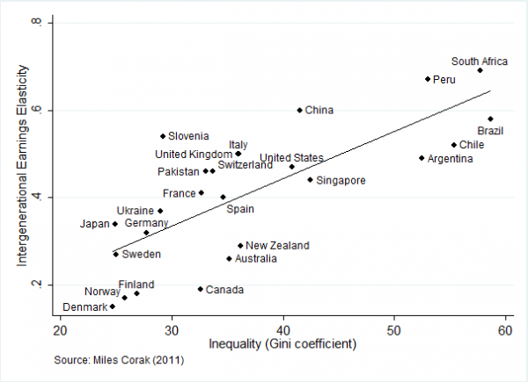
Inequality and social mobility

Slide 24
Technological change
Skills biased technological change benefits skilled workers
This effect is sometimes confused with China entering the global economy (trade effects)
Most analysis suggests that the former has had a greater effect on wage differentials than the latter
Other economists argue that skills biased technological change in combination with more open capital markets have had the effect of boosting skilled workers’ salaries and raised returns to those with investable cash
Technological change introduces some wage inequality since not all firms acquire technology at the same time
Technological change is good for growth
When labour markets are flexible, the wage inequality introduced by technology dissipates quickly

Slide 25
Division between labour and capital
GDP can be split between gross operating surplus (returns to capital), remuneration (returns to labour) and taxes on production
Rodrigeuz and Pineda, 1999
  Generally, commodity exporters have higher GOS than non-commodity exporters
  Generally countries with higher GOS spend less on human capital formation
  Generally countries with higher GOS grow more slowly (which is counter intuitive since we would think that higher profits lead to higher investment)

Slide 26
A thought experiment
Take a standard capital accumulation model with depreciation of capital
Growth is a function of growth in the stock of capital, ala Cobb Douglas
Now take only human capital
The stock of human capital is a function of schooling years plus years of work experience less depreciation at a fixed rate
If a person is employed, then they accumulate human capital (one year of work experience is greater than depreciation of the capital)
If the person is unemployed, then the capital depreciates quickly
This model explains the South African labour market
  While there has been an increase in years of schooling, no impact on growth
  This is because too many people take too long to find work
Getting people into work will be better for growth than only investing in better education

Slide 27
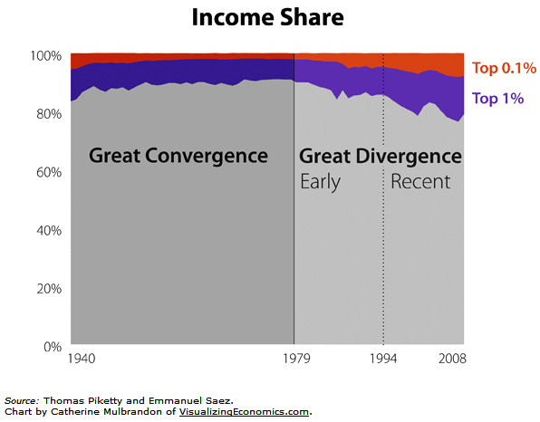
It wasn’t always like this (US data)

Slide 28
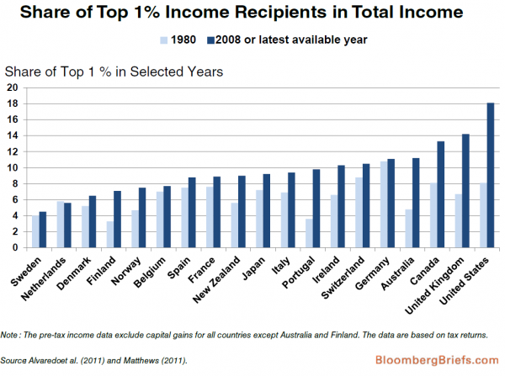
It wasn’t always like this

Slide 29
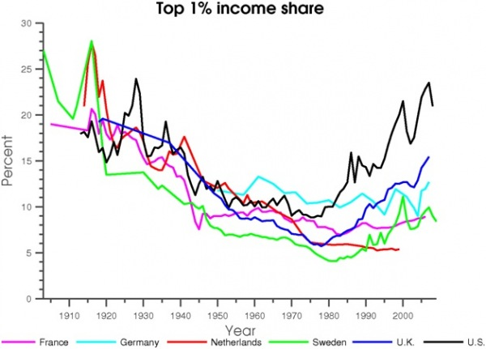
In fact, the last 30 years is an anomaly

Slide 30
Turning to South Africa

Slide 31

Economic Gordian Knot
Low investment, low growth, low employment and high inequality
Uncompetitive product markets
Uncompetitive labour markets
Low savings
Poor skills profile

Slide 32

Economic Gordian Knot
Product markets are uncompetitive due to history of isolation and siege mentality of the apartheid economy.
  This leads to high profit margins but low investment and innovation. It also stifles new firm entry.
Uncompetitive labour markets keep new entrants out, with workers and capital sharing in the high profits.
  This leads to low employment and skews the economy towards skills intensive, high productivity sectors.
Low savings mean that we are reliant on foreign capital inflows, which reinforce the oligopolistic nature of the economy.
  Capital chases high returns and also leads to high dividend outflows.
Low skills profile and pattern of growth pushes up skills premiums, leading to labour market mismatch and high wage inequality.

Slide 33

What to do about it is not obvious
If we liberalise labour markets, we may well get even higher profits but no increase in investment or employment
Liberalising product markets is hard and if we did, we may get lower profits and even lower savings (investment)
Fixing the skills system is difficult and long term
Raising savings too quickly will lead to lower consumption and a fall in employment and growth in the short term
Growing exports may reduce reliance on foreign capital inflows but it may also just accelerate them, leading to overheating

Slide 34
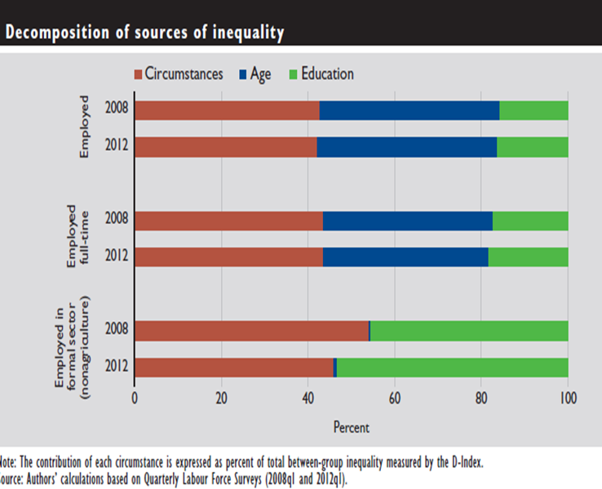
Sources of inequality in SA

Slide 35

What can be done
Difficult trade-offs
  Redistribution may have negative short run effects on growth
Progressive taxation a necessity
  The more unequal a country is, the more steeply progressive its income tax system should be
High expenditure on quality education
Redistribution of assets
  Land, housing etc
Get young people into work (faster)
Firm regulation of the financial sector and of monopoly industries
Social safety nets
Promote exports
Fiscal policy that contributes towards national savings

Slide 36

Policies that will not work
Fixing the exchange rate will not work because our uncompetitive product and labour markets will mean that prices will rise to render us uncompetitive, ala Greece
  We have too low a savings rate to intervene too heavily in the currency
Curbing capital inflows might be necessary under extreme circumstances, but has not worked in Brazil
Curbing capital outflows – we do curb capital outflows. To do more would quickly result in less capital inflows, leading to a balance of payments crisis
General tariff increases or export taxes to encourage beneficiation will raise the cost structure of the economy, appreciating the real exchange rate, ultimately reducing exports
Nationalisation will result in both capital outflows, which we cannot afford, and lower investment in the economy in general
Wholesale labour market liberalisation is likely to result in social instability that would outweigh any competitiveness or employment gain

Slide 37
Conclusion
There are strong theoretical and empirical reasons to believe that inequality is not good for growth
South Africa’s low growth trap is at least in part caused by high levels of inequality, leading to
  Excessive consumption, and less fixed investment
  Insufficient investment in human capital
  Declining social mobility
  Weakening of institutions
  Potential for instability
It will be in everyone’s interest, including the rich, if there was less inequality
Today’s economists think that inequality is a given product of growth
  This is not true. With 400 years of capitalism, rising inequality is actually an anomaly, and I would argue at great cost to society.
Redistribution is necessary to support growth, especially in South Africa
One should be cautious because
  Redistribution may have negative effects in the short term
  If human capital is more important, then the redistribution of income or assets may not make much difference

Slide 38
Thanks

