Slide 1

The Free Economy and some implications for Economic Theory
27 March 2014

Slide 2
Law of Accelerating Returns
Technology change is exponential,
contrary to the common sense linear view
Information technologies (of all kinds)
double their power (price, capacity, bandwidth) every year
Accelerating returns will drive economic growth through powerful deflation

Slide 3
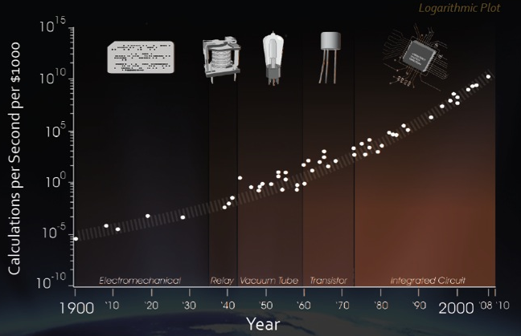
Moore’s Law is only one example
Exponential Growth of Computing for 110 Years
Moore’s Law was the fifth, not the first, paradigm to bring exponential growth in computing

Slide 4
Moore’s Law
A unit of computer processing power halves in price every 2 years
Add to that bandwidth and storage
The cost of information at every level incurs deflation at 50% pa
Whatever it costs to play a video today, will cost halve as much in a year

Slide 5

Take 30 linear steps:
1, 2, 3, 4, 5, 6 … 30
Take 30 exponential steps:
1, 2, 4, 8, 16, 32, 64 …
1,073,741,824 meters =
>26 X around the Earth

Slide 6

The Exponential Growth of Data
5 Exabytes = 5 Billion Gigabytes
From the start of time ⟶ ∼ 2003
In 2010 ∼ 2 days
In 2013 ∼ 10 minutes
Source: Eric Schmidt, Abu Dhabi Media Summit, 2010

Slide 7
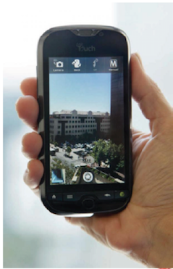

Why information growth is exponential
Zero friction to move/copy
Zero marginal cost
Apply computation
Data correlations
Machine learning
Modelling
Simulations
100% democratisation of
effort/innovation

Slide 8
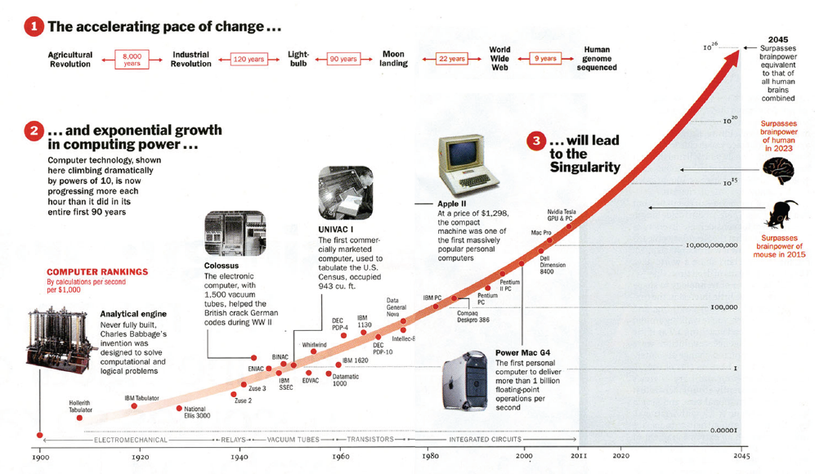
The accelerating pace of change

Slide 9
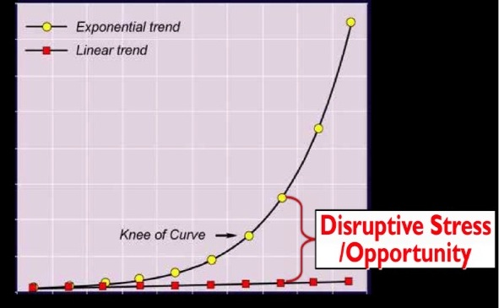
Artificial Intelligence (AI), Robotics, 3D Printing, Synthetic Biology, Media Tech, Nanotechnology Computers, Networks & Sensors

Slide 10
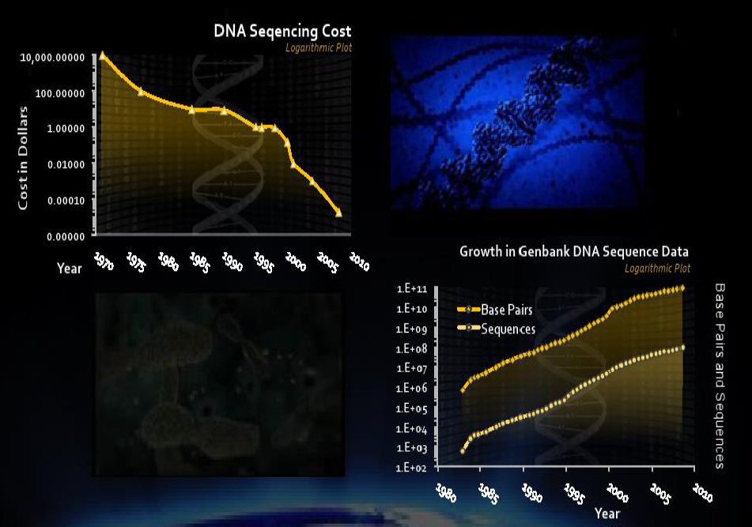

Slide 11

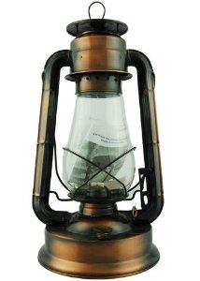

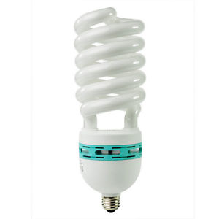
How long does it take to earn an hour of reading light?
Labour cost of 1,200 lumen hrs at average US wage
Tallow Candle 1800 – 6 hrs
Kerosene lamp 1880 – 15 mins
Incandescent bulb
1950 – 8 secs
CF bulb
1997 – ½ sec

Slide 12
Ideas Reduce Resource Use

Slide 13
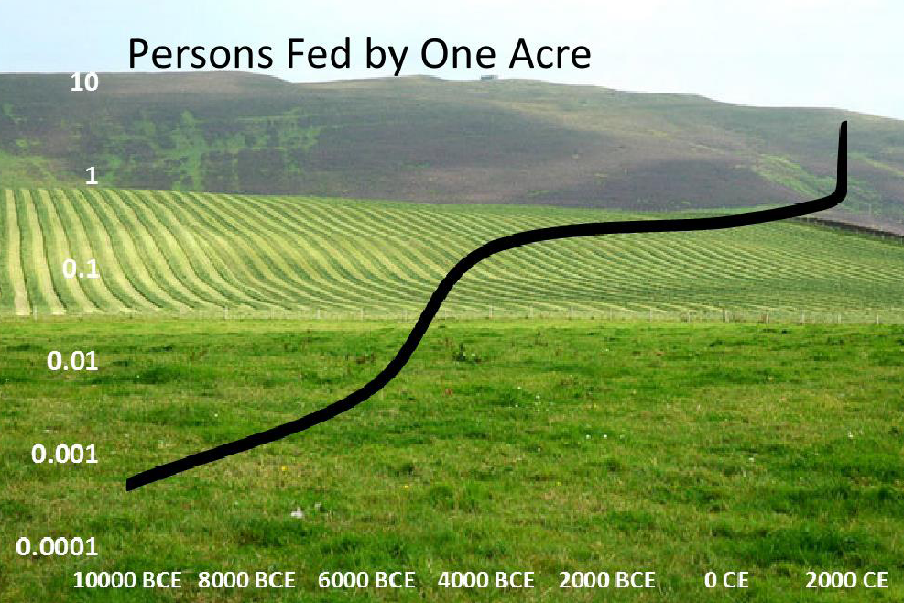

Slide 14
Technology is a
Resource Liberating Force
Converting
Scarcity ⟶ Abundance

Slide 15

Explosions of Mobile phones ⟶ Freedom
“Transforming ordinary citizens disenchanted by their governments into resistance fighters”

Slide 16
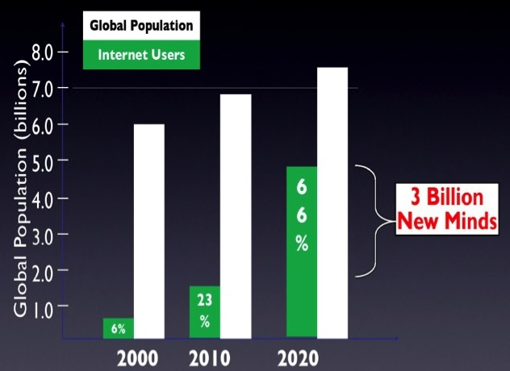
Force: Rising Billion

Slide 17
Artificial Intelligence
Augments
Human Intelligence

Slide 18
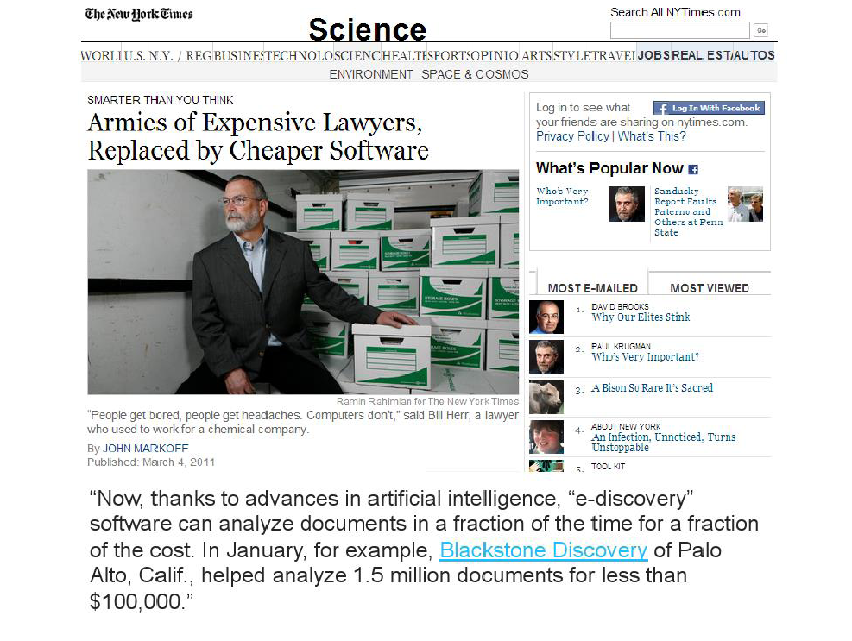

Slide 19
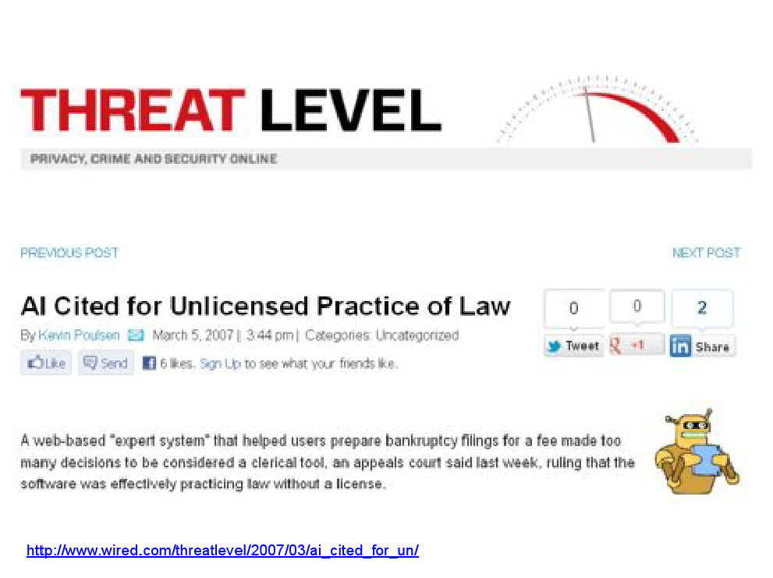

Slide 20
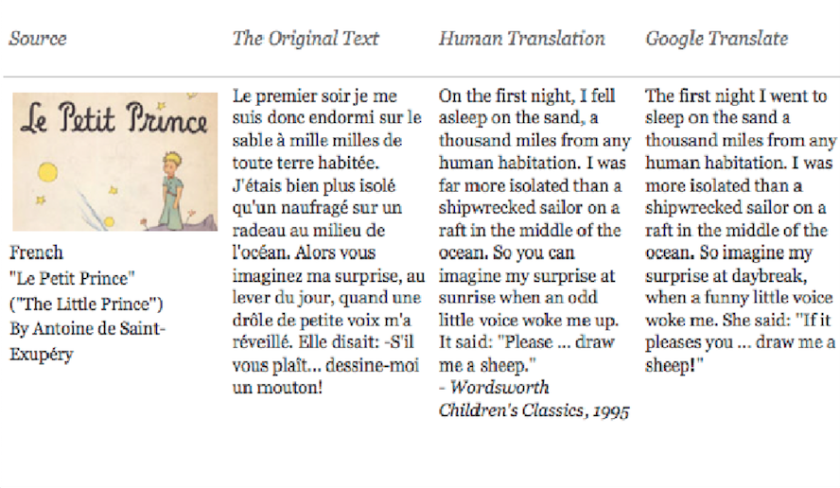
Complex Communication

Slide 21
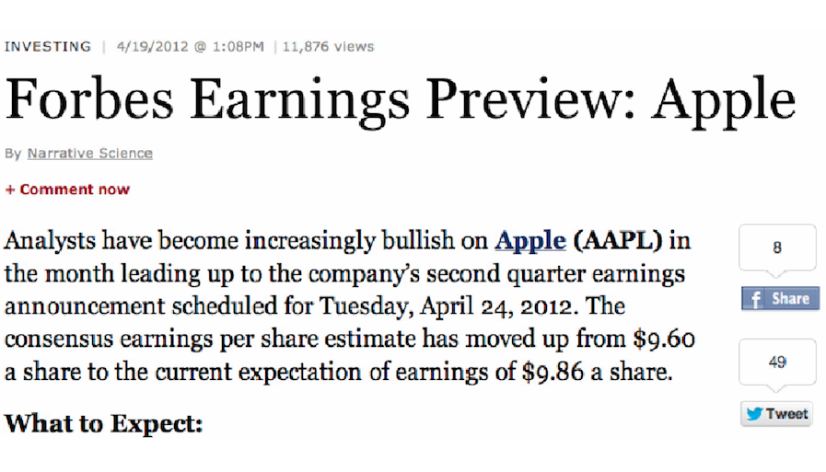
Complex Communication

Slide 22
The Digital Age
Information: Zero

Slide 23
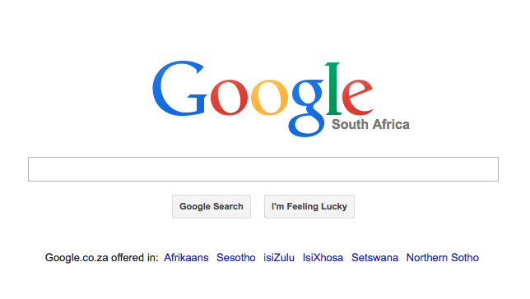

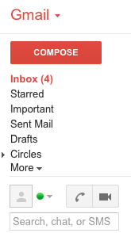





Slide 24
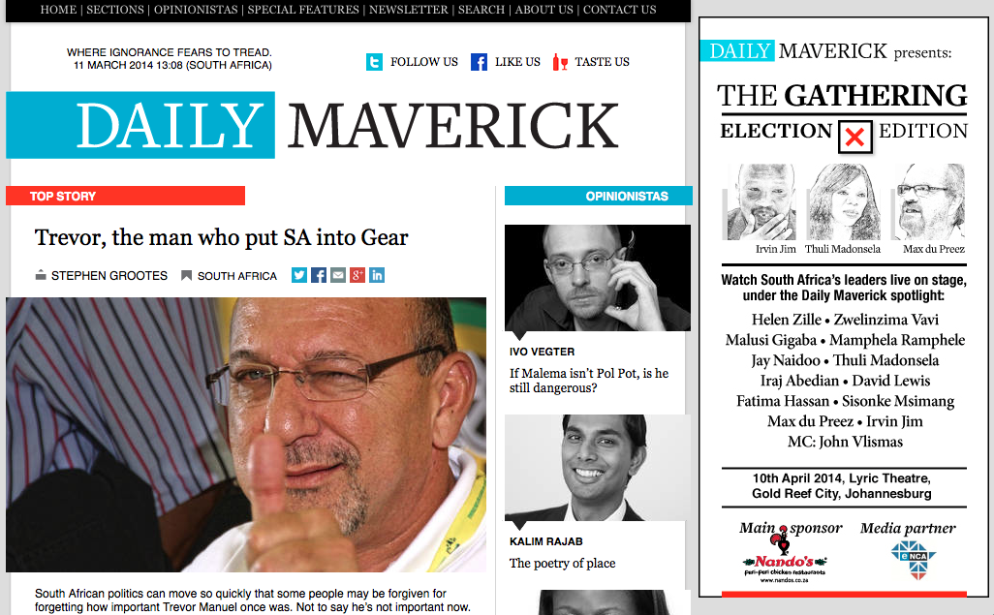
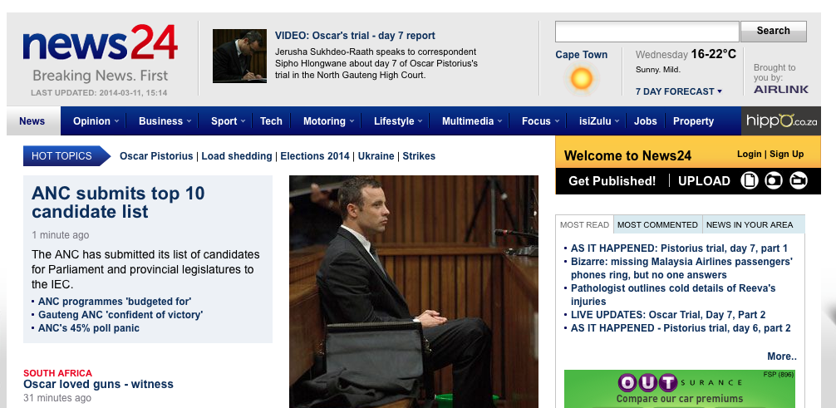

Slide 25









Slide 26
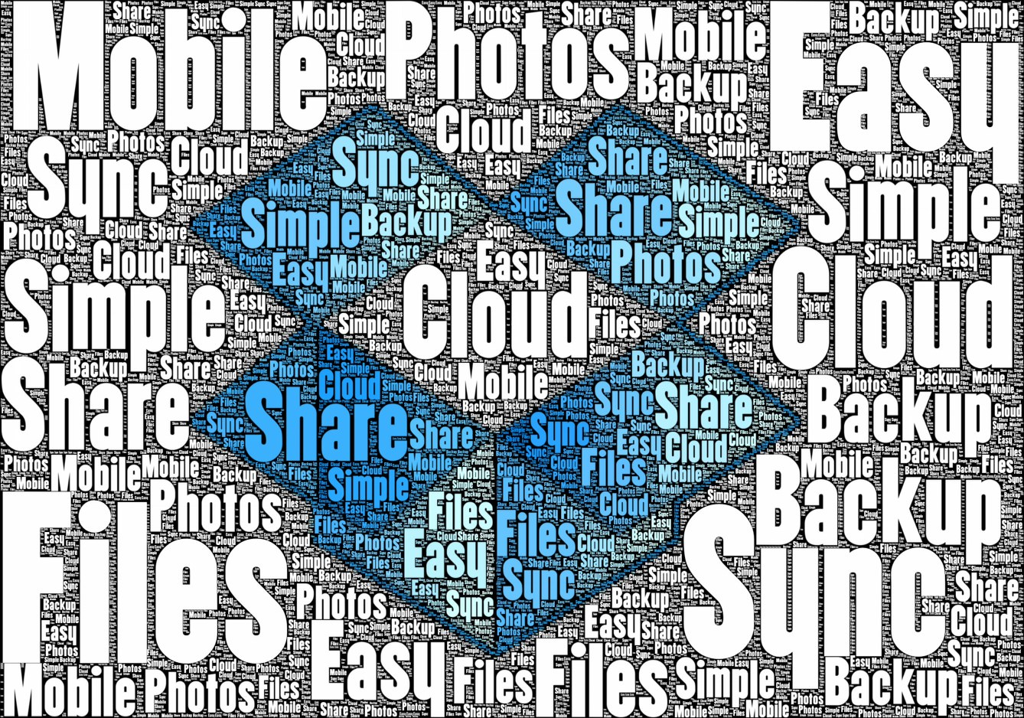

Slide 27


Slide 28
The wide availability of
free services
changes consumer behaviour

Slide 29


Rational cost-benefit analysis
Choose between a Lindt and Cadbury chocolate:
⟶ R15 ⟶ 50 Satisfaction points
⟶ 15 Dissatisfaction points
35 Satisfaction points
⟶ R1 ⟶ 5 Satisfaction points
⟶ 1 Dissatisfaction points
4 Satisfaction points
Dan Ariely, Predictably Irrational, 2008

Slide 30
Consider RELATIVE rather than ABSOLUTE value:
which has the larger net benefit?
Relatively, Lindt leads by 31 satisfaction points
Logically, Lindt is the better choice:
73% surveyed chose Lindt
What happens if you reduce the cost of both by the same amount?

Slide 31
Reduce both by R1:
Satisfaction remains the same but dissatisfaction is lowered
Both are discounted by the same amount, the relative difference doesn’t change
Lindt still leads by the same amount
69% surveyed chose Cadbury (up from 27%)
R0
FREE
R14

Slide 32


Slide 33
Transactions have an Upside & Downside FREE implies:
  No loss
  No risk
  No downside
We will give up the better deal for something that is not what we wanted cause of FREE
We buy something we don’t want or need if it includes FREE

Slide 34

Want to attract more customers?
Make something FREE
Want to sell more products?
Include FREE

Slide 35
Lessons from the Zero-price effect applied to social policy
If health is a concern, use early detection to eliminate progression of illness
If you want people to monitor their health, make testing free (HIV, cholesterol, blood sugar, mammogram)
Environment – electric cars registration fees
Education – free textbooks online

Slide 36
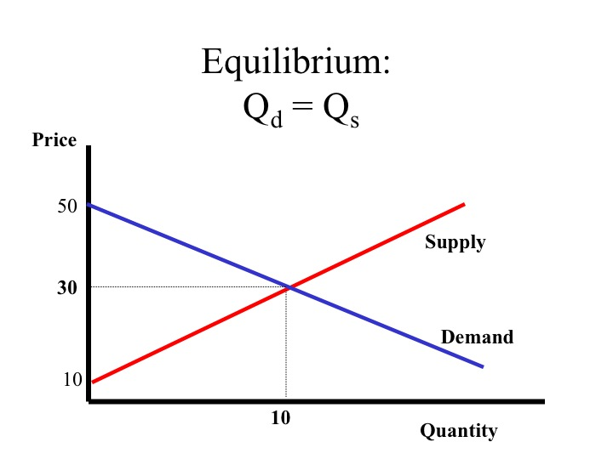
Mainstream Economics
Classic economics is built on strong assumptions: Rationale of buyers & sellers, the invisible hand, market efficiency ...

Slide 37
Individuals are not always rational optimisers
Factor in competitive behaviour - unlikely the economy settles into equilibrium
Example: certain luxury goods do not follow the laws of supply & demand - as the price rises, demand increases.
Small actions ≠ small effects
Reality is much more complex than a consistent formula
Notes:
Neoclassical models are built on the assumptions that individuals make their own decisions based on self-interest, that they seek to maximise their welfare and that the result is a stable system of equilibrium
Consumers are also driven by competitive behaviour – competitive people display their social status with luxury or veblen goods.

Slide 38
Economics needs FREE thinking

Slide 39
The Freeconomic Model
FREE ⟶ new economic model driven by technologies of the digital age
Marginal cost of goods and services close to zero
Demand is unconstrained by Price
Abundance of products & services FREE online

Slide 40
Every abundance creates a new scarcity
Wealth of information ⟶ scarcity of time
What consumers choose to consume with little time ⟶ Non monetary economies
Rise of new markets in the digital age:
  Reputation markets: Google’s pagerank algorithm, Twitter followers, Facebook friends
  Attention markets: Site traffic
  Quantify? Ad revenue
  Time is money
Network of closed online economies with disruptive technologies as the central bankers
Notes:
Every abundance creates a new scarcity – Economist Herbert Simon 1971
Normally our scarcity of money makes us choose from the products available to us, we buy what we can afford. But in the digital age, so much is offered for free online.
Free has given rise to Nonmonetary economies
Pagerank – incoming links counts as votes when consumers select to consume that information, and when linked from another site, it’s like saying, leave my site and read this on another site – giving that site reputation.
Reputation: where you choose to spend time consuming info
Attention: how long you spend there
Quantification of reputation and attention is a global endeavour – however people turn that into money.

Slide 41
Agriculture
Technology
Transport
GDP
Products
Output
Quality of Life
Export
Finance
Services
Manufacturing
Trade
Entertainment
Real
Construction
Investment
Growth
Gross Domestic Product
World
Time
Products
Outlook
Jobs
Work
Mining

Slide 42
When you download a free product or service, has a transaction taken place?
How do you measure that value?
GDP underestimates the progress of technologies
What we Spend ≠ What we get
Need to expand how we measure GDP

Slide 43

Data scientists are using Twitter to measure the population’s emotional health or national mood
The ‘Hedonometer’ looks at 50 million tweets per day. The more positive words, the higher the score.
Traditional benchmarks alone are inadequate measures of social progress
Notes:
Napa is America’s happiest town (in the heart of the winelands)

Slide 44

CPI
  Basket Lag: The basket of goods is only revised every 10 years whereas tech change is exponential
  New tech products not included in Index
  Tech products and services available free online
  Tech increases quality & usefulness of products

Slide 45

  The price of a product may increase, but time taken to produce the product halves every year
  Consumer substitution: If prices increase, consumers look for cheaper substitutes, enabled by technology. When the price of fuel goes up, you buy an electric car or take public transport.
  Inflation is overstated

Slide 46
Hypotheses
Technology is giving rise to new economic models
Economics needs new theories that try to incorporate FREE
GDP understated
Inflation: lower than we think
Implied: Real interest rates are higher than we think
Interest rates can remain lower for much longer

