Slide 1
Monetary Policy In South Africa Some Unanswered Questions
Rashad Cassim
Economic Research and Statistics
Stellenbosch University
27/02/2017

Slide 2
Objectives of Presentation
To share with you some of the analytical and empirical difficulties we experience in making sense of the current conjuncture
For practical reasons, presentation limited to a few themes
Assess what future work is needed to come to grips with some of the issues identified

Slide 3
Theory of Inflation Targeting (IT)
Inflation Target –not a theory but a way of communicating
But is our nominal anchor and therefor guides the theoretical framework on which decisions are made
Theoretical fabric of IT hangs on a few constructs
  Loss functions
  Output gaps
  Taylor rule type intuition
  Phillips Curve
  Focus on real interest rates rather than nominal
  Flexible inflation targeting and the transitional nature of supply side shocks
  Forward looking inflation expectations?

Slide 4
From Theory to Practice
Economic Fluctuations – business cycles in the context of structural decline – major challenge since the onset of the financial crisis- output gaps
Drivers of inflation – exchange rate, unit labour costs, supply shocks
Specific attention to the exchange rate and monetary policy
How do we deal with Supply shocks and second round effects
Is there a need to Revisit the : Monetary Transmission, Credit and Housing
Changing role of price formation in the economy
Making sense of inflation expectations

Slide 5
Importance of Credibility and Transparency
Credibility and communication central to IT framework
Should Central Banks reveal its objective function? (Mishkin, 2004)
Should central banks be precise about loss functions (Cukierman, 2004)
In other words, provide co-efficients on how much emphasis we give to output stabilisation vs inflation
What analytical thinking underlies flexible inflation targeting ?
How transparent and successful is the SARB in demonstrating the underlying analytical apparatus?

Slide 6
Instruments of monetary policy
Market Reactions to interest rate changes – asset prices, exchange rates, term structure
IS curve- how will real aggregate demand react
Okun’s law – how will unemployment rate to react to changes in real GDP
Phillips Curve – how will react to changes in unemployment
See Blinder A- What Central Banks Could Learn from Academics – Vice Versa, JEP, 1997, Vol 11, 2, p 7

Slide 7
Current Conventional Wisdom
There is no permanent trade-off between inflation and unemployment
High and unstable inflation hurts growth
Price stability consistent with growth (low and stable inflation)
Further efficiency gains if the commitment to price stability is credible
There is a trade off between variances of inflation and unemployment
See - Arminio Fraga A Journey from Theory to Practice. ECB colloquium, March 2006

Slide 8
South Africa’s Potential Growth
Major challenge for monetary policy makers – distinguishing between trend and cycle
Has become increasingly murky specifically since the beginning of the financial crisis
Determination of potential growth and output gap, one instrument used to gauge where we are in the cycle
Growing uncertainty in estimating output gaps

Slide 9
Recent Estimates of Potential Growth

Slide 10
The economy’s potential output since the Crisis
Source: South African Reserve Bank

Slide 11
The Evolution of our thinking on Output Gap
In the past few years, our output gap has been consistently revised downwards from just over 3% to just under 2%
Derived from an assumed reduction in our potential growth accompanied by low de-facto real growth
Revision in our methodology incorporating the impact of excessive borrowing and leverage in the economy (see Anvari et al SARB publications 2011)
Introduction of time varying output gap partly in response to a slow recovery from the recession
Downward revision implies that we have seen an erosion of supply capacity of the economy?
but also our overall assessment of a decline in the output gap of all our trading partners.

Slide 12
Potential Growth and The Output Gap
Quite Critical specifically in the context of growing emphasis on `growth momentum’ dependent of supply side reforms
Key challenge today -what role is there for monetary policy in the face of a negative output gap, low growth and an inflation problem in South Africa
Stimulate aggregate demand in periods of negative output gap despite the need for structural reform?
Double uncertainty –output gap measurement/link between gap and inflation ?
Has the output gap lost its explanatory power in explaining inflation

Slide 13
Measurement Uncertainty
Why did we revise potential output down ? ( see paper on SARB website)
How much of the revision can be explained by a revised methodology?
How much can be explained by a recognition that supply capacity has been eroded?
How do we know that supply capacity has been eroded?

Slide 14
Complementary Indicators to Output Gap
Capacity utilization
to what extent can we rely on unemployment as an indicator of slack in the economy?
An important complement to assessing our output gap, is the unemployment gap.
In other words, the deviation of the actual unemployment rate from the long-run natural unemployment rate.
This forms an important part of the monetary policy decision-making of many countries that have frequent and credible labour market statistics.

Slide 15
What is South Africa’s natural rate of unemployment?
How much sense do we make of the year-to-year or our seasonally-adjusted quarter-to-quarter change in the unemployment rate
do the magnitudes makes sense, or should we believe purely in the direction of change because there is too much instability in the survey?
Do we even have confidence about the direction of change at least in the short-run?

Slide 16
Nominal to Real to Real Equilibrium interest rates
Nominal interest rates are directly observable and is the most direct instrument of monetary policy
However, they limited in assessing the de facto monetary policy stance, for obvious reasons ( they have to be looked at in conjunction with the inflation rate).
The neutral real interest rate refers to the real interest rate that would prevail if the economy were at maximum employment and inflation were at target.
Household and savings decisions made on the basis of real interest rates

Slide 17
Real Rate?

Slide 18
Estimates of Equilibrium Real Interest Rates
Wide variety of estimates in many countries
The Laubach and Williams (2003) approach is designed specifically to estimate a time-varying natural interest
Wide disagreements in the US of what the neutral is ranging from negative to low positive
Not much work done on estimates in SA
Some internal work done at the SARB but work in progress
Laubach, Thomas, and John Williams,.Measuring the Natural Rate of Interest,.Review of Economics and Statistics , Vol. 85(4), 1063-1070, 2003.

Slide 19
Are Equilibrium Real Interest Rates Useful?
The SARB currently does not publicly release a neutral interest rate estimate?
In theory such an estimate would provide some guidance as how whether monetary policy is expansionary or contractionary ?
Some of the literature raises caution on the usefulness of this measure ( Taylor and Williams, 2010, Blinder 1999 )
more usefully thought of as a concept rather than a number, as a way of thinking about monetary rather than as the basis for a mechanical rule.
Think about deviations from inflation and output as the basis for the conduct of monetary policy

Slide 20
Drivers of Inflation in South Africa
Demand side inflation where monetary policy works best specifically through the interest rate channel a rare phenomenon nowadays
Supply side shocks and second round effects preoccupation of monetary policy makers
What is a supply shock is not straight forward
Are oil price increases a supply shock or a response to real economic growth or increase demand?
Droughts, floods
Is the exchange rate a supply shock?
Structural inflation and unit labour costs

Slide 21
Exchange Rate
Exchange Rate behaviour and what it means for exports or the real economy (role of foreign exchange intervention)
Exchange Rate Pass through-relatively well developed literature but quite tricky from a practical point of view
Exchange Rate rules in monetary policy – the most difficult of the three- how do we factor exchange rates in our decision making? – (will discuss in the context of monetary spillovers)

Slide 22
Exchange Rate Pass Through
A view that pass through has come down over the last two decades (long run pass through = 20%)
Not precisely clear why pass through has come down?
Some obvious reasons
  Negative output gaps
  Ability
  Reduction in international producer prices
  Some credibility of the SARB ( needs to be empirically tested)
  Markups in firms still high allowing absorption of costs from imports
  Expectations

Slide 23
The Exchange Rate Challenge?
Modelling the trajectory of the exchange rate is quite important to our assessment of the balance of risks.
Current Status Quo -assume a flat real effective exchange rate?
In general has a downward bias – always assume that there will be a nominal depreciation
Effects of exchange rate pass through depends on the nature of the shock
Eg – portfolio balance effect totally different from a shock emanating from terms of trade?

Slide 24
Second Round Effects : Eg. Oil prices
1) the direct effect - rise in prices of energy products;
2) the indirect effect- pass-through of higher energy related costs of production to prices of other goods and services such as freight and transportation
3) the second-round effect - increase in the costs of living workers to bargain for a wage increases (more long lasting but depends on demand conditions)

Slide 25
Analytical tools to Measure Second Round Effects (SRE)?
Differing views as to how second round effects works through the economy often contributes to differences in views about interest rate decisions.
How do we actually, or empirically, detect second effects ?
Ex-post or ex-ante review of prices ?
Do we make decisions on what we anticipate the second round effects are likely to be from a shock ?
What other factors play a role in responding to a supply shock – for example if wages continue to rise or contract at the same time?

Slide 26
Operationalizing second round effects
Is evidence of the indirect effect a sufficient basis to act upon?
For a start we look at underlying inflation (core) and what it means?
However, core inflation is a mixed bag
Current practice in our forecast is to build in some indirect effects based on past behavior through the expectations channel
Problems is that it assumes that past relationships are intact and replicable in the future
Difficulty of lags in the transmission mechanism

Slide 27
Responding to Second Round Effects
Conjectural assessment of
wage behaviour and price stickiness
the specificity of the commodity crisis( accepted view as to when food will mean revert),
our assessment of how credible we are – in other words whether agents are comfortable that if the supply shock continues to persist, we will react an now allow it to derail inflation even if at a cost to growth
Change vs level of the output gap?

Slide 28
Monetary Policy and the Labour Market
Two different set of issues here
the first, the practice of monetary policy in a market where price and wage setting is rigid -an important area of study – see Viegi et al for a discussion of how the structure of the labour market in SA constrains the labour market
http://www.up.ac.za/media/shared/61/WP/wp_2015_69.zp69385.pdf
The second is how do we asses the impact of wages and unit labour costs on inflation?

Slide 29
Labour Costs and Structural Inflation in South Africa
Importance of wage pressures to inflation in SA well known
Sources of wage pressures? What it means for policy?
The difficulty of squaring up some key indicators that the MPC uses?
Getting a sense of pass through co-efficient of wage to inflation as important as exchange rate pass through as it could be wide spread?
What is the best indicator ? – mean vs median wages?
Usual data problems poses major challenges? Aggregation bias

Slide 30
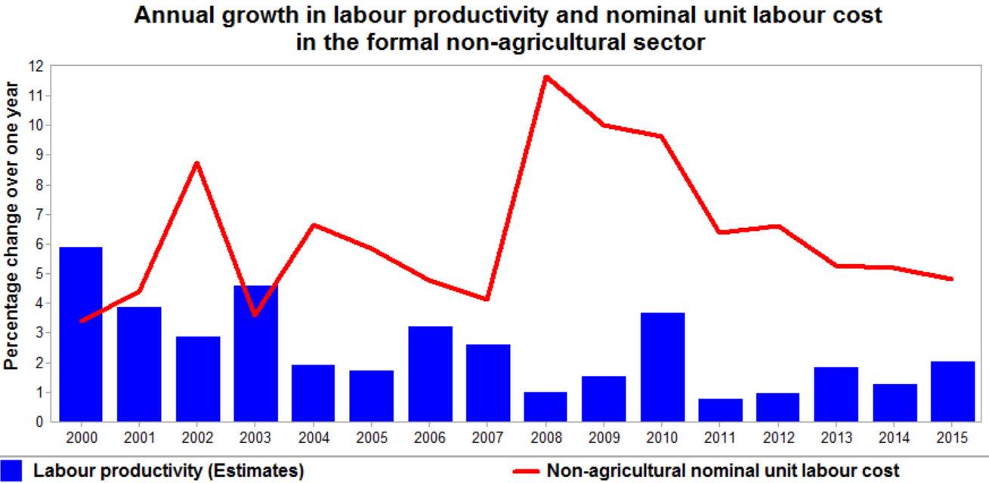

Slide 31
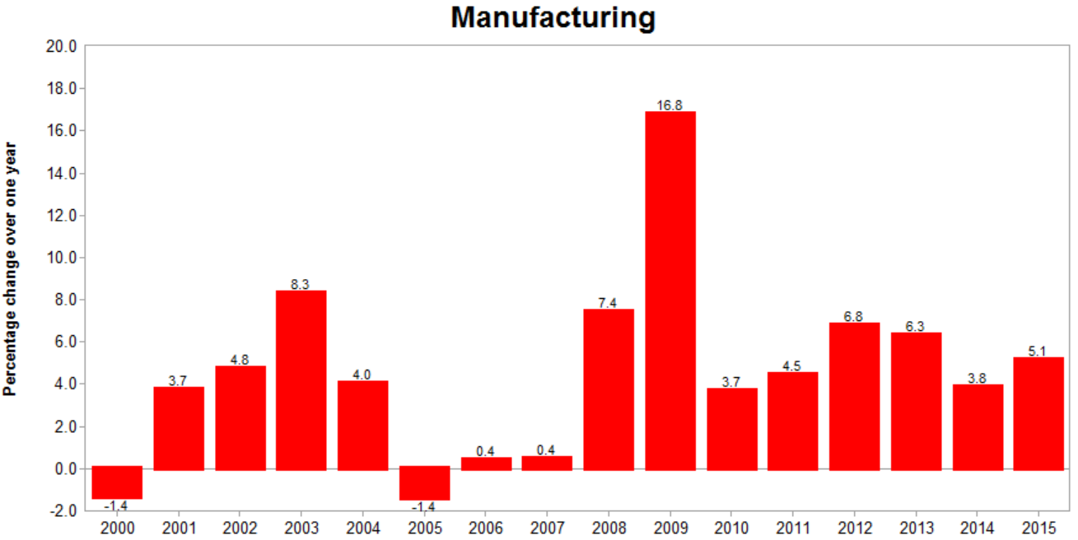
Nominal unit labour cost

Slide 32
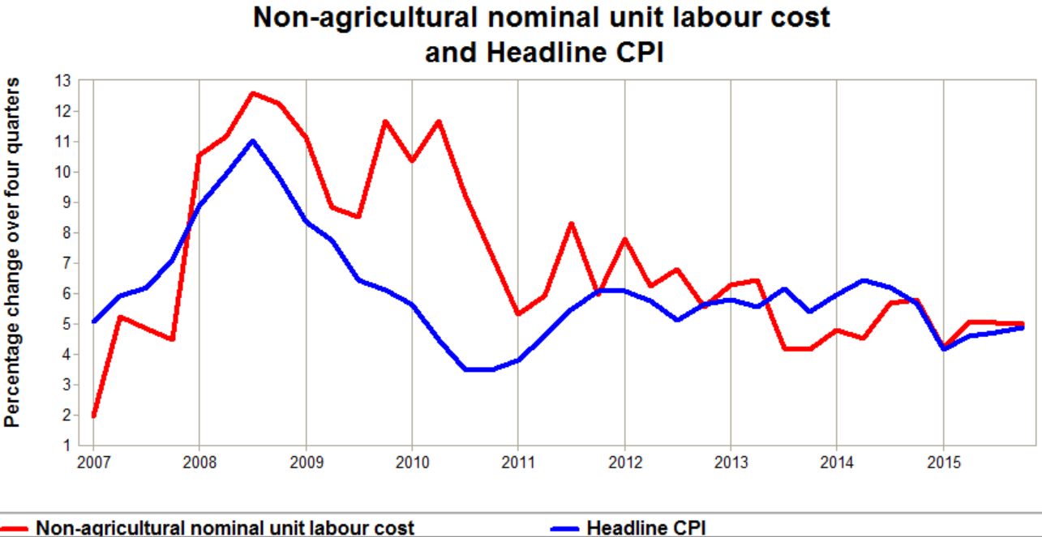

Slide 33
Inflation Expectations
Why are inflation expectations generally anchored at the top end of the target?
What does a breakdown of the BER inflation expectations tell us about expectations formation in South Africa? Are there flaws in the survey that we have to take cognisance of in our assessment of expectations?
What should we interpret the relationship between one year, two years of five year expectations?
How do we reconcile, the survey of inflation expectations with market based signals such as breakeven rates, for example?
How do we reconcile – backward looking expectations with the Lucas Critique

Slide 34
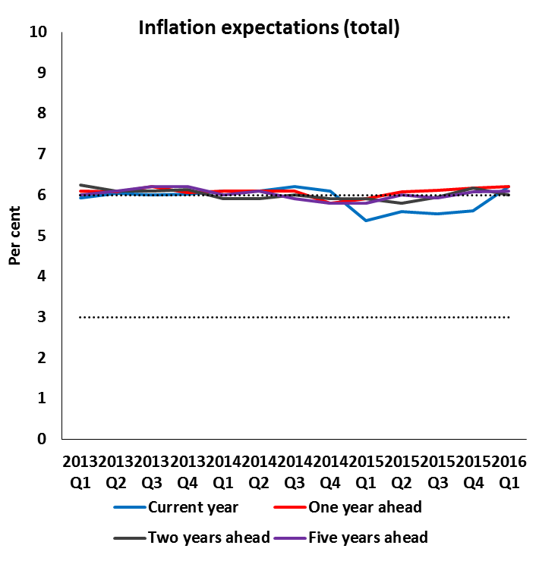
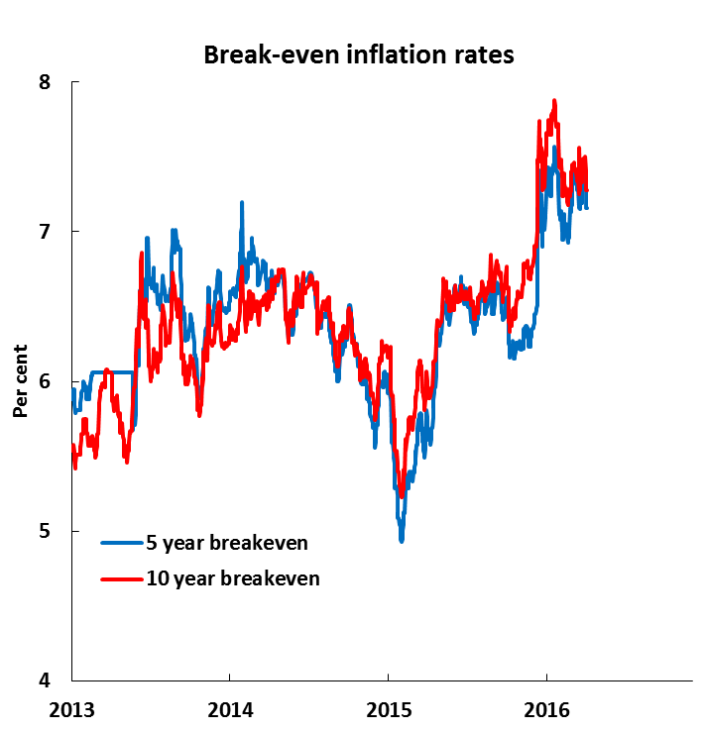
Inflation expectations are elevated
Sources: Bureau for Economic Research and Bloomberg
Notes:
Break even definition?

Slide 35
Expectations

Slide 36
Practical Issues: Inflation Expectations
Key tool to assess second round effects
Backward and forward looking expectation - our trajectory is based on a composite of permanent and transient – how we separate the two we don’t really know.
Is there a meaningful improvement and change in inflation expectations? It is important to look at second order movements in inflation expectations – is it increasing or decreasing?
Also look at standard deviations…of inflation expectations – if expectations go up but you have a lower standard deviation – it may have a different meaning?

Slide 37
Characteristics of Anchored Expectations
Short-term inﬂation expectations should vary with the business cycle and shocks to the economy
Longer term inﬂation expectations ( 2 to 5 years) anchored if the variations in short-term expectations do not affect their level signiﬁcantly.
Surprise economic news should have little impact on long-term inﬂation expectations,
Assumes agents believe that the underlying monetary regime’s commitment to price stability remains stable.

Slide 38
Research Considerations
What will it take to anchor inflation expectations below the top end of the target?
Why should we bother in the first place?
How important is speed and timing?
Sacrifice ratio?

Slide 39
Pressure on the Monetary Transmission Mechanism - Finance
changing nature of financial intermediation and credit extension to households which is along with investment to firms the most important channel of monetary policy
Empirical question- to what extent has proportion of fixed relative to floating exchange rates changed?
Increase in the relative cost of borrowing despite low interest rates

Slide 40
Pressure on the Monetary Transmission Mechanism
Reduced reliance on mortgages to finance consumption and growing reliance of more expensive borrowing to finance consumption
( evidence of growing gap between the repo and the normal rate)
Housing is the business cycle ( efforts at boosting housing)
These tend to be high – 20% and fixed?
Pressure on specific household balance sheets?
What is normal credit extension ?

Slide 41
Slow Credit Growth
Recently literature that defines housing as the critical factor in both triggering a recession as well as recovering from it
What should optimal credit growth be? ( see slide)
Rule of thumb- close to nominal GDP ?
Is the transmission mechanism under threat?

Slide 42
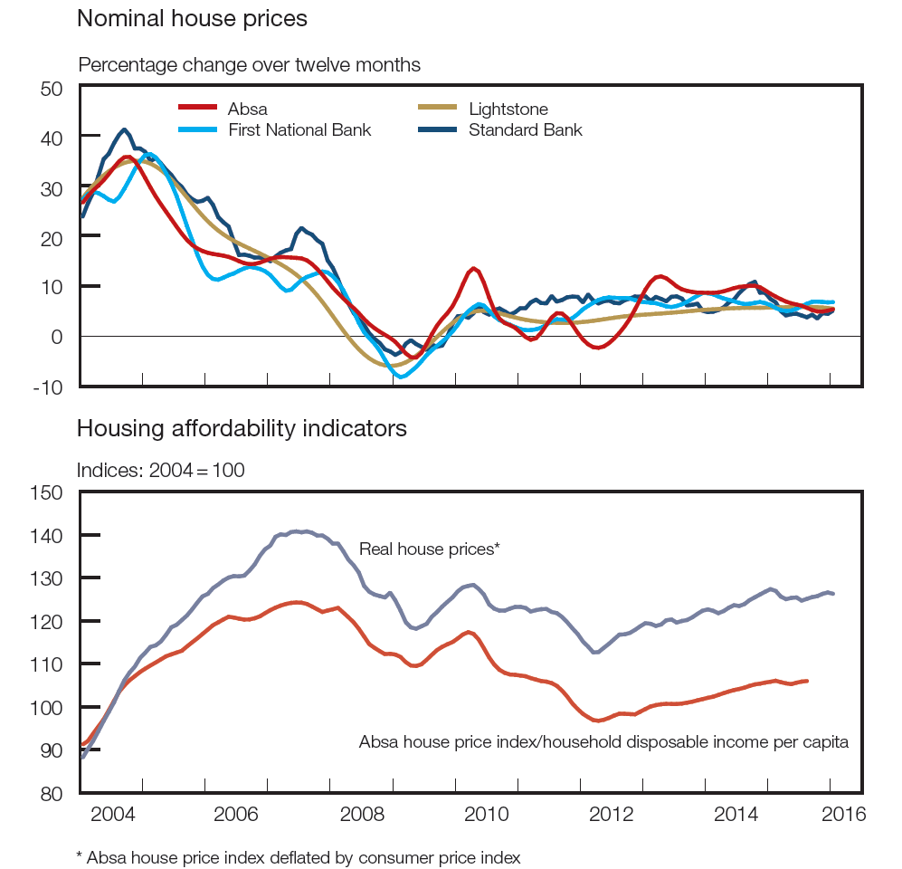

Slide 43
What is Optimum Growth in Mortgage Advances?

Slide 44
Monetary policy spillovers
In Search of a conceptual framework
What are these spillovers ?
How do we incorporate these into our policy reaction function?
several channels – trade, finance and capital flows ( exchange rate) and sentiment
Series of event studies on what impact it has had? ( see Brookings Institution)
Does monetary policy in South Africa need to pay more attention to spillovers in the past?
Key channel – the yield curve and the term structure of interest rates

Slide 45
Conceptual Issues: Spillovers
The implications of normalisation depend on how capital inflows were used in these specific countries.
If they contributed to asset-price booms and private-sector credit extension, financial stability considerations will feature more prominently as a risk.
dominant trend in most Latin American countries, and it is another area where South Africa has been an outlier.
Spill-overs has created renewed interest in how we think of the exchange rate in our monetary policy reaction function

Slide 46
Gaps: Monetary Policy and the Changing Structure of the SA Economy
Monetary policy effectiveness and the growing role of the services economy.
Do we understand services price formation
What does capacity utilization and output gap mean in the context of services ( manufacturing not a proxy for economy wide capacity)
Persistence of balance of payments deficit under negative output gaps ( miscalculate output gap, declining competitiveness of the economy, infrastructure related capital investment )

Slide 47
Further knowledge gaps?
Theoretical/empirical framework to delineate structural vs cyclical factors based on the behaviour of South Africa’s economy over various business cycles
Monetary policy and structural reform ?
Why has the Phillips curve become flatter?
Exchange rate under inflation targeting?
Monetary policy and the yield curve? Does it matter in South Africa
Financial Regulation ( Basel) and its impact on the monetary transmission mechanism

