Slide 1

The Economics of Tobacco Control Project:
How research can have policy impact
Seminar at the University of Stellenbosch
Corné van Walbeek
www.tobaccoecon.org
@Tobaccoecon

Slide 2
Why this presentation?
Some personal background
Does research have an impact on policy?
Macroeconomic research vs. microeconomic research
Some good fortune and good timing is required

Slide 3
Why is tobacco control important?
World-wide:
  More than 1.2 billion smokers
  About 6 million people worldwide die from tobacco-related diseases each year
  The burden of disease is increasingly shifting to low- and middle-income countries
South Africa:
  About 7 million smokers (20% adult prevalence in 2013) (SANHANES, 2013, NIDS, wave 3, 2013)
  In 2000 about 44 000 people died from tobacco related diseases (Groenewald et al. 2007)
  Tobacco use was the third most important risk factor for premature death (after unsafe sex and high blood pressure) (8.5% of total deaths)

Slide 4
The Framework Convention on Tobacco Control
Adopted by the World Health Assembly in 2003
Currently 180 countries are members of the FCTC, covering about 90% of the world’s population
Aims to reduce tobacco use through both demand and supply measures
Important tobacco control tools:
  Increase excise tax and price (Art. 6)
  Protection from exposure to tobacco smoke (“clean indoor air policies”) (Art. 8)
  Tobacco product regulation and disclosures (Art. 9 & 10)
  Packaging and labelling (Art. 11)
  Education, communication, training and public awareness (Art. 12)
  Banning tobacco advertising, promotion and sponsorship (Art. 13)
  Provide cessation services (Art. 14)
  Eliminate illicit trade (Art. 15)

Slide 5
Why do we focus on Africa?
Cigarette consumption over time in Africa
Source: Blecher and Ross (2013)

Slide 6
Why do we focus on Africa:
Forecasted proportion of smokers by region
Source: Blecher and Ross (2013)

Slide 7
History of tobacco control research at UCT
Mid- to late 1990s:
  Iraj Abedian launched the first Economics of Tobacco Control Project (within AFReC)
  Research provided strong economic support to anti-tobacco legislation of 1999
Early 2000s:
  Second phase of the Economics of Tobacco Control Project
  South Africa is a role model for other developing countries, especially for using excise tax increases as a tobacco control tool
  We also did some ad hoc evaluation the implementation of the 1999 Tobacco Products Control Amendment Act

Slide 8
South Africa as a role model

Slide 9
Some research lessons from the early work on tobacco control
Let the data speak
  Do not try to force a result where the data does not support it
The tobacco industry will certainly read the research
  They will attack it if it deserves to be attacked
Separate research from advocacy
  Stay objective
  Let the advocates use the research to push the public health agenda
  Build credibility
Build good relationships with strategic officials in government

Slide 10
The current Economics of Tobacco Control Project
2011-2012: American Cancer Society
  Institutionalise the “ad hoc” capacity at UCT School of Economics
  Develop a self-sustaining research unit
2012-2017: Gates Foundation/African Tobacco Control Consortium
  Scale up & out the project to increase the technical content knowledge of the economics of tobacco control in Africa
  Increase the profile of economic & tax issues in tobacco control in Africa within the broader economic community
  Train advocates to become literate in economic & tax issues to better facilitate advocacy efforts & policy development
  Create a program to train & develop researchers in the area

Slide 11
Two main project objectives
Scholarships to postgraduate students
Technical assistance and support on tobacco tax to countries or regional groupings

Slide 12
Some examples of postgraduate research
South Africa focused
  The prevalence of water-pipe smoking among tertiary students in the Western Cape (Lara Kruger)
  The determinants of smoking initiation in South Africa, using survival analysis (Nicole Vellios)
  A study on the causes of the real net-of-tax increases in cigarette prices in South Africa (Diana Nyabongo)
  Declining tobacco production in South Africa: Analyzing key drivers of change (Clarina Du Preez, University of Pretoria)
Focused on other African regions/countries
  The socioeconomics of tobacco use in the Southern African Customs Union (Linda Nyabonga)
  The impact of excise tax harmonization in the East African Community (Jodie Posen)
  Price and income elasticities of demand in Uganda (Grieve Chelwa)
  Assessing the causal impact of tobacco expenditure on households’ spending patterns in Zambia (Grieve Chelwa)

Slide 13
Project Objectives (2)
Technical assistance and support on tobacco tax
  Direct to Ministries of Finance/Ministries of Health
  World Bank
  World Health Organization
  Treaty Secretariat of the Framework Convention on Tobacco Control
  Campaign for Tobacco Free Kids (NGO)
  Framework Convention Alliance (NGO)

Slide 14
Some regions/countries we were involved with
Regional blocs
  East African Community
    Tax harmonization
  West African Economic and Monetary Union (WAEMU) and Economic Community of West African States (ECOWAS)
    Structural tax reform and tax harmonisation
Individual countries
  Kenya & Uganda
    Tax increases and tax structure reform
  Botswana
    Introducing a levy above the SACU excise tax
  Cameroon & Chad
    Tax situational analysis

Slide 15
An example: Jamaica
Goal:
  Evaluate historical tax increase and modelling potential tax increase (2005 and 2015)
Partners:
  Pan-American Health Organisation (PAHO), Jamaican Ministries of Health and Finance
Findings:
  Until 2008 the excise tax system was unnecessarily complex, which was exploited to the industry’s benefit
  Excise tax was a Special Consumption Tax (SCT), levied as a specific tax, but subject to additional ad valorem taxes in excess of a “base price”
  The “increase” in the excise tax gave an excuse for the industry to raise the retail price and its profits, through the fine print of the SCT
  The excise tax system was greatly simplified in 2008
  Since 2010 the nominal excise tax did not change, resulting is a decrease in the real excise tax and real government revenue

Slide 16
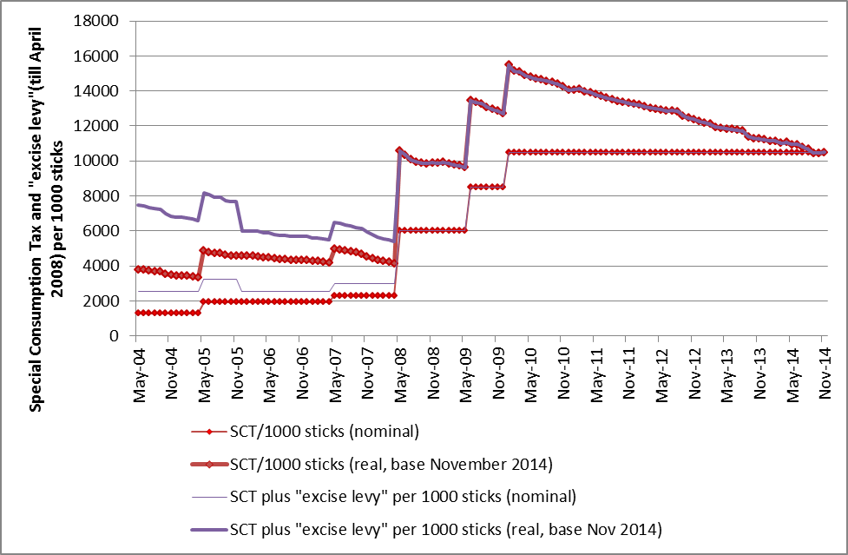
The nominal and real excise tax in Jamaica

Slide 17
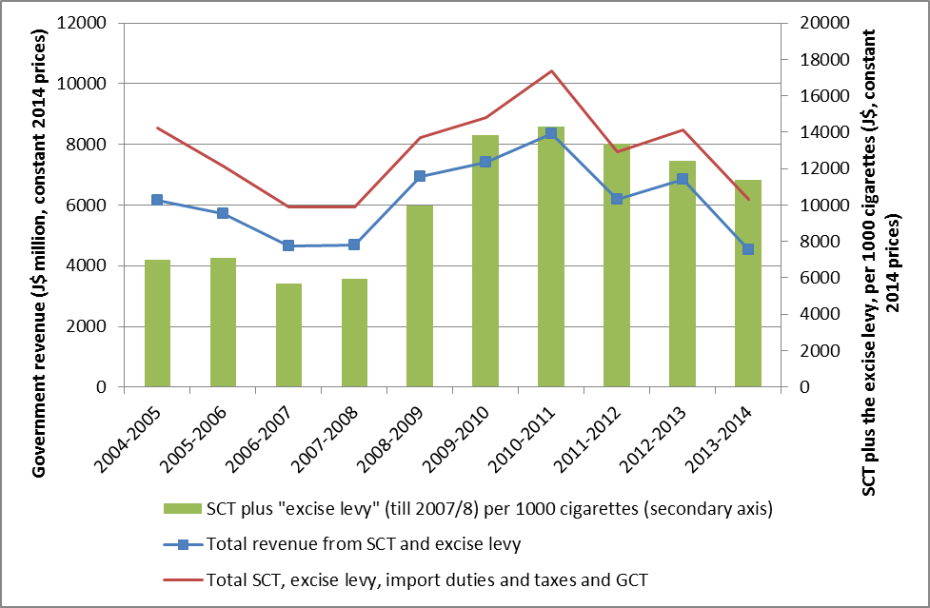
Excise tax revenues in Jamaica

Slide 18
Jamaica (continued)
Suggestions:
  Simpler tax structures are better
  Specific excise taxes are good but they have to be adjusted regularly to keep pace with inflation
Outcomes:
  Jamaican government raised the excise tax from J$ 210 to J$ 250 per pack in April 2015

Slide 19
Another example: Ghana
Goal:
  Model tax reforms and increases on tobacco and alcohol
Partners:
  World Bank, Ghanaian Ministry of Finance
Current tax structure:
  For cigarettes: ad valorem excise tax at 150% of CIF value
  For alcohol: ad valorem excise tax with tiers (based on local content)
Findings:
  For imported product the reported CIF value is very low
  Total tax burden on cigarettes and alcohol is well below comparative burdens, despite the fact that the tax sounds high
Suggestion:
  Replace ad valorem tax system with a specific tax system, adjusted in line with inflation
Outcome:
  Excise tax on cigarettes was increased to 175% of CIF value ☹

Slide 20
Main research focus areas of the ETC Project
Tobacco control (Africa and LMIC focus)
  Tax structures
  Tax levels
  The relationship between excise tax and price
  Illicit trade
  International coordination (blocs and economic integration)
Alcohol policy in South Africa

Slide 21
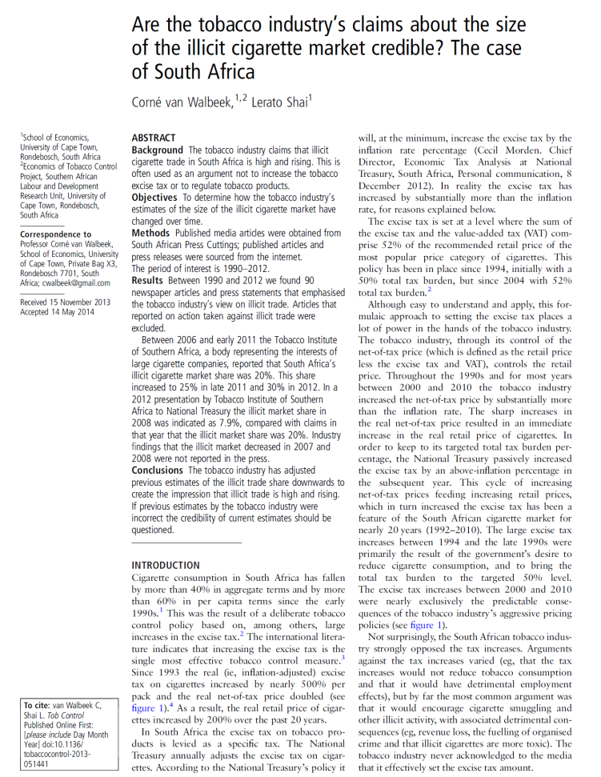
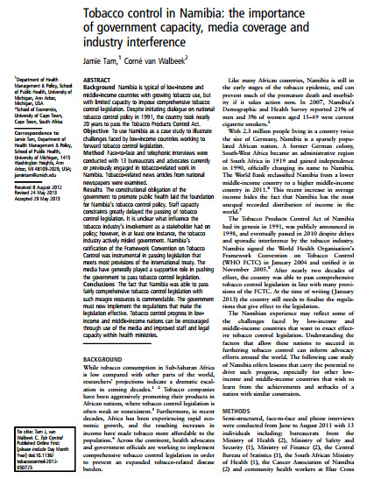
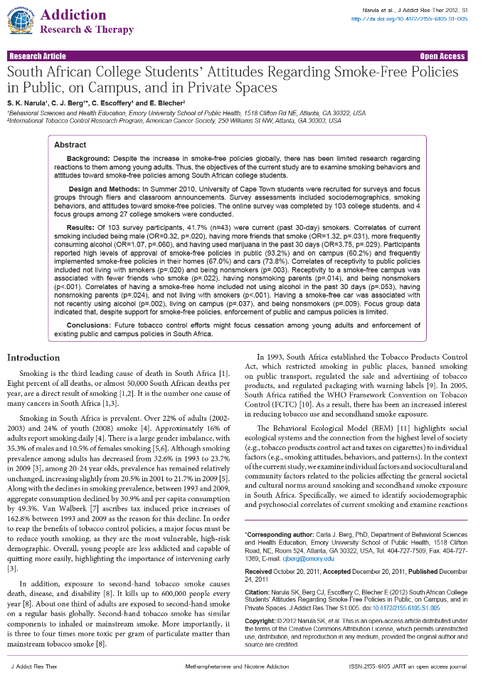
Research Highlights

Slide 22
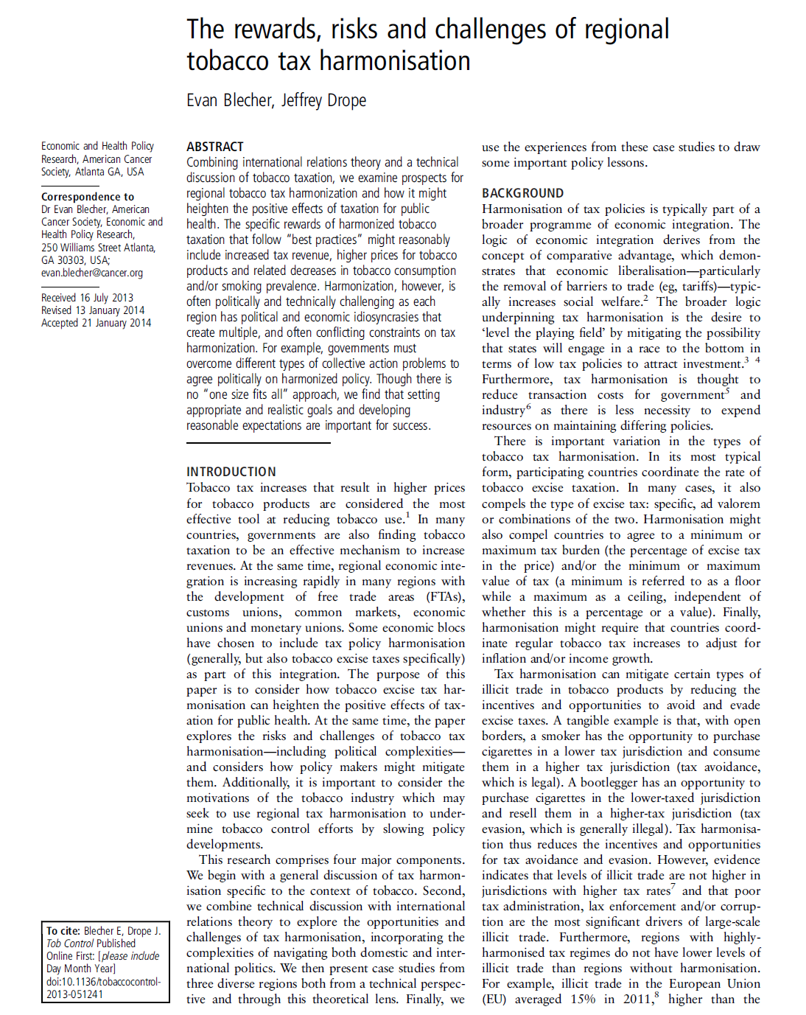

Research Highlights

Slide 23
Illicit trade
As taxes increase, so does the incentive to avoid & evade taxes
  Illicit trade has the ability to undermine tobacco control policy objectives (reduced consumption & increased revenue)
  However, the tobacco industry has an incentive to exaggerate the extent of illicit trade
Our research attempts to answer key questions:
  What is the extent of illicit trade?
  What are the trends in illicit trade?
  What is the industry’s role in illicit trade?
  How can governments respond to illicit trade?

Slide 24
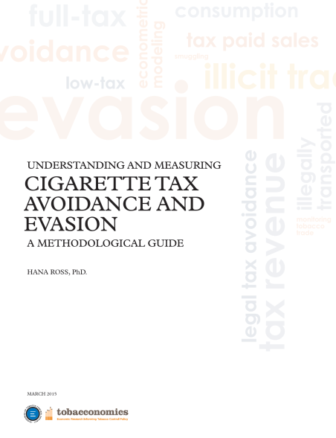
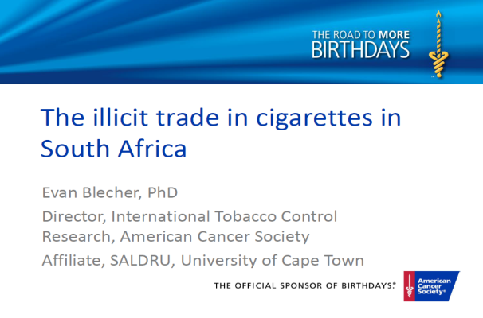
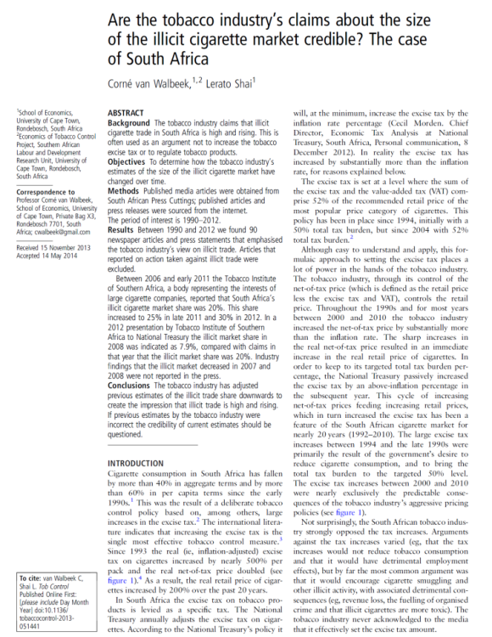
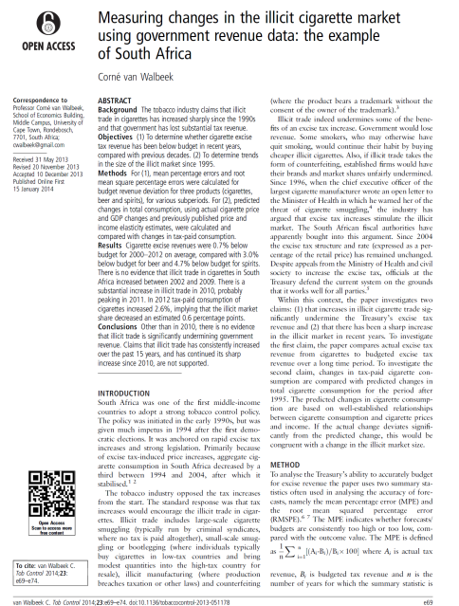
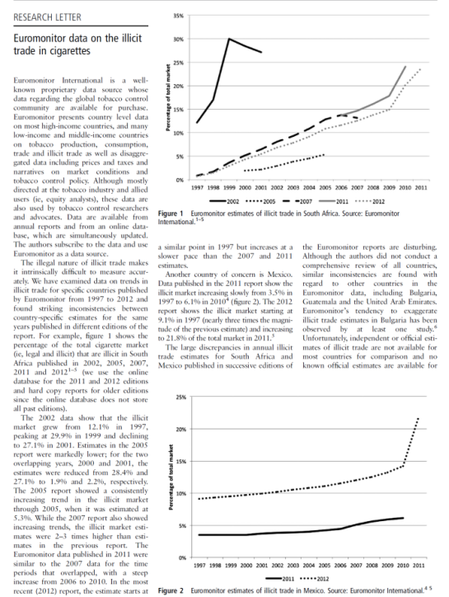
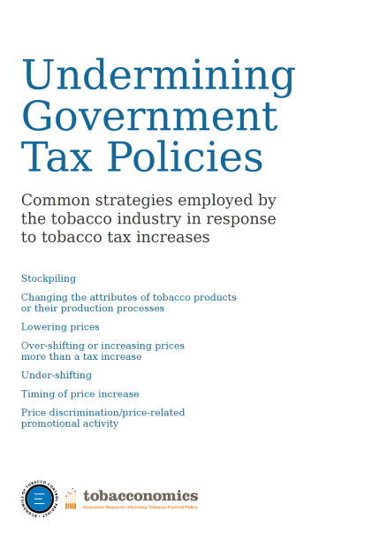
Illicit trade
Research Highlights

Slide 25
Alcohol
A new research area for us is alcohol policy
This work is an attempt to translate experience on tobacco to alcohol
Work is focused on South Africa at present
Collaboration with World Health Organization driven by the policy objectives of national government (particularly Minister of Health)

Slide 26
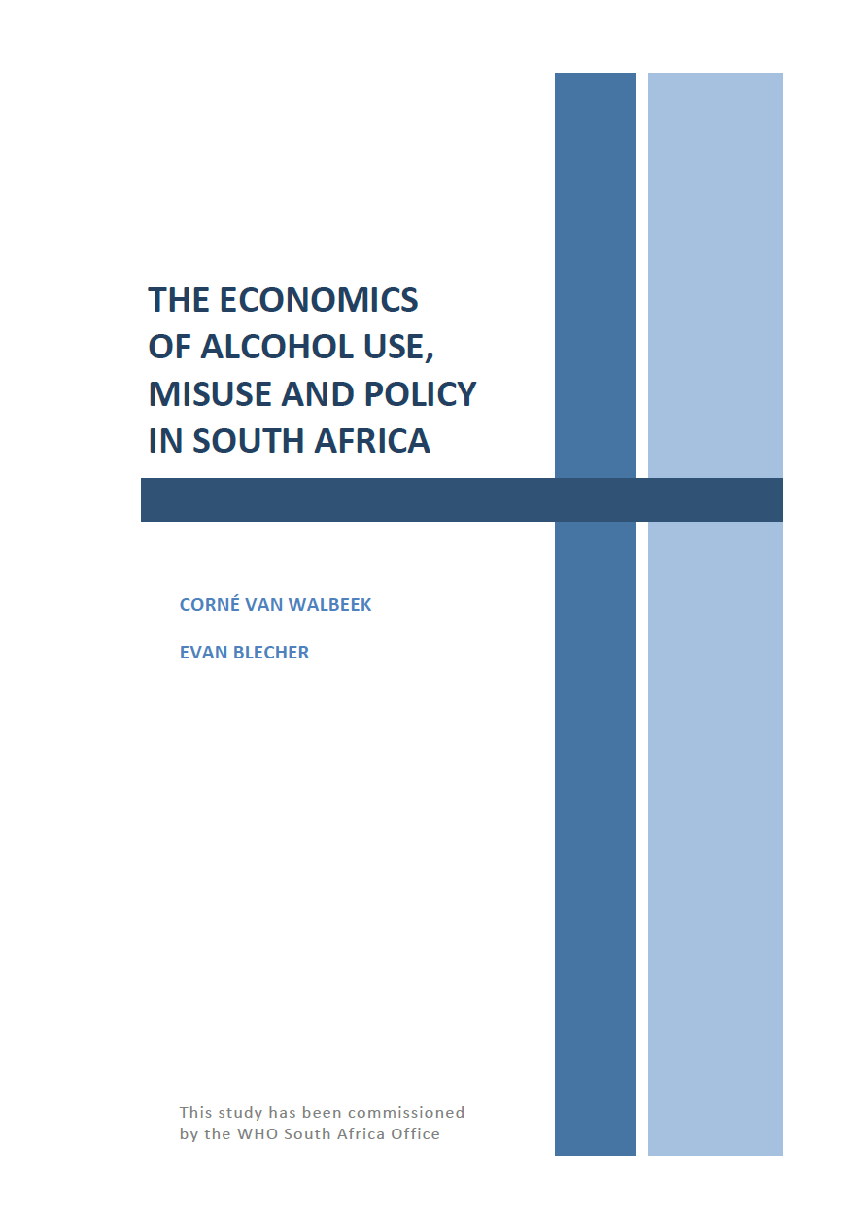
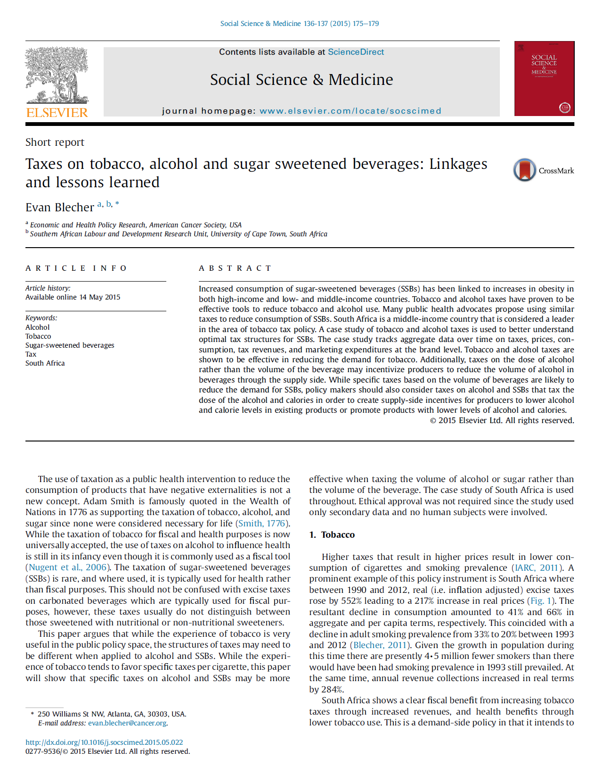
Alcohol
Research Highlights

Slide 27
For more information see
www.tobaccoecon.org

Slide 28
Some slides on alcohol

Slide 29
Excise taxes on alcohol and tobacco

