Slide 1
Estimating the Cost of Violence:
Methodological Choices and Data Availability
Based on joint work with James Fearon
Anke Hoeffler
University of Stellenbosch 7 June 2019

Slide 2
Cost of Violence
world
society
community
individual

Slide 3
How Costly is Violence?
Why should violence be quantified?
Common metric: assess the size of the problem and compare across different types of violence, across time and across countries/regions, enables CBA, adds weight to policy debate

Slide 4
How Costly is Violence? –Three Questions
Which societies have high costs of violence?
Which type of violence is most costly?
Who is most affected by violence?

Slide 5
Definition?
Violence:
any action that uses force,
intended to cause harm

Slide 6
Categorization
Collective Violence
State-based armed violence
Non-state violence
One-sided violence
Interpersonal violence
Homicide
Physical assault
Sexual assault & rape
IP violence
Violence against children, elderly, disabled
terrorism
Excludes self-directed violence

Slide 7
Cost Calculations
Total Cost
=
Number of Cases × Unit Cost
Prevalence

Slide 8
Number of Cases - Prevalence
Collective Violence
Homicide
Violence against children
Violence against women (IP)

Slide 9
Collective Violence: Uppsala Conflict Data Program (UCDP) Definition)
State-Based Violence
use of armed force between two organised armed groups
of which at least one is the government of a state
effective resistance
min 25 battle-related deaths per year
battle related deaths, military & civilian
not general war deaths (hunger, disease)
> 25 minor armed conflict, >1,000 major armed conflict (war)
Non-state Based Violence
use of armed force between two organised armed groups
neither of which is the government of a state
min 25 battle-related deaths per year
One-sided Violence
use of armed force by the government of a state or by any organised group against civilians
min 25 deaths in a year
excludes extrajudicial killings in government facilities

Slide 10
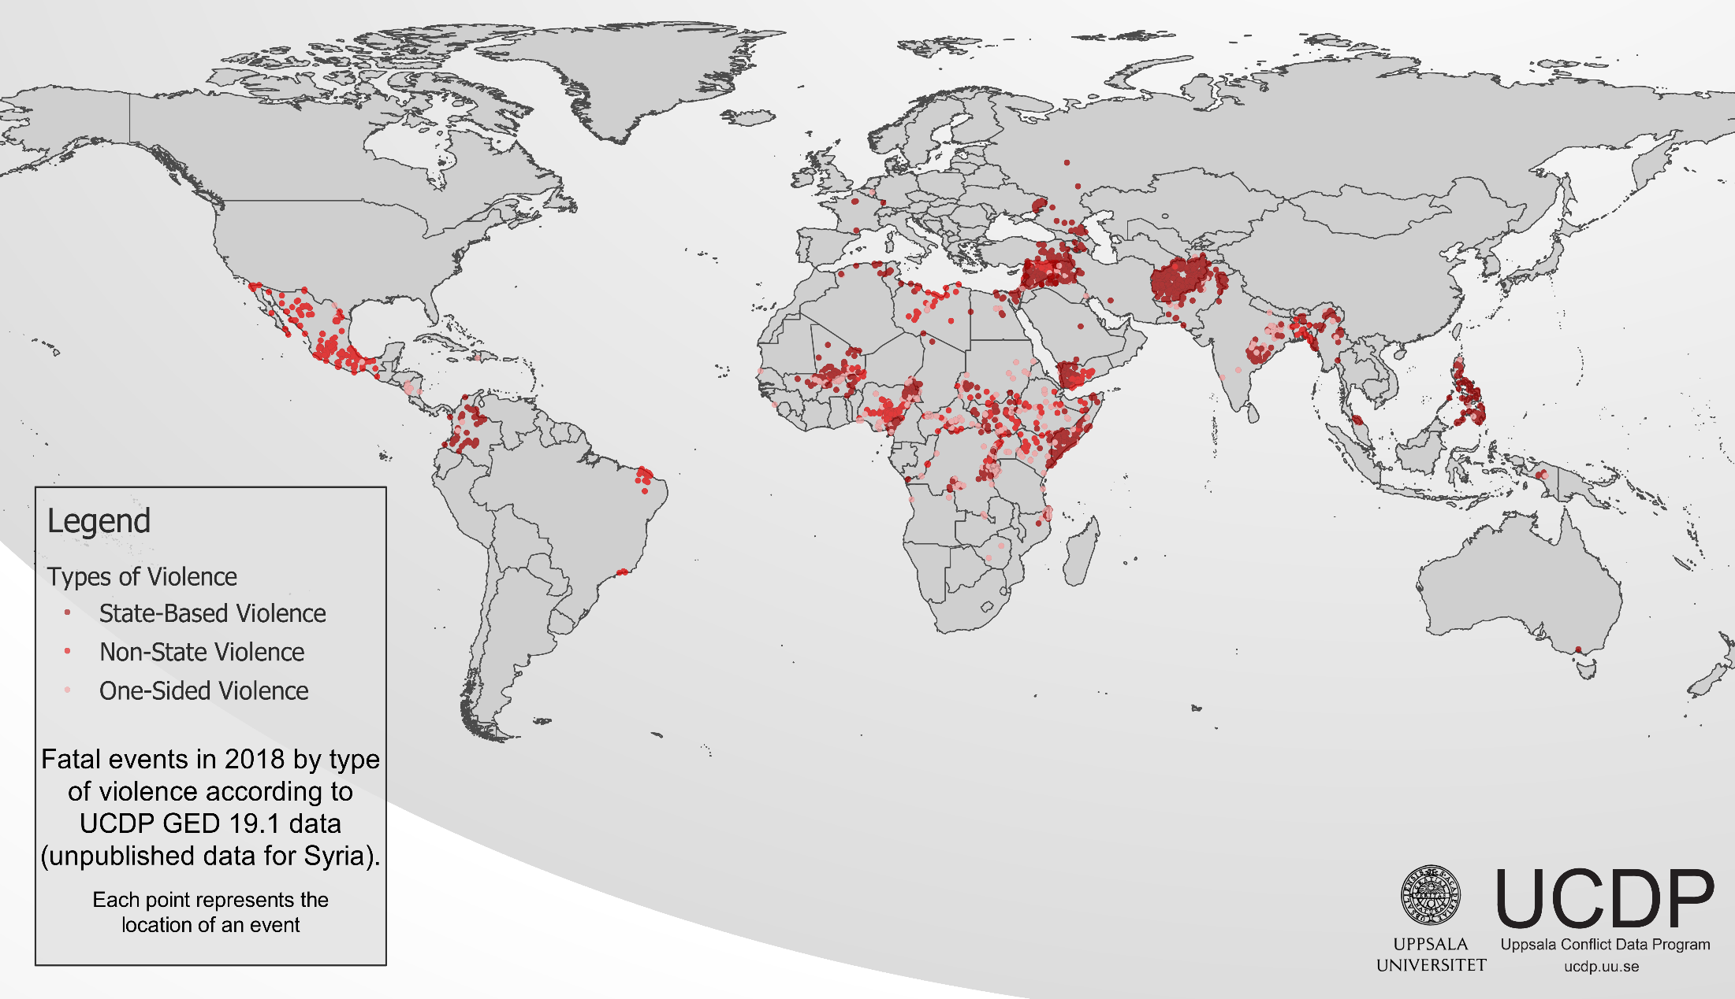
Collective Violence

Slide 11
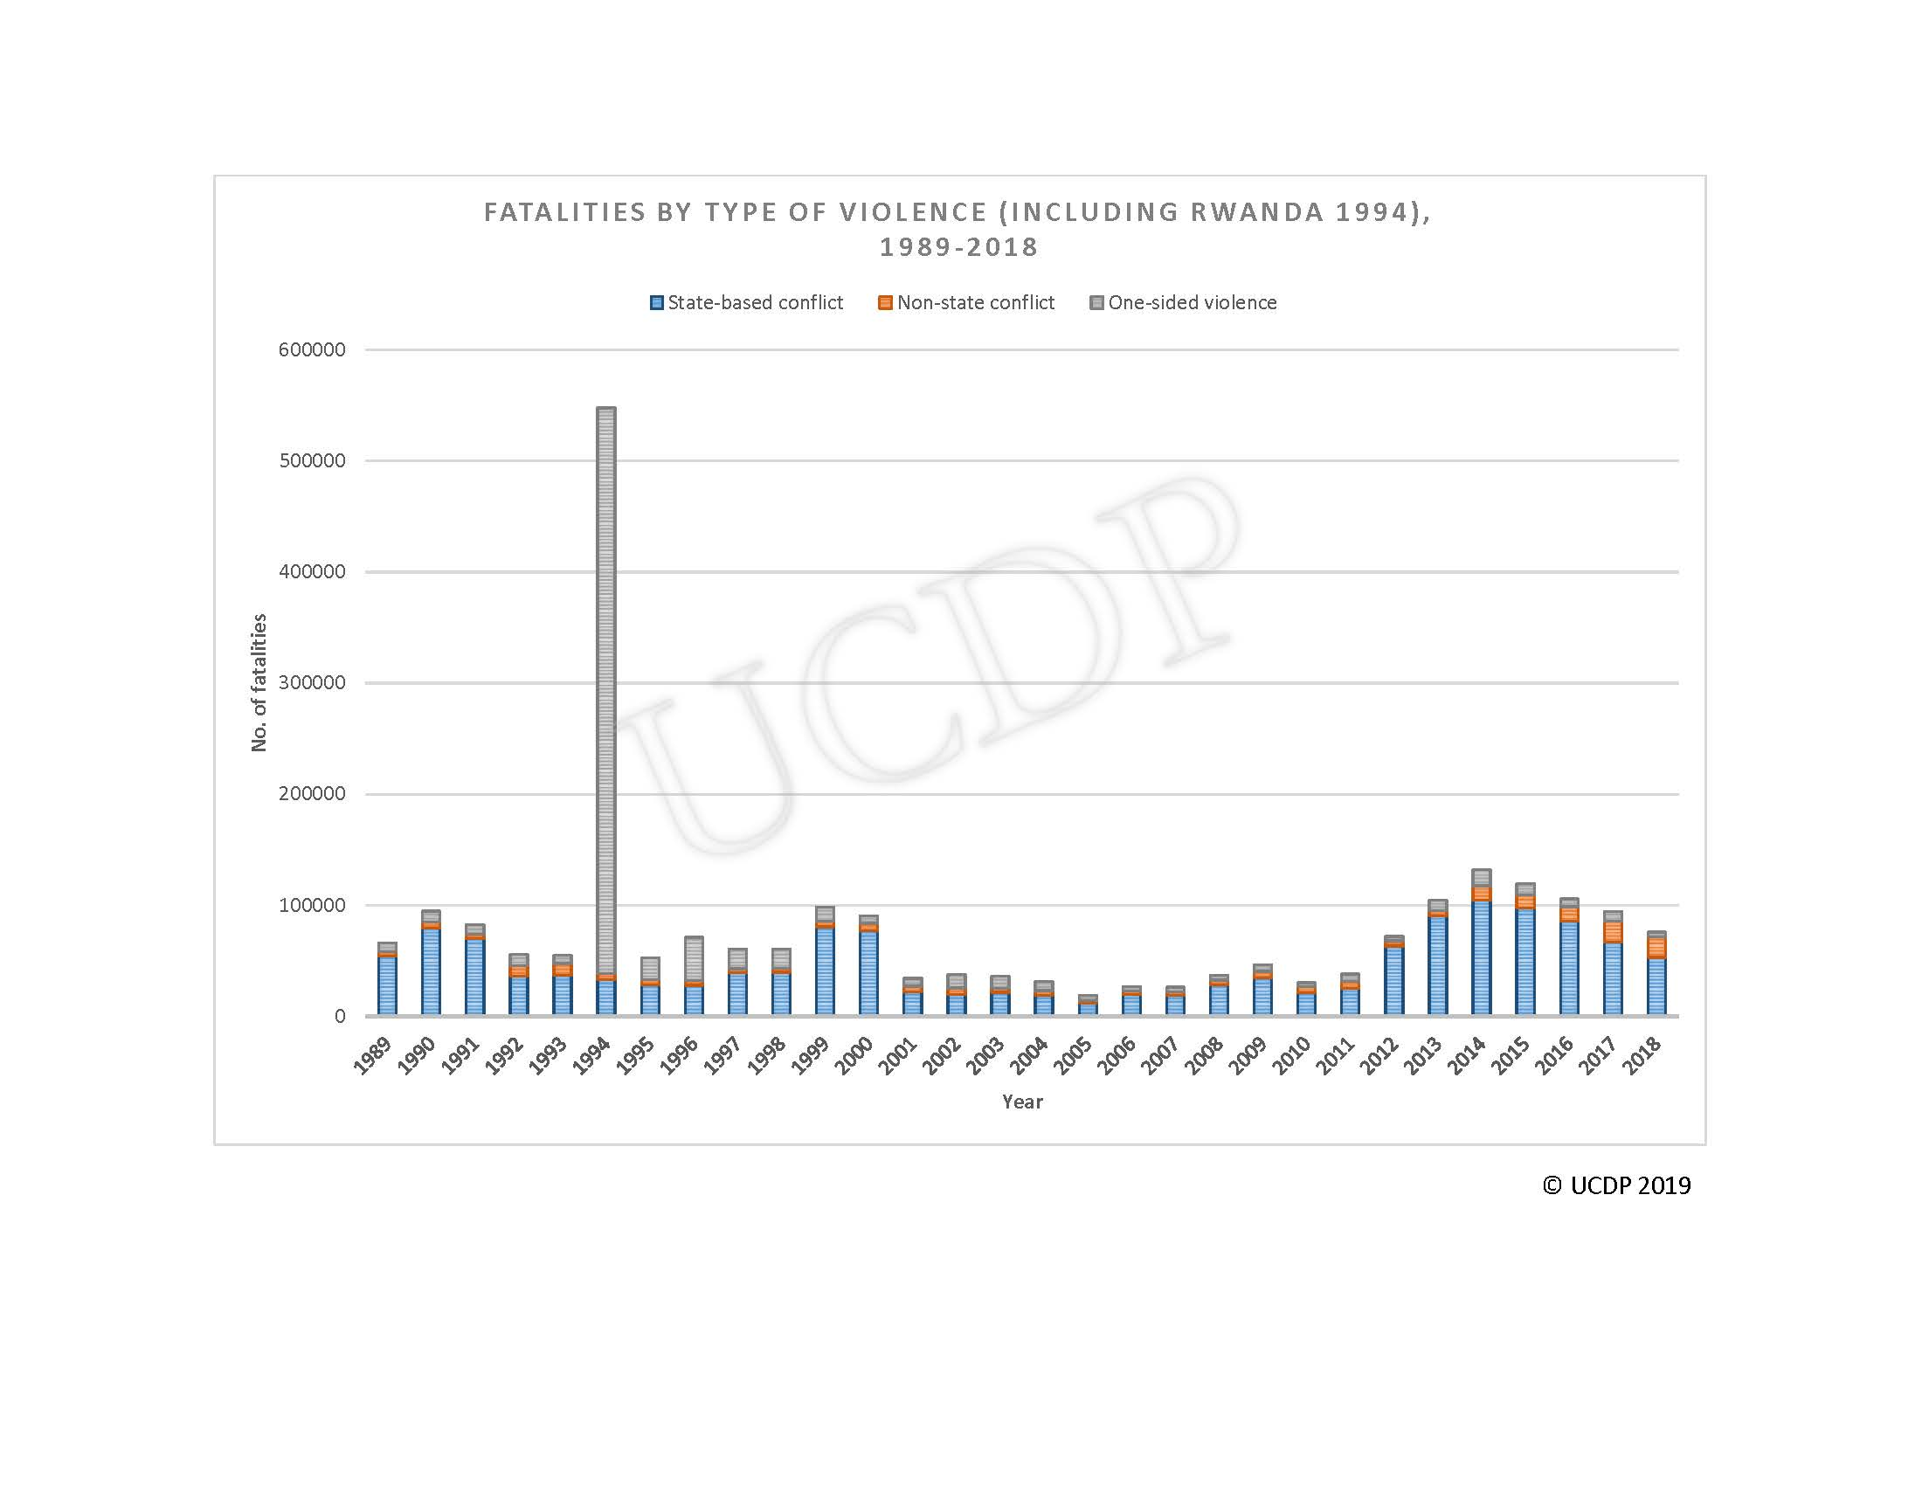

Slide 12
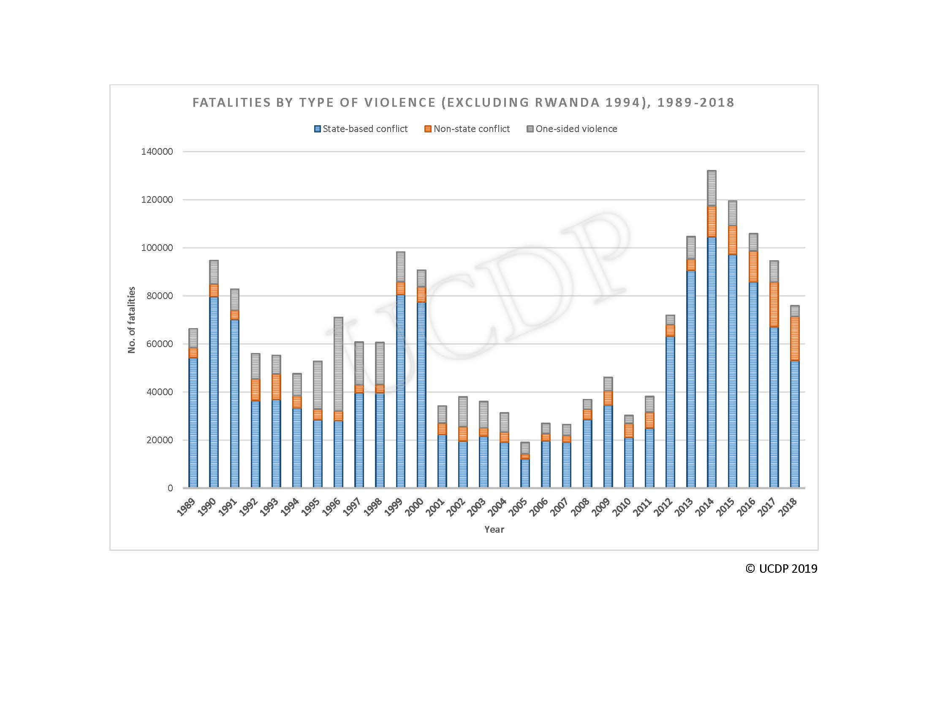
Fatalities by type of violence (ex Rwanda)

Slide 13
Homicide Rates and Counts (2015)
Comparison:
Germany 0.85 (682)
US 4.88 (15,696)
Country | Ratio (per 100,000) | Count
El Salvador | 109 | 6,656
Honduras | 64 | 5,148
Venezuela | 57 | 17,778
Jamaica | 43 | 1,207
South Africa | 34 | 18,673
Trinidad&Tobago | 31 | 420
Brazil | 27 | 55,574
Colombia | 27 | 12,782
Guyana | 19 | 149
Mexico | 16 | 20,762
Puerto Rico | 16 | 584
DRC | 13 | 10,322

Slide 14
Homicides
(about 490,000 globally)

Slide 15
US Homicide Rates
For more discussion see Steve Pinker

Slide 16
Child and Young Adult Homicides
(Low&Middle Income Countries)

Slide 17
Non-Fatal Violence against Children
Violence against children in schools, in the community, prisons, at work, in institutions but most of the violence happens in the home
Focus on violence in the home
Definition? Parent-Child Conflict Tactics Scale
non-violent discipline, psychological aggression, physical punishment , severe physical punishment

Slide 18
Percent of Primary Care Givers Using
Severe Physical Punishment (self-reported)

Slide 19
Non-Fatal Violence against Women
Violence against women happens everywhere but most of the violence happens in the home
About 30 per cent of women state in surveys that they suffered IPV during their lifetime
Underreporting: About one in nine women report physical or sexual assault to the police

Slide 20
Prevalence Rates of IP Assault

Slide 21
What have we got so far?
Collective Violence
Homicide
IP Assault
Violence against children
Assault
GBV
UCDP (deaths only)
UNODC (Homicide Monitor)
DHS DV module & similar
MICS & similar
Victimization surveys
Victimization surveys

Slide 22
Prevalence Rates per 100,000
Region | Collective Violence | Homicide Rate | IP assault against women | Non-fatal violence against children
Asia | 0.557 | 2.72 | 4210 | 6585
East&Central Europe | 0.698 | 6.06 | 1781 | 1341
Latin America & Caribbean | 0.580 | 21.07 | 2600 | 1229
Middle East & North Africa | 5.801 | 4.06 | 3084 | 8853
Sub-Saharan Africa | 4.291 | 9.62 | 5134 | 10336
High Income | 0.047 | 2.87 | 667 | 1307
World | 1.381 | 5.56 | 3601 | 5930

Slide 23
Cost Calculations
Total Cost
=
Number of Cases × Unit Cost
Prevalence
DALY? VSL?

Slide 25
Value of a Statistical Life (VSL)
A life is ‘invaluable’ – price for a life?
particular – statistical life
$10 extra to accept 1:1,000,000 risk - equivalent to $10,000,000 certain risk
Markets provide implicit information on trade-off between life and health
  Life insurance
  Labour market
  Compensation payments
  Product liability
Explicit information: willingness to pay (contingent valuation)
VSL: how much is society prepared to spend to avoid death/injury?
Should labour market data be used to assess dread risks?
VSL: revealed<stated

Slide 26
Cost of Violence
 | Tangible Direct Costs | Tangible Indirect Costs | Intangible Costs
Concept
Measures
Collective violence
Interpersonal violence

Slide 27
Cost of Violence
 | Tangible Direct Costs | Tangible Indirect Costs | Intangible Costs
Concept | Consumption | Lost productivity | Pain, suffering, quality of life, inequality, norm changes
Measures
Collective violence
Interpersonal violence

Slide 28
Cost of Violence
 | Tangible Direct Costs | Tangible Indirect Costs | Intangible Costs
Concept | Consumption | Lost productivity | Pain, suffering, quality of life, inequality, norm changes
Measures | Treatment & care Justice costs | Income losses | VSL, compensation awards
Collective violence
Interpersonal violence

Slide 29
Cost of Violence
 | Tangible Direct Costs | Tangible Indirect Costs | Intangible Costs
Concept | Consumption | Lost productivity | Pain, suffering, quality of life, inequality, norm changes
Measures | Treatment & care Justice costs | Income losses | VSL, compensation awards
Collective violence | Medical costs, displacement | GDP losses, increased milex | VSL, values for injury & disability
Interpersonal violence

Slide 30
Cost of Violence
 | Tangible Direct Costs | Tangible Indirect Costs | Intangible Costs
Concept | Consumption | Lost productivity | Pain, suffering, quality of life, inequality, norm changes
Measures | Treatment & care Justice costs | Income losses | VSL, compensation awards
Collective violence | Medical costs, displacement | GDP losses, increased milex | VSL, values for injury & disability
Interpersonal violence | Medical costs, criminal justice costs | Income losses, reduced productive activity, increased security exp | VSL, values for injury & disability

Slide 31
Cost Calculations
Total Cost
=
Number of Cases × Unit Cost
Prevalence? Officially reported (WHO, UNODC) and survey evidence (DHS, MICS)
intangible costs dominate VSL: US $8.4 mil. homicide; $200,000 rape; $95,000 aggravated assault; scale cost by country GDP

Slide 32
Cost Calculations
Crime
(Civil) War
Human costs: war deaths/wounded
Economic costs: reduction in GDP & externalities
Human costs: pain&suffering, homicide&assault
Tangible costs (medical&justice)
little on economic externalities

Slide 33
Global Cost of Violence

Slide 34
How Costly is Violence? – Some Answers
Which societies have high costs of violence?
Low income countries
Which type of violence is most costly?
Interpersonal violence
Who is most affected by violence?
Women and children
Centre for the Study of African Economies

Slide 35
Further Reading
Hoeffler, Anke. 2018. Security and development: Shifting the focus to interpersonal violence. The Economics of Peace and Security Journal 13:12-22.
Hoeffler, Anke. 2017. Violence against Children: A Critical Issue for Development. European Journal of Development Research 29:945-963.
Hoeffler, Anke. 2017. What are the Costs of Violence? Politics, Philosophy & Economics 16(4): 422 - 445.
Fearon, James and Anke Hoeffler. 2014. Benefits and Costs of the Conflict and Violence Targets for the Post-2015 Development Agenda, Post-2015 Consensus, mimeo. http://www.copenhagenconsensus.com/sites/default/files/conflict_assessment_-_hoeffler_and_fearon_0.pdf

Slide 36

Baie
dankie!
Anke Hoeffler
Chair in Development Policy
Department of Politics and Public Administration
Tel.: +49 (0) 75 31 88 4801
anke.hoeffler@uni-konstanz.de
@ankehoeffler

Slide 37
Terrorism
Definition?
Global Terrorism Database (2013, 7) —“the threatened or actual use of illegal force and violence by a non-state actor to attain a political, economic, religious, or social goal through fear, coercion or intimidation.“
Defined by actor?
Defined by strategy?
Exclude state terrorism?
Violence against civilians?
Exclude terrorism against police/armed forces?

Slide 38
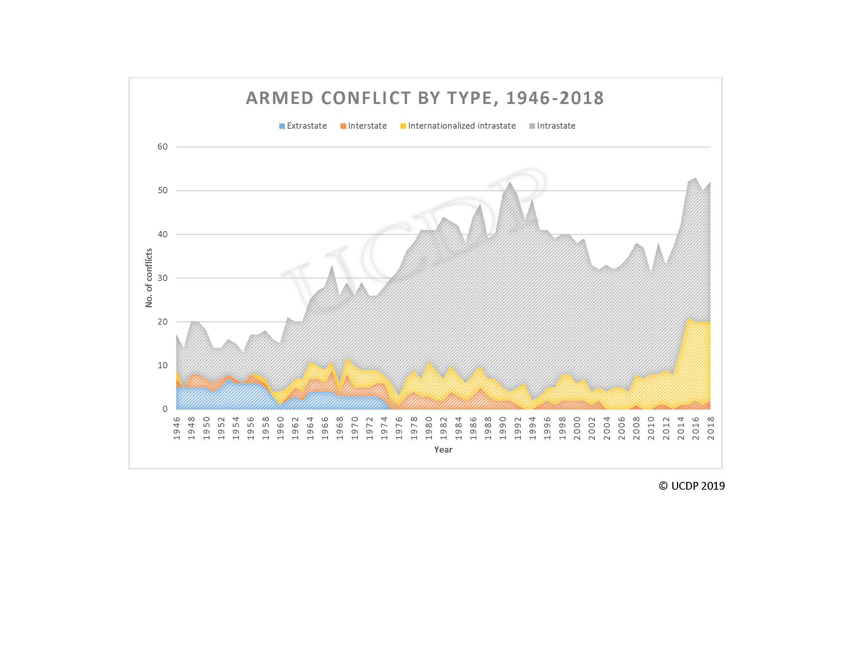

Slide 39
Violence: Global Prevalence Rates
approximations
1 in 100,000 people die in civil conflicts (only direct violence, not as a result of hunger etc)
6 in 100,000 people are victims of homicides
5,200 in 100,000 people are victims of serious assault
6,000 children in 100,000 people are subjected to severe physical punishment
3,600 women in 100,000 are assaulted by their intimate partner

Slide 40
Reducing Collective Violence
International community better at resolving international wars (e.g. Ethiopia-Eritrea)
Overwhelmingly civil wars are repeat conflicts, concentrate on stabilizing peace in post-conflict societies
The longer peace lasts, the lower the risk of conflict recurrence
UNPKOs: evidence for a peace preparation effect
Countering war finance: Kimberley Process, PATRIOT Act, smart sanctions
UN Arms Trade Treaty (2013) aims to reduce arms transfers to conflict regions

Slide 41
Reducing Interpersonal Violence
  Effectiveness of interventions to combat homicide, assault, violence against children and IPV?
  Legal reforms to change harmful traditional practices?
  Changing norms and attitudes?
  RCT evidence?
  Alcohol and drug programmes
  Change in policing (hot spots, community policing)
  Parenting programmes
  IPV: change in policing (DASH, Duluth), economic empowerment, changing norms, teen education

Slide 42
Cost of Violence $bn, source: IEP
Collective Violence
23 deaths civil conflict
0.7 deaths intern conflict
2 IDPs&Refugees
130 GDP losses
terrorism
Total: 167
Interpersonal violence
706 homicides
325 assault
incarceration
23 fear
Total : 1,238

Slide 43
Percentage of Women Married at 15 (DHS, MICS)

Slide 44
Prevalence of FGM by Age (DHS, MICS)

