Slide 1
Uncovering indicators of effective school management in South Africa using the National School Effectiveness Study
Stephen Taylor
Department of Economics, Stellenbosch University
PSPPD Project – April 2011

Slide 2
Motivation (the problem)
Low quality education a poverty trap to many children in historically disadvantaged schools
Question: Poverty itself or the characteristics of schools in poor communities?
  SACMEQ II and III:
  Poor South African children performing worse than equally poor children in other African countries
This despite substantial resource shifts to correct for apartheid inequalities
  Historically disadvantaged schools have been largely unresponsive to additional resources
  Consequence: Perpetuation of a “2 systems” system
How does the literature explain this?

Slide 3
Motivation (the literature)
Resources do not necessarily make a difference:
  the ability of schools to convert resources into outcomes is the crucial factor (Van der Berg, 2008)
Socio-economic status (SES) has a dominant impact on the distribution of achievement
Studies based on large sample surveys have typically struggled to identify specific aspects of effective management and teaching practice that explain performance.
  Crouch and Mabogoane (1998): 50% of variance explained by “management efficiency”
  Van der Berg and Burger (2002): 2/3 variance explained by SES, racial composition & school resources; remainder probably due to unobserved “management efficiency”.
Largely due to data limitations most large surveys

Slide 4
Data
National School Effectiveness Study (NSES)
  JET Education Services & RNE
Literacy and numeracy testing:
  Grade 3 (2007)
  Grade 4 (2008)
  Grade 5 (2009)
Principal questionnaires (2007, 2008, 2009)
Teacher instruments (2008, 2009)
  Teacher comprehension and maths test
  Extensive review of learner workbooks
Greater potential to uncover indicators of effective management an teaching
same individuals

Slide 5
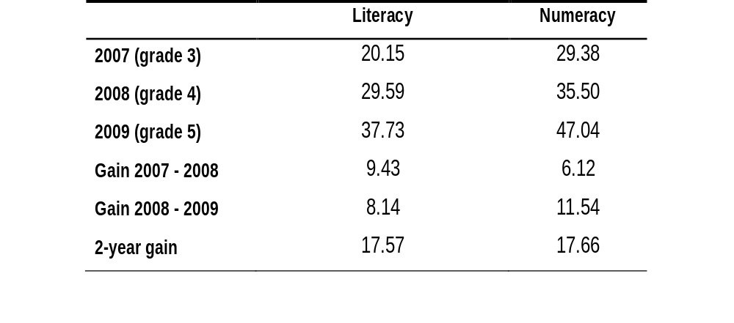
Results – overall scores

Slide 6
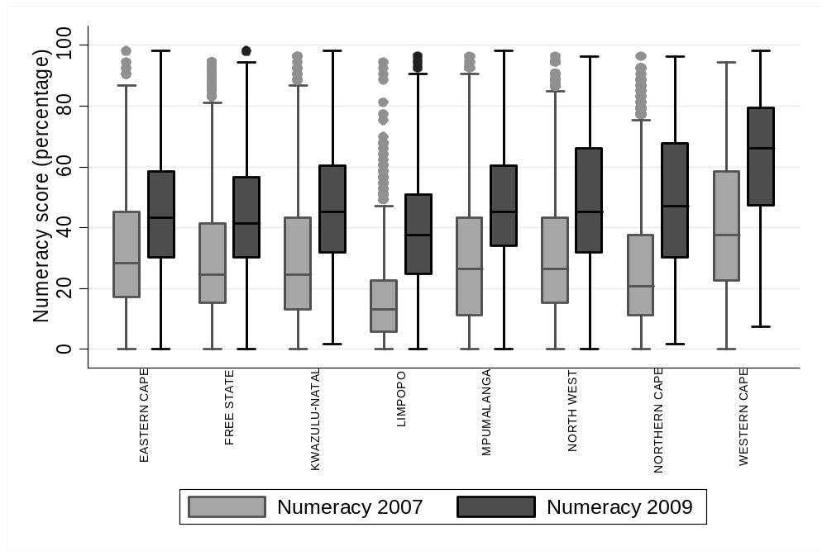
Results: Numeracy scores by province

Slide 7
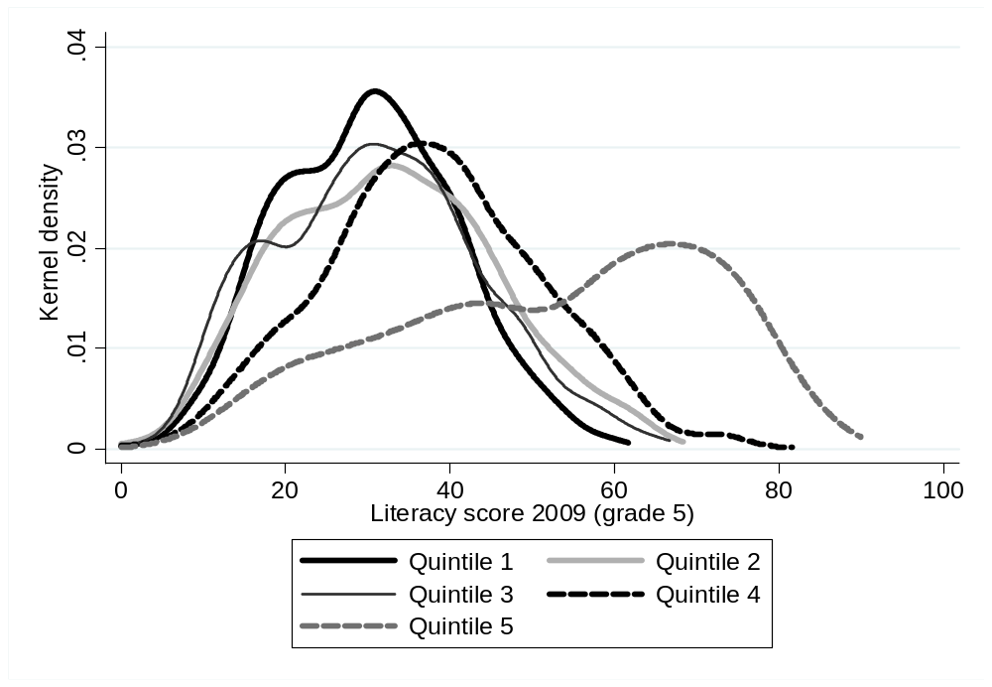
Results: Literacy achievement by SES

Slide 8
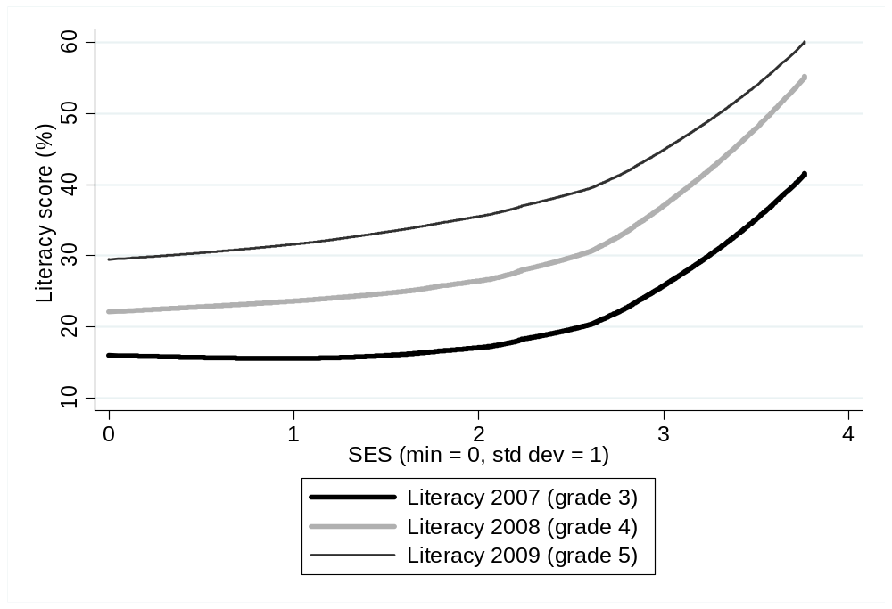
Results: Literacy achievement by SES

Slide 9
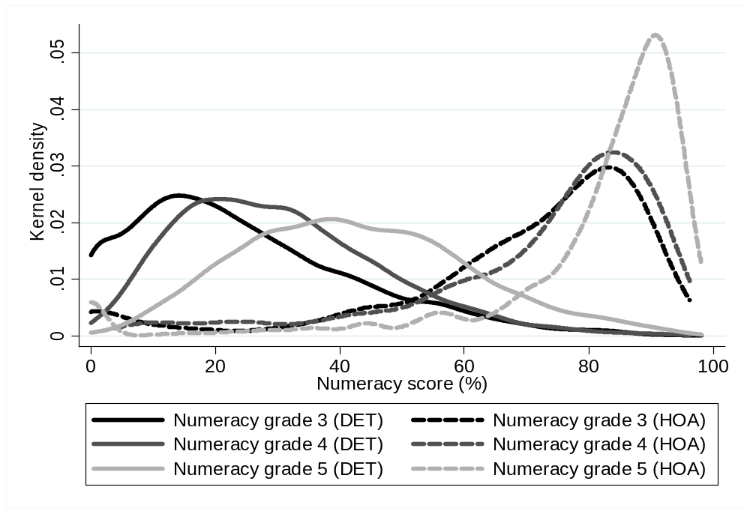
Results: Numeracy achievement by ex-department

Slide 10
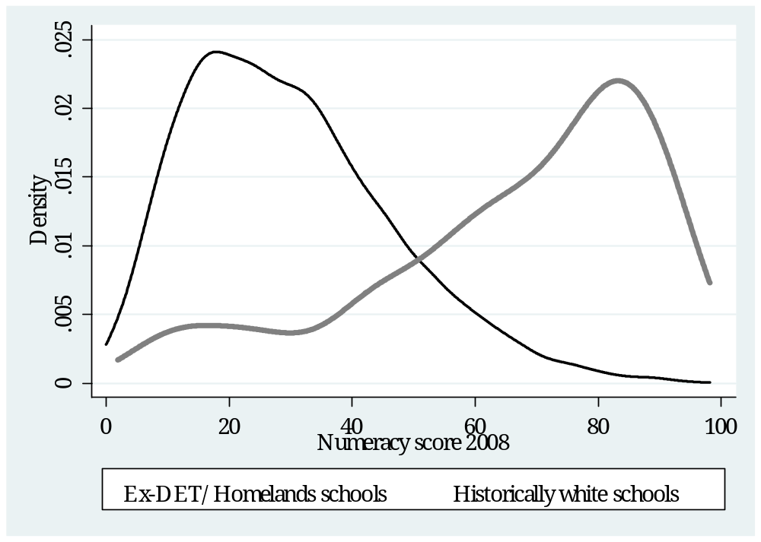
Results: Numeracy achievement of African language students by ex-department

Slide 11
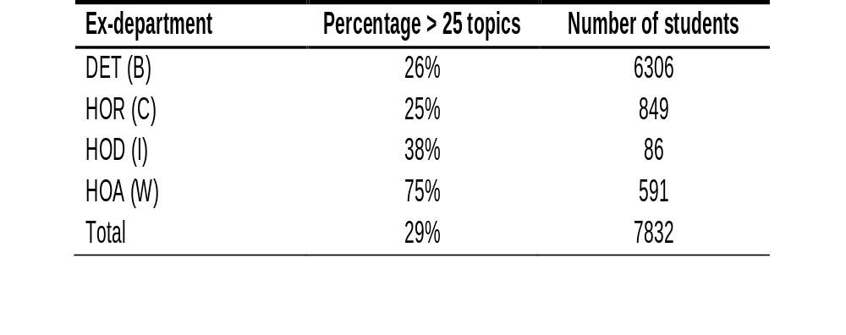
Results: Indicators of effective management and teaching
Percentage of students in schools where more than 25 maths topics were covered

Slide 12
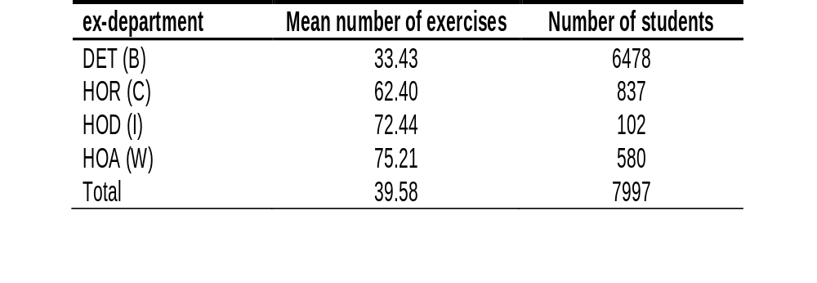
Results: Indicators of effective management and teaching
Mean number of literacy exercises found in the “best” learner’s book

Slide 13
Results: Extended writing

Slide 14
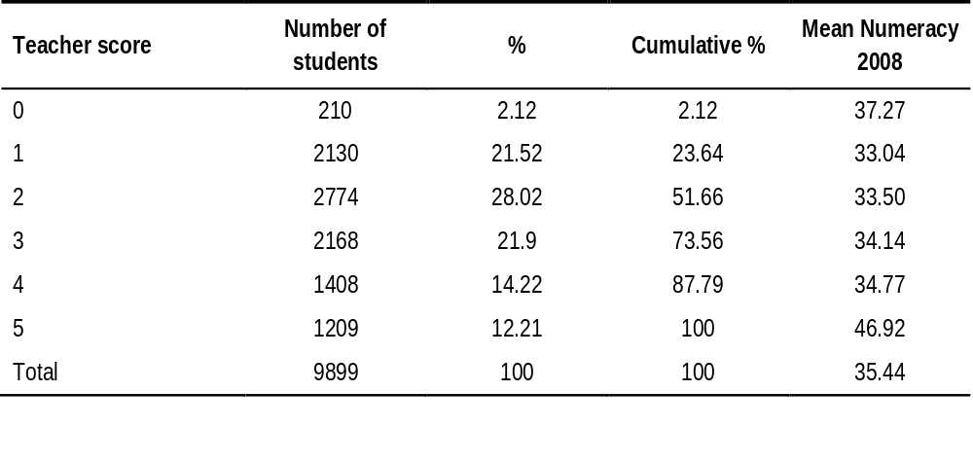
Results: Maths teacher knowledge
10 days 75 hours can be written as .... days .... hours

Slide 15
Results: Multivariate analysis
Are teachers with better subject knowledge located in more affluent schools?
And is it this affluence driving the association of student achievement with teacher knowledge?
The need for multivariate analysis to disentangle this.
After accounting for the influence of SES, what school and teacher characteristics are associated with student achievement?
What distinguishes better and worse-performing schools within poor communities?

Slide 16
Results: Multivariate analysis
4 multivariate regression models estimated in the education production function tradition:
  OLS regression predicting Literacy achievement in grade 4
  OLS regression predicting Numeracy achievement in grade 4
  2 more sophisticated techniques to model gain scores

Slide 17
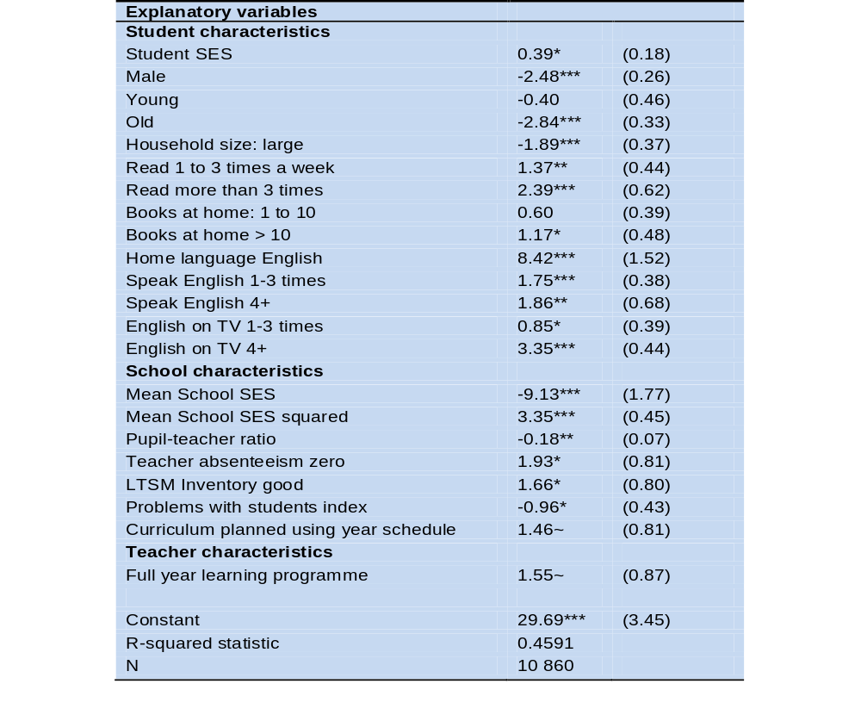
Results: Multivariate analysis

Slide 18
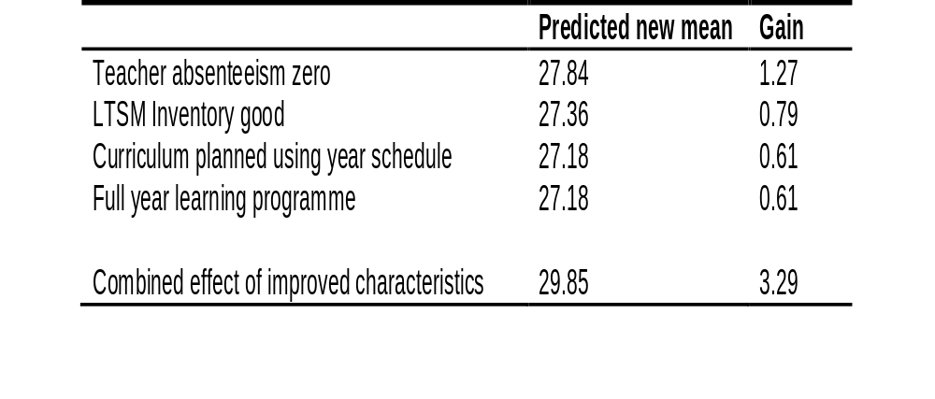
Results: Multivariate analysis
Literacy grade 4 (2008)
Estimated effects of change in characteristics on the literacy national average (Original sample mean = 26.57%)

Slide 19
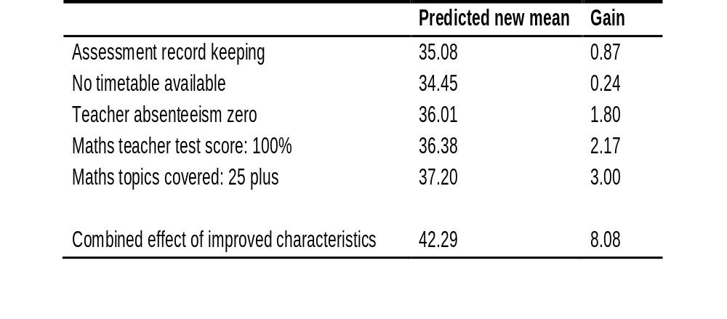
Results: Multivariate analysis
Numeracy grade 4 (2008)
Estimated effects of change in characteristics on the numeracy national average (Original sample mean = 34.21%)

Slide 20
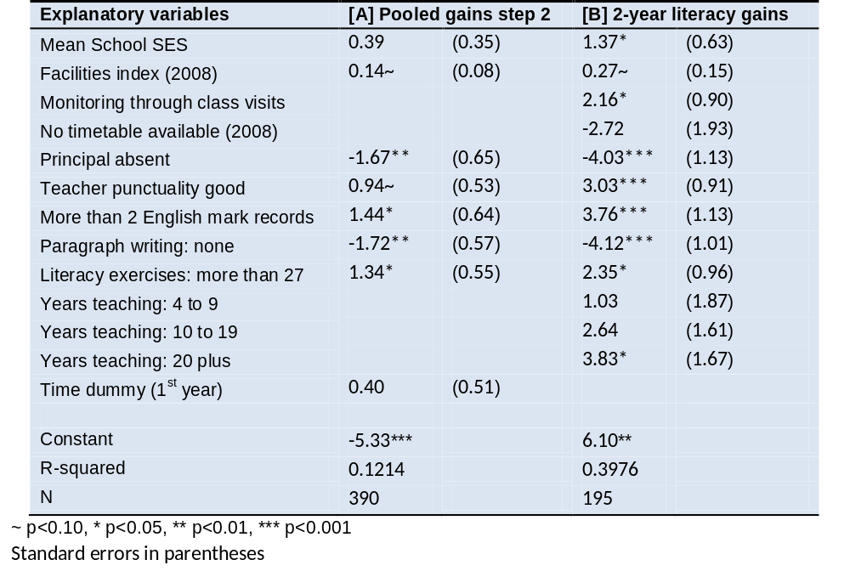
Results: Multivariate analysis:
Modelling the literacy gain scores (Historically black schools only)

Slide 21
Conclusions and Policy Implications
Resource variables were not amongst the most important factors predicting achievement
Several indicators of effective school management and teacher practice that are associated with student achievement have been identified
  even within the large historically disadvantaged section of the school system.
  This is an advance on earlier analyses
An organised learning environment:
  curriculum planning for the full year, a functional timetable, good-quality inventories for LTSM, low teacher absenteeism and up-to-date assessment records
Extensive coverage of curriculum and exercises

Slide 22
Conclusions and Policy Implications
Policies should empower teachers to cover curriculum and administer exercises:
  At the top: clearly communicated curriculum requirements
  Also, textbooks and workbooks that make worked examples easier for both teachers and students to implement.
Command and control measures to enforce adherence to best practices?
  Probably not…
Explore ways to attract, train and support better principals, and to replace those at the head of dysfunctional schools.

