Slide 1
Repetition, dropping out and Matric passes: Using NIDS, GHS and examinations data to inform policy*
Martin Gustafsson
Department of Economics, Stellenbosch University
PSPPD Project – April 2011
*Full report is titled The when and how of leaving school: The policy implications of new evidence on secondary schooling in South Africa. It is available at ideas.repec.org/p/sza/wpaper/wpapers137.html.

Slide 2
Motivation
A number of important knowledge gaps and peculiar perceptions in relation to secondary schooling:
  Drop-out rates by grade not known.
  Uncertainty in relation to the levels of grade repetition.
  Uncertainty in relation to the percentage of youths obtaining a Matric, largely due to data problems.
  Confusion around the global rankings of South Africa’s secondary school enrolment indicators.
  Insufficient discussion and analysis around trade-offs between ‘aspirational’ and more rational Grades 10 to 12 subject choices.
  Insufficient high-level stocktaking of what we know about secondary schooling, from a policy perspective.
This presentation tackles the above.

Slide 3
Data
National Income Dynamics Study (NIDS) dataset of 2008
  ± 7,300/28,000 households/individuals. Includes hitherto unasked repetition, drop-out and ‘state of mind’ questions.
  Numeracy test (15 four-item MCQs at 4 different levels) interesting, but non-random participation: 41% rate for age 12 to 20; 28% for age 21 to 30.
General Household Survey (GHS) dataset of 2009
  New and exciting additions on grade enrolment and repetition.
National Senior Certificate (NCS) dataset of 2009
  The obvious source for examining subject choices. Exceptional situation with regard to physical science should be kept in mind.

Slide 4
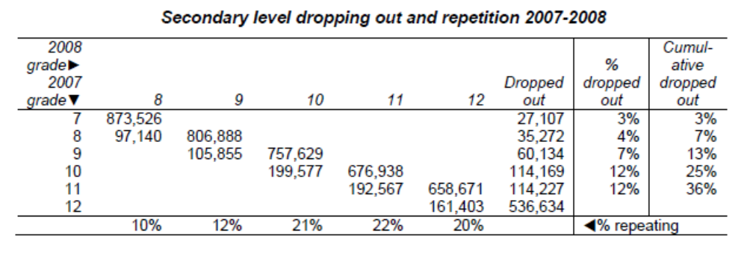
Results – Dropping out and repetition
The trend is for dropping out to be higher the higher the grade.
High repetition in Grades 10 to 11 worsens class size situation. Note it increases already in Grade 10.
Much of this (arguably valuable) Grade 12 repetition occurs privately.
64% of those who begin secondary school reach Grade 12.
4

Slide 5
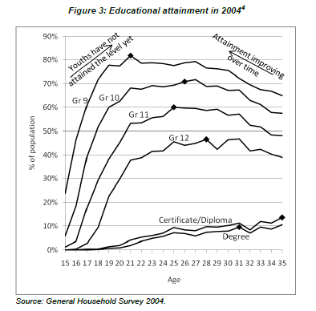
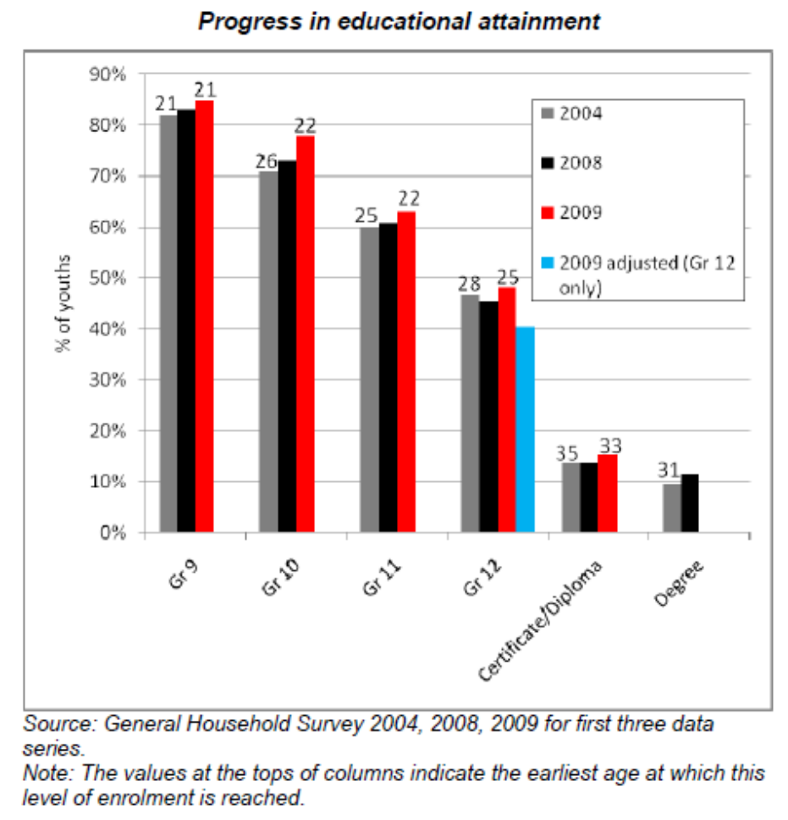
Results – Recent age/grade trends
Progress insofar as (a) improved levels of grade attainment (up to Gr 11) and (b) younger completion.
How to answer the important question “What percentage of youths attain Grade X?”
5

Slide 6
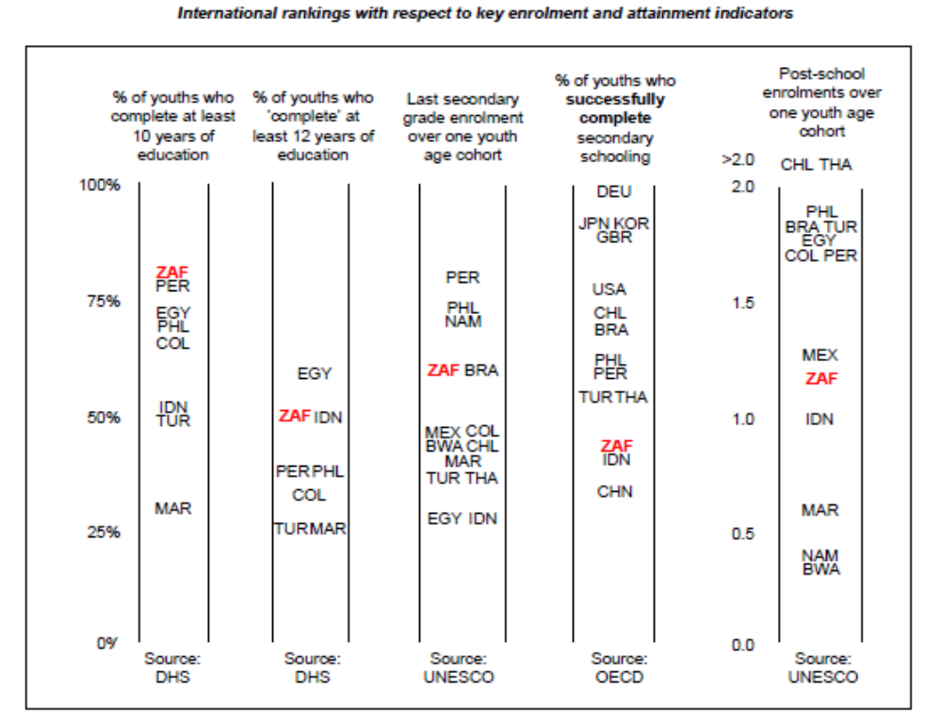
Results – Global rankings
Highly successful.
Areas of concern.

Slide 7
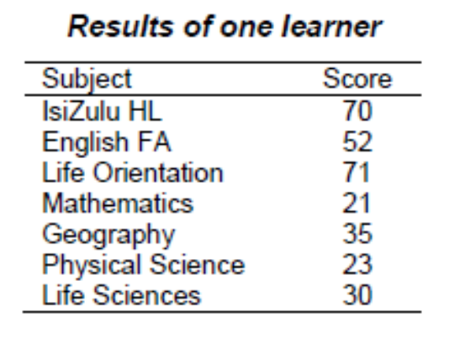
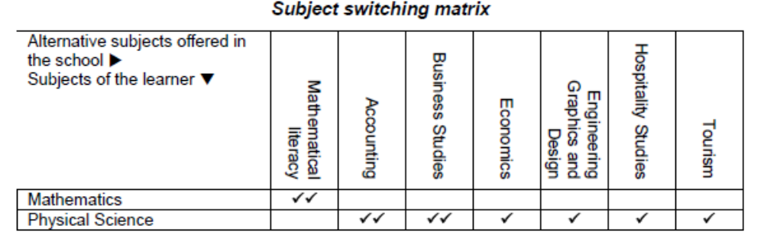
Results – Subject choices (1)
If one of these two subjects had exceeded 30, the learner would have passed.
As an example, estimated accounting score obtained by examining other learners who took mathematics, geography, life sciences and accounting.
✓ - The subject switch was possible within the learner’s school.
✓✓ - The learner is estimated to have obtained 30 in the alternative subjects.
7

Slide 8
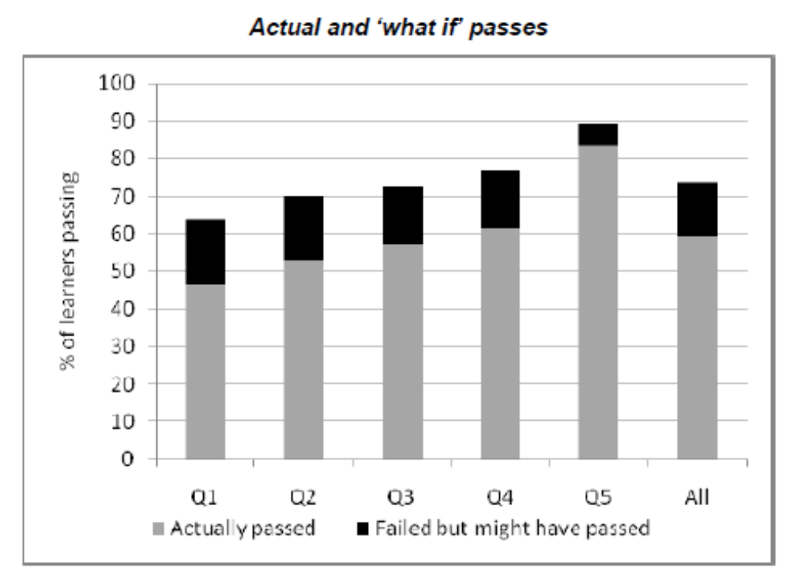
Results – Subject choices (2)
The actual situation: Systematic inequality across quintiles with respect to pass rate. Importantly, taking of mathematics and science is about equally common across quintiles.
Importantly, (a) it is non-language subject problems that account for the bulk of failing and (b) most learners can find the alternative subjects they ‘need’ within the their school.
The simulation suggests the poorer the learner, the more inappropriate the subject choice.
Clearly the results presented here must come with a range of caveats (see full report)…
8

Slide 9
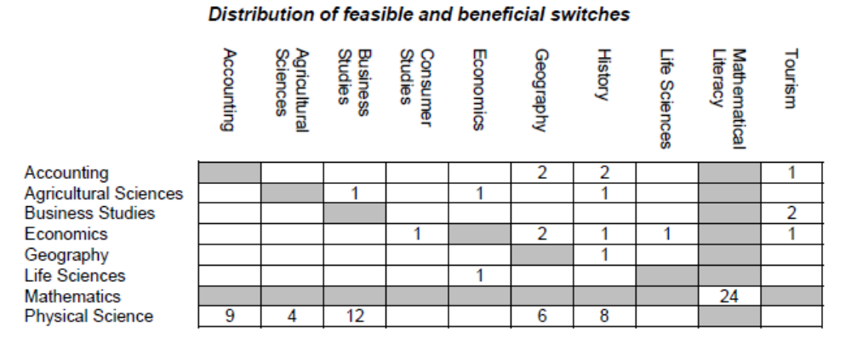
Results – Subject choices (3)
Switches indicated above (in percentages) account for 81% of feasible and beneficial switches.
There were on average 2.6 feasible/ beneficial switches per ‘rescued’ learner. Thus it is not necessary for e.g. 24% of learners to switch from mathematics to mathematical literacy.
9

Slide 10
Conclusions and Policy Implications
The data confirm strategies to improve schools must include the following things:
  Access to books, reducing absenteeism (scope exists), reducing learner pregancies through advocacy/support (see full report for details).
  Focus on English (important in labour market)
10

Slide 11
Conclusions and Policy Implications
Enrolment priorities:
  Improving performance and graduation rates (partly through better subject choices) seems more important than increasing secondary school enrolments.
  Non-completion of secondary schooling should be explicitly catered for, should not be a ‘failure one does not contemplate’.
  Two arguments for a Grade 9 qualification/examination emerge: (a) dealing explicitly with non-Matriculation in Grade 12, (b) creating a rational basis for appropriate subject choices.
A better emphasis on technical education in schools.
  Part of the analysis points to a relatively weak focus on technical subjects in poorer schools (see full report).
11

