Slide 1
Quality of education and the labour market
A conceptual and literature overview
Eldridge Moses
Department of Economics, Stellenbosch University
PSPPD Project – April 2011
Notes:
Brief discussion on the evolution of the education-labour market literature and the results of South African studies

Slide 2
How economists model the impact of education
Traditional sense
  Wages is function of years of education and experience
More years of education = higher productivity = higher earnings
Therefore makes intuitive sense to invest more in education
Education also benefits society in other ways e.g. health, crime levels
Economic growth benefits

Slide 3
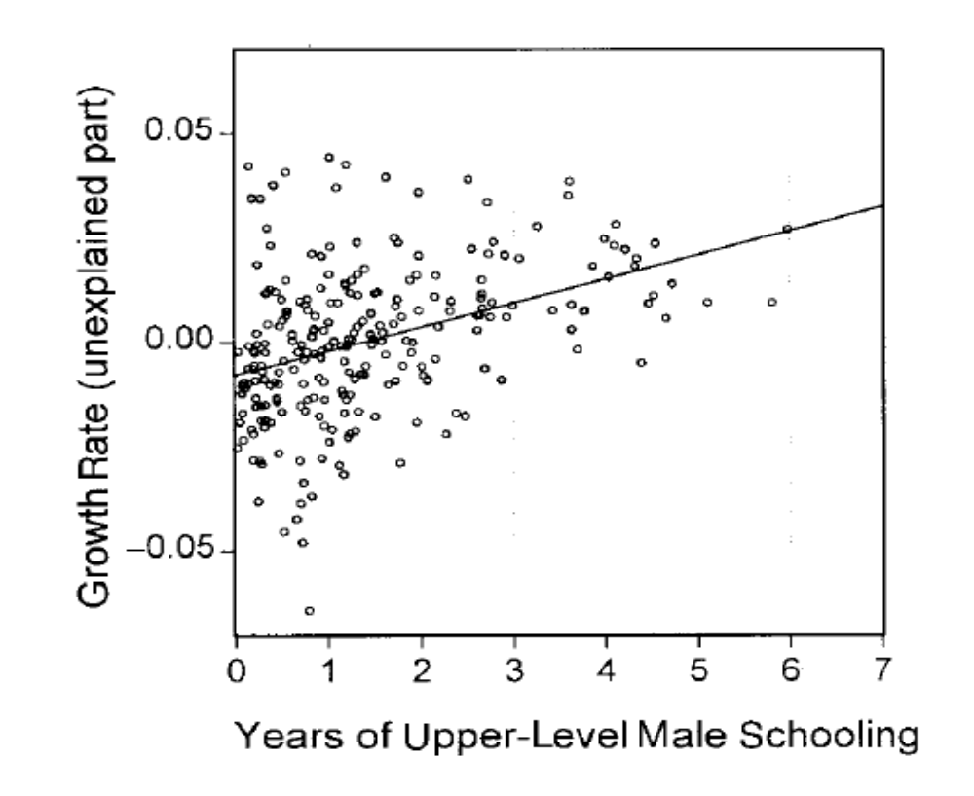
Education and growth in developed countries

Slide 4
Results of spending more on education
Pupil-teacher ratios reduced
More schools
Convergence between whites and blacks in terms of years of education
Differences between black and white mean educational attainment
  1920 birth cohort – 7.3 years
  1970 birth cohort - 3.6 years
  1980 birth cohort – 2.3 years

Slide 5
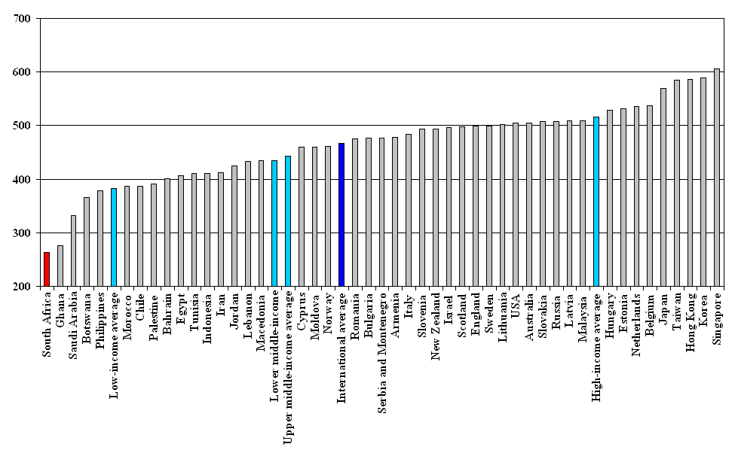
Education quality in South Africa 2003: Maths
TIMSS, Mean Grade 8 Maths score
Notes:
TIMSS 2003, mean Grade 8 Maths score

Slide 6
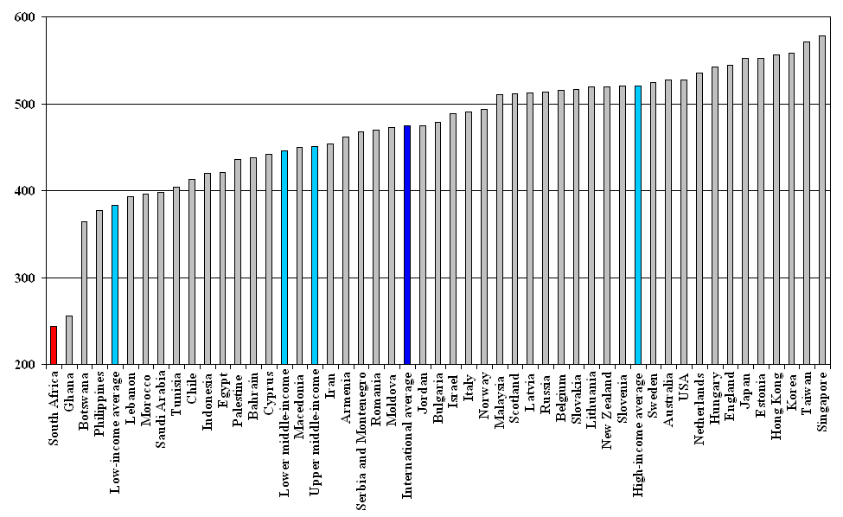
Education quality in South Africa 2003: Science
TIMSS, Mean Grade 8 Science score
Notes:
TIMSS 2003, mean Grade 8 Science score

Slide 7
Matriculants’ performance by race, 2007

Slide 8
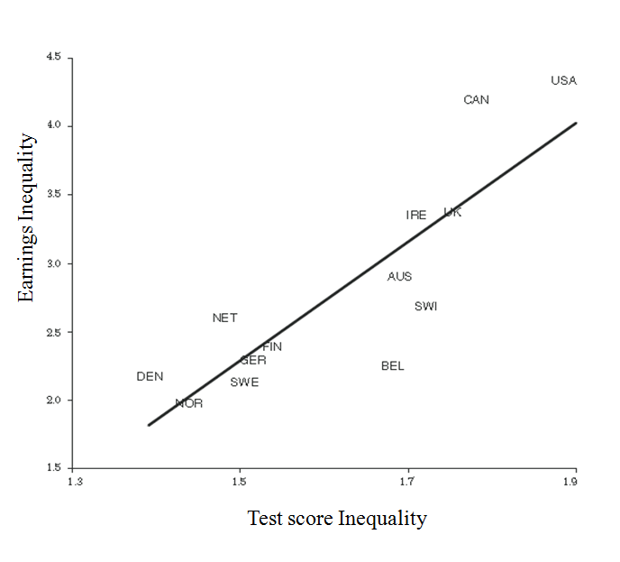
Earnings inequality as a result of cognitive skills inequality

Slide 9


Moll (1998)
Based on Becker’s (1975) returns to schooling
Income affected by schooling, ability, cognitive skills

Slide 10
Moll (1998): data
PSLSD 1993:
  8800 households, rural and urban
  contains data on wages, schooling, proxy for home background, school quality, measure of cognitive attainment, but no measure for ability (genetic endowment)
Literacy test for every six households
Notes:
Conducted by SALDRU
Weekdays so employment-

Slide 11
Extract from literacy module PSLSD, 1993
A. Comprehension
Question 3: ‘When Mbaya was a child, he got very excited when his mother, Corfu, asked if he would like to go to the meat market with her. As they walked into the centre of town, the wonderful odours of meat – both fresh and spoiled – could be smelled up to 1 kilometre away. The hundreds of market stalls formed a row of 1 ½ kilometres long. It took almost one hour to walk slowly from one end of the meat market to the other.’
How long was the row of meat stalls, from one end to the other end? Tick one:
1 ½ kilometres long
1 kilometre long
It was very close from one end to the other end
Hundreds of stalls were lined up
B. Computation
Question 5: 103kg – 37kg = _____ kg
Question 6: R35.50 x 7 = R ______
Source: Project for Statistics on Living Standards and Development, 1993.

Slide 12
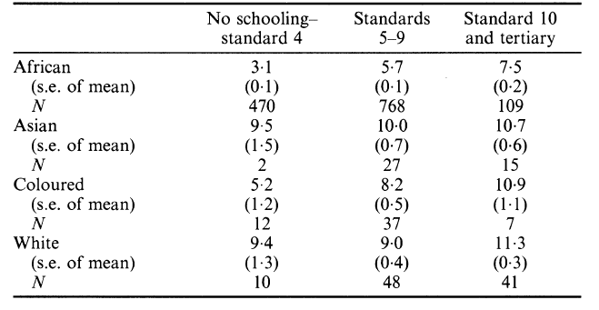
Mean literacy scores (by race)

Slide 13
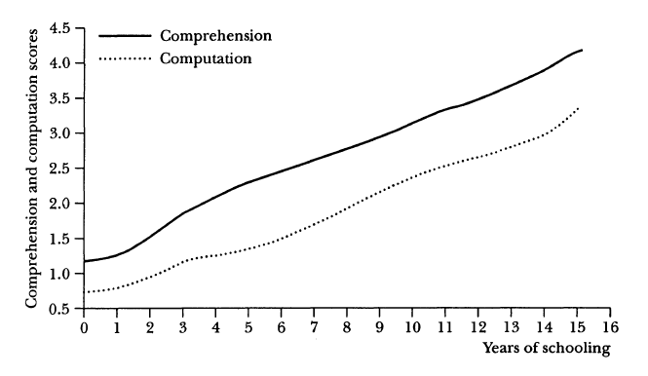
Literacy scores: Africans 18 – 59 years old

Slide 14
Literacy score differentials explained
Differentials in spending by race
1976 Soweto riots
Language policy
High unemployment, low wages
Promotion even though requirements not met
Low- level equilibrium trap

Slide 15
Chamberlain and van der Berg, 2002
Level of educational quality (1) | Average black wage (2) | Average white wage (3) | Wage gap accounted for by white characteristics (4) | Wage gap unaccounted for even with white characteristics applied (5) | Residual as a % of the white wage (6)
0% | R1589 | R 6989 | R 2150 | R 3250 | 46.5%
10% | R1589 | R 6989 | R 2161 | R 3239 | 46.3%
20% | R1589 | R 6989 | R 2206 | R 3194 | 45.7%
40% | R1589 | R 6989 | R 2341 | R 3059 | 43.8%
80% | R1589 | R 6989 | R 3335 | R 2064 | 29.5%

Slide 16
Why measure cognitive skills regularly?
Can determine whether schools are actually imparting cognitive skills
Can help determine whether curricula is appropriate
Can help determine whether wage differences are justified or not
Can help determine which type of cognitive skills are rewarded for different occupations

