Slide 1
Explaining Education Returns and Racial Discrimination with Numeric competence, confidence and school quality in South Africa
Gideon du Rand, Hendrik van Broekhuizen and Dieter von Fintel
Department of Economics, Stellenbosch University
PSPPD Project – April 2011

Slide 2
Motivation
The role of education in economic development is undisputed
Identified as a binding constraint to growth in South Africa
  Developing the appropriate skills for the needs of the labour market
Given South Africa’s high levels of (secondary) enrollment and good access to education…
  What defines this binding constraint?
  The role of education quality?
    South Africa’s performance in international standardised tests compares poorly with other developing countries
    Access to education is successful; access to quality education is still limited

Slide 3
Motivation
How much does an additional year of education increase earnings?
  How much of this “value added” is the result of the quantity of education?
    It is well-documented that at low levels of education returns are low, and very high for post-secondary qualifications
  How much of the “value added” is the result of the quality of the additional education received?
    Persisting inequalities in outputs of the schooling system, despite fiscal equalisation
How much of what we usually consider to be racial discrimination in earnings is driven by school quality?
  In other words: is anti-discrimination legislation correctly targeted towards the labour market, or is much of the root still in the school system?

Slide 4
Data
National Income Dynamics Study of 2008
Rich survey in which income, sociodemographic features are measured
  And more importantly a numeracy test
    Respondents completed a short test of numeric ability
    Represents inherent individual level ability in addition to the cognitive value added by schools
    Sample selection issues dominate the estimation procedure (discussed later)
  And information on historical matric performance of schools
    A less noisy measure
    Represents quality of schools which labour market participants attended

Slide 5
Results – returns to numeric skills

Slide 6
Results – returns to numeric skills
Increasing returns to an additional year of education, as usually found in South Africa
  From about 5% at primary level to about 45% for a Bachelors degree
  Reflective of the skills shortage
  High return to scarce type of labour
The numeric skills component ranges from 2.6% to 4.5%
  Suggests that quality and cognitive skill is important in employers’ decisions
  And not just the demand for specific levels of education

Slide 7
Results – labour market discrimination vs access to quality schools
Unexplained white-black wage premia (discrimination) using different measures

Slide 8
Results - discrimination
Different results due to different samples
Reduction of wage premium from
  40.6% to 33% when controlling for numeric ability
    A fall of 7.6 percentage points (or about 19% of the discrimination component)
  69% to 40% when controlling for historical school quality measures
    A fall of 29 percentage points (or about 37% of the discrimination component)
Suggests that wage differentials are in part driven by natural abilities and the value added by schools
  Though other factors remain
Separate “labour market discrimination” and “access to quality education” issues at play

Slide 9
Correspondence with other results
Burger & van der Berg (2011)
  Simulated cognitive skills and decomposed wage gaps
  About 74% of unexplained wage gap (“discrimination”) explained by school quality
    R10.70 of R14.44
  Far more important than educational attainment premia, which contributes only R3.50 to wages, roughly a third of what quality contributes
  These results add more emphasis to school quality than our own

Slide 10
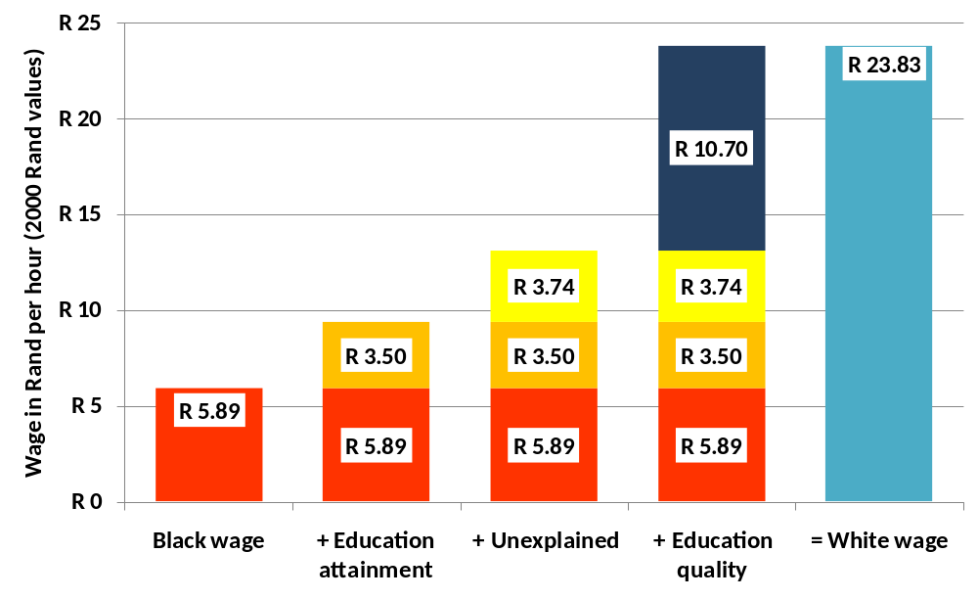
Van der Berg & Burger (2011)

Slide 11
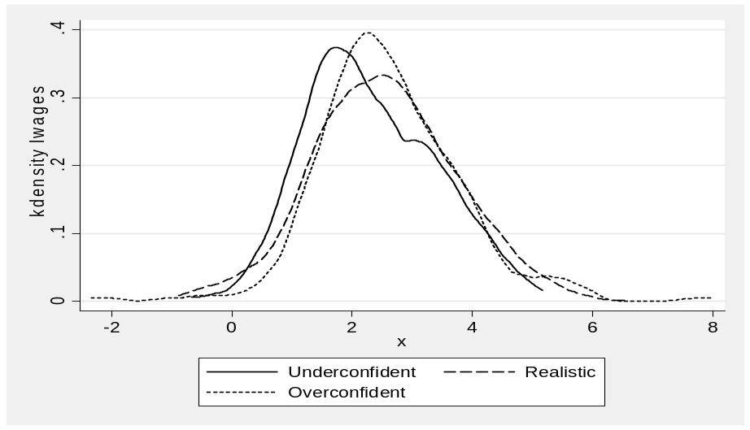
Results – Respondent Confidence
Revealed perceptions of abilities
  Some individuals chose to write easier/ more difficult tests than they should have
    Underconfident have lower wages than the average
    Overconfident have highest and lowest wages
      Indicate perception must be backed up by actual ability – but confidence helps!

Slide 12
Results – sampling issues
Those who took numeracy tests were
  More educated
  Indicated that they were more confident in their writing abilities
  More likely to search for jobs
Those who provided school quality data were
  More educated
  Younger (as they had exited school more recently)
All of these factors require corrections in the estimates
  Instrumental variables (not successful)
  Double Heckman estimates

Slide 13
Results – impacts of sampling

Slide 14
Results – impacts of sampling
Sample of test respondents had higher returns to education
  Higher ability individuals took the test
  We do not capture the poorest part of ability distribution
  Hence numeracy does not appear to make a difference to education returns initially
    …except if we account for sample selection issues
    Then we find the returns to quality that are reported earlier

Slide 15
Conclusions and Policy Implications
High returns to higher levels of education are only partially explained by school quality
Suggests that skills shortage is dominated by a lack of quantity of educated workers, though quality nevertheless has an important role to play
  School quality matters to employers’ reward of workers
  Long-term labour market benefits to improving school quality

Slide 16
Conclusions and Policy Implications
Racial discrimination (once controlling for educational quantity differences)
  Has a large component that is explained by disparities in school quality
    The extent differs by estimation strategy
    Ranges from 20-74%
    Even the lowerbound is a high figure
  Racial patterns of school outputs persist despite shifts in fiscal allocations
  Suggests that at least some of the racial inequalities in wages is determined long before individuals enter the labour market
    Therefore a combination of school and labour market policies required

Slide 17
Conclusions and Policy Implications
School vs labour market policies
  Educational attainment (at secondary level) has improved vastly already
    However, this has reduced labour market returns for this group, due to a greater supply of this type of labour
  Bottleneck: progression to “high return” education (at the tertiary level)
    The “quantity” issue of a lack of highly skilled workers
    Constraint is that poor quality (at primary / secondary level) limits this progression
    Not a labour market issue directly and should be addressed by education policy
  Affirmative action should only address labour market disparities (and not educational quality differentials)
    In the long-run, improvements in school quality will address some of the labour market disparities and remove some of what we observe as “discrimination”

