Slide 1
Constraints to school effectiveness: what prevents poor schools from delivering results?
Debra Shepherd
Department of Economics, Stellenbosch University
PSPPD Project – April 2011

Slide 2
Motivation
Despite large resource shifts within the SA school system, substantial educational differentials persist
Historically white schools significantly outperform historically black (and generally poorer) schools
Research shown that SA’s overall lack of performance is mainly attributed to the under-performance of learners in poor, black schools
What school characteristics/practices lead to better performance?
  Would be tempting to look at the characteristics/practices of well-performing, affluent schools when formulating policies to improve poor school effectiveness
  BUT these may not necessarily translate into improved performance as they travel across the socio-economic divide.

Slide 3
Data
Progress in Reading Literacy Survey (PIRLS) 2005/06
14125 grade 5 students tested in 385 schools (387 classrooms)
Tested in 11 official languages; separate schools testing in African languages from schools testing in English/Afrikaans (crude proxy for ex department)
Further restrictions on English/Afrikaans testing schools; remove schools where >65% of students did not speak the test language at home and >30% of students have no access to basic utilities
English/Afrikaans testing schools = 70 (21%), African testing schools = 259 (79%)

Slide 4
% of Grade 4(or 5 in SA) students below the low international benchmark (400) in PIRLS 2006
% of Grade 4(or 5 in SA) students below the low international benchmark (400) in PIRLS 2006
Notes:
4

Slide 5
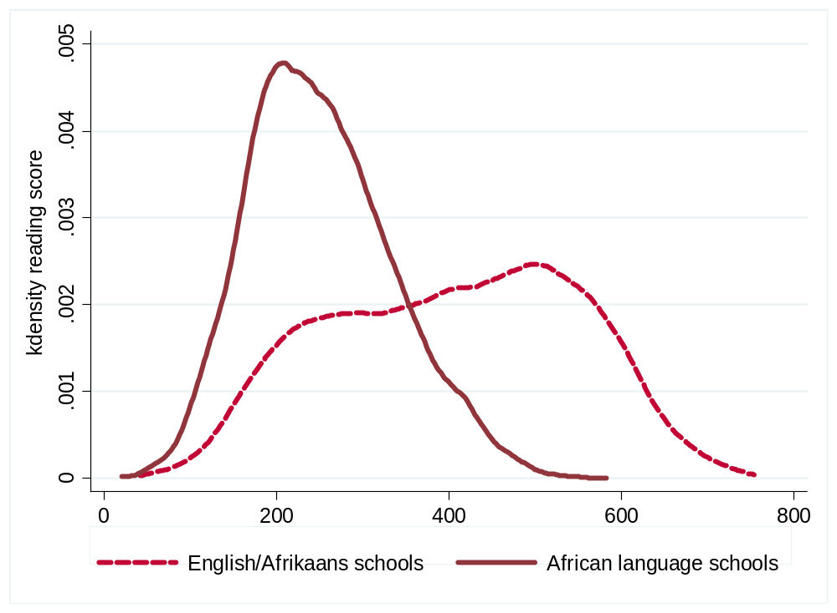
Reading Test Performance distributions across different language testing schools

Slide 6
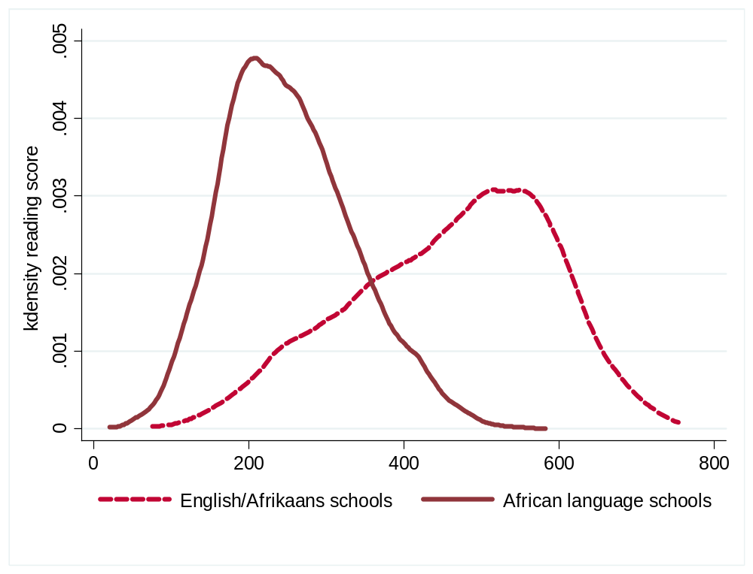
Reading Test Performance distributions across different language testing schools

Slide 7
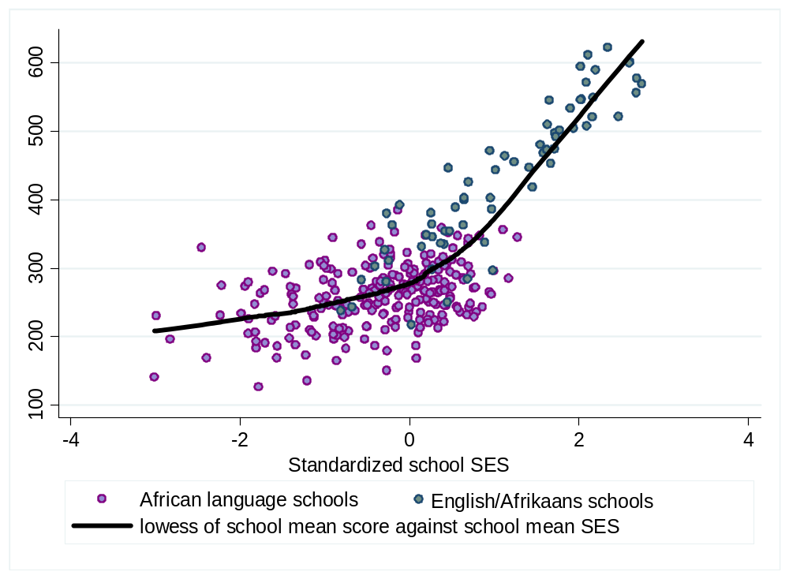
SA mean school scores vs. mean school SES
Mean Eng/Afr school performance
Low international benchmark
African language school performance

Slide 8
School effectiveness framework
1.0 SUPPORTING INPUTS
Strong parent and community support
Effective support from the Education System
Adequate material support
Frequent and appropriate teacher development activities
Sufficient textbooks and other materials
Adequate facilities
3.0 SCHOOL CLIMATE
3.1 High expectations of students
3.2 Positive teacher attitudes
3.3 Order and discipline
3.4 Organized curriculum
3.5 Rewards and incentives
5.0 STUDENT OUTCOMES
5.1 Student participation
5.2 Academic achievement
5.3 Social skills
5.4 Economic success after school
2.0 ENABLING CONDITIONS
2.1 Effective leadership
2.2 Capable teaching force
2.3 Flexibility and autonomy
2.4 High amount of time-in-school
CONTEXTUAL FACTORS
Socio-Cultural
Political
Economic
CHILDREN’S CHARACTERISTICS
4.0 TEACHING/LEARNING PROCESS
4.1 High amount of learning time
4.2 Variety in teaching strategies
4.3 Frequent homework
4.4 Frequent student assessment and feedback
Source: Heneveld & Craig (1996)

Slide 9
Methodology: Education production function
Inputs:
student
household
community
classroom
teacher
school
PRODUCTION PROCESS
Output:
reading score
?
Regression analysis → coefficients provide an indication of the direction, size and significance of the impacts of inputs on output.

Slide 10
Model variables
Dependent variable = reading test score
  standardised to international mean of 500, std dev 100
Regressors
  Pupil/household level: age, gender, SES, homework & classwork, speak test language, parent education & employment, mother tongue, time spent on TV & computer, reading habits
  School level: school socio economic status, urban / suburban, absenteeism, extended instruction, parent involvement, students on free/subsidised lunch, time spent on management tasks
  Teacher/classroom: class size, teacher qualifications, class exercises, reading tools, teacher collaboration, classroom testing, teacher age, gender, experience

Slide 11
English / Afrikaans school sample |  | African school sample
Positive | Negative | Positive | Negative
Female | Under/over age | Female | Under/over age
Speak test language | TV/computer | Speak test language | TV/computer
Feel safe at school | Long time on hmwk | Parents help with hmwk | Large class size (30+)
Household SES | School absenteeism | Frequent reading hmwk
Mother matric | Suburban location | Long time on hmwk
Early reading activities | Discuss reading aloud | Borrow books
Parent employment | Diagnostic class tests | Feel safe at school
School SES |  | Mother/father matric
Parent involvement |  | Mother speak test lang
Qualified teacher |  | Parent employment
Reading series |  | Urban location
Long stories |  | Extended instruction
Teacher collaboration |  | Qualified teacher
Weekly class work |  | Weekly class work
 |  | Discussion of reading
 |  | Teacher collaboration
 |  | Diagnostic class tests

Slide 12
Results:
1. Classroom practices:
  Previous research has shown that different classroom practices may lead to effective outcomes in low-SES schools than is the case in high-SES schools.
  PIRLS:
    African language schools: regular classroom exercises as well as diagnostic testing were found to have positive and significant impacts on average student reading scores
    English/Afrikaans schools: higher-order reading aids and the use of books with chapters are found to be more effective
2. Extended learning time:
  In African language schools where extended learning time is offered, and >75% of learners take part, there is a significant, positive impact on average learner test performance.

Slide 13
Results:
3. Homework
Homework may serve two functions: educational or symbolic
Teachers from English/Afrikaans schools more likely to give homework expected to take less than 30 minutes:
  may indicate that homework is (at least sometimes) given for reasons that are not purely educational – i.e. to satisfy parents’ expectations
Teacher reported homework frequency
  Weekly homework shown to have a positive impact on average reader test scores in English/Afrikaans schools; no significant impact is found in African language schools
Students reported homework frequency
  In African schools: positive and significant impact of frequent homework; individual learners who spend >hour on reading homework also perform significantly better
  In English/Afrikaans schools: students spending >hour perform worse

Slide 14
Results:
4. Parental involvement
At the household level, the following factors were shown to have a positive effect on reading scores:
  Parents help with homework
  Parents’ level of education
  Regular joint reading activities at home
  Parent-child communication in the test language
But parental involvement can be important outside of the household too
Analysis controlled for two factors: opportunities created by the school for parents to be involved (supply side) and second, parents’ willingness to become involved (demand side)

Slide 15
Results:
4. Parental involvement
High involvement coded as
  2+ formal PTA meetings annually
  parents volunteer regularly to help in the classroom/school activities
Parent involvement has a significant positive impact on performance in English/Afrikaans schools; yet no significant impact in African language schools
School’s SES may affect the nature, quality and impact of parent involvement:
  Crozier (1999): parents in low SES schools perceived teachers to be “superior and distant” → discourages pro-active parent-teacher partnerships
  parents doubt their own ability to make useful contributions → less likely to become involved
  And even when they do their level of involvement may not be of sufficient depth or quality

Slide 16
Results:
5. Teacher qualifications
Teacher qualifications (diploma or degree) has a significant positive impact on performance in English/Afrikaans schools, but not in the case of African language schools.
doesn’t imply that teacher quality isn’t important, but rather effective teachers are better defined by skills and abilities that aren’t dependent on their formal academic qualifications
  Motivated,

Slide 17
Conclusions and Policy Implications
Varying impact of classroom activities vs. homework between African language and English/Afrikaans schools is illuminating
  regularly prescribed homework has a much larger impact in the case of English/Afrikaans schools
  learners in African schools benefit more from a focus on classroom reading and assessment activities
low-SES schools need to provide additional opportunities for learners to develop their skills in school time as they may not benefit from sufficient support/ideal conditions at home to help them get the full benefits of homework

Slide 18
Conclusions and Policy Implications
Learners from African language schools benefit disproportionately from extended school learning time
Policies aimed at providing schools with the ability to fund such initiatives should have a significant impact
Regarding parent involvement
  merely forcing African language schools to replicate the frequency + structure of arrangements of English/Afrikaans schools will not necessarily have the desired effect
  Low SES parents may face barriers (real and perceived) that prevent them from making useful contributions
Developing leadership on the part of school principals is vital
  encourage parents to become involved + help stimulate and strengthen parent/community involvement

Slide 19
Conclusions and Policy Implications
The determinants of school effectiveness highly context dependent; centralised micro-management of targets will probably not be effective
The professional development of teachers in general, and principals specifically, is vital
Great schools perform well for reasons that go beyond effective curriculum coverage, great facilities or money
They are able to understand, choose, develop, and evaluate relevant, effective practices within the context of their own school’s status and culture.

